Slide 1


New techniques for bounding stabilizer rank
Benjamin Lovitz* Vincent Steffan**
*NSF Postdoc, Northeastern University
**QMATH, University of Copenhagen
Portland State Computer Science
November 11, 2022
arXiv:2110.07781

Slide 2
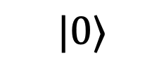
Classical simulation of quantum circuits
Question: Given a classical description of a quantum circuit
Can it be simulated efficiently on a classical computer?
$$|0⟩$$
Notes:
32

Slide 3
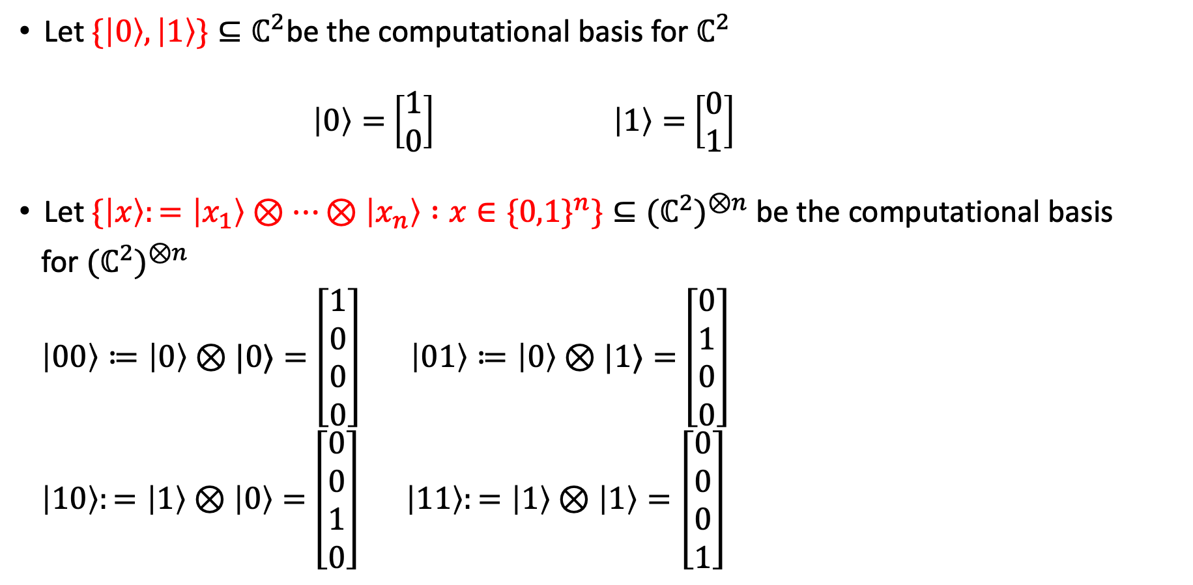
Computational basis
Let $\{\left|0\right\rangle ,\left|1\right\rangle \}⊆ℂ^{2}$be the computational basis for $ℂ^{2}$
$\left|0\right\rangle =$ $\left[\begin{aligned}1 \\ 0\end{aligned}\right]$ $\left|1\right\rangle =$ $\left[\begin{aligned}0 \\ 1\end{aligned}\right]$
Let $\{\left|x\right\rangle :=\left|x_{1}\right\rangle ⊗…⊗\left|x_{n}\right\rangle :x∈\{0,1\}^{n}\}⊆{{(ℂ}^{2})}^{⊗n}$ be the computational basis
for ${{(ℂ}^{2})}^{⊗n}$
$\left|00\right\rangle ≔\left|0\right\rangle ⊗|0⟩=$ $\left[\begin{aligned}1 \\ 0 \\ 0 \\ 0\end{aligned}\right]$ $\left|01\right\rangle ≔\left|0\right\rangle ⊗|1⟩=$ $\left[\begin{aligned}0 \\ 1 \\ 0 \\ 0\end{aligned}\right]$
$\left|10\right\rangle :=\left|1\right\rangle ⊗\left|0\right\rangle =$ $\left[\begin{aligned}0 \\ 0 \\ 1 \\ 0\end{aligned}\right] \left|11\right\rangle :=\left|1\right\rangle ⊗\left|1\right\rangle =\left[\begin{aligned}0 \\ 0 \\ 0 \\ 1\end{aligned}\right]$

Slide 4
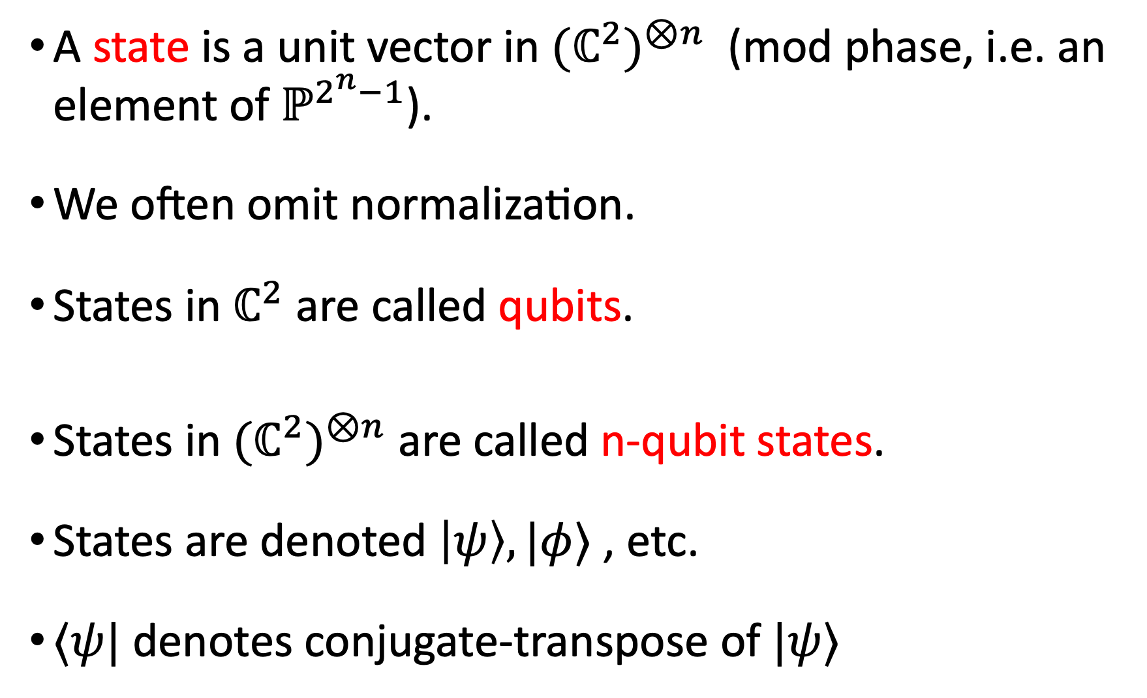
A state is a unit vector in ${{(ℂ}^{2})}^{⊗n}$ (mod phase, i.e. an element of $ℙ^{2^{n}−1}$).
We often omit normalization.
States in $ℂ^{2}$ are called qubits.
States in ${{(ℂ}^{2})}^{⊗n}$ are called n-qubit states.
States are denoted $\left|ψ\right\rangle ,|φ⟩$ , etc.
$⟨ψ|$ denotes conjugate-transpose of $|ψ⟩$

Slide 5
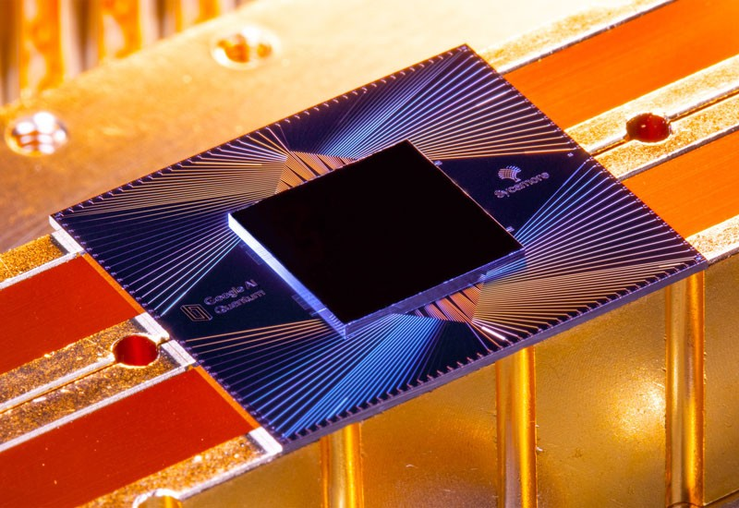
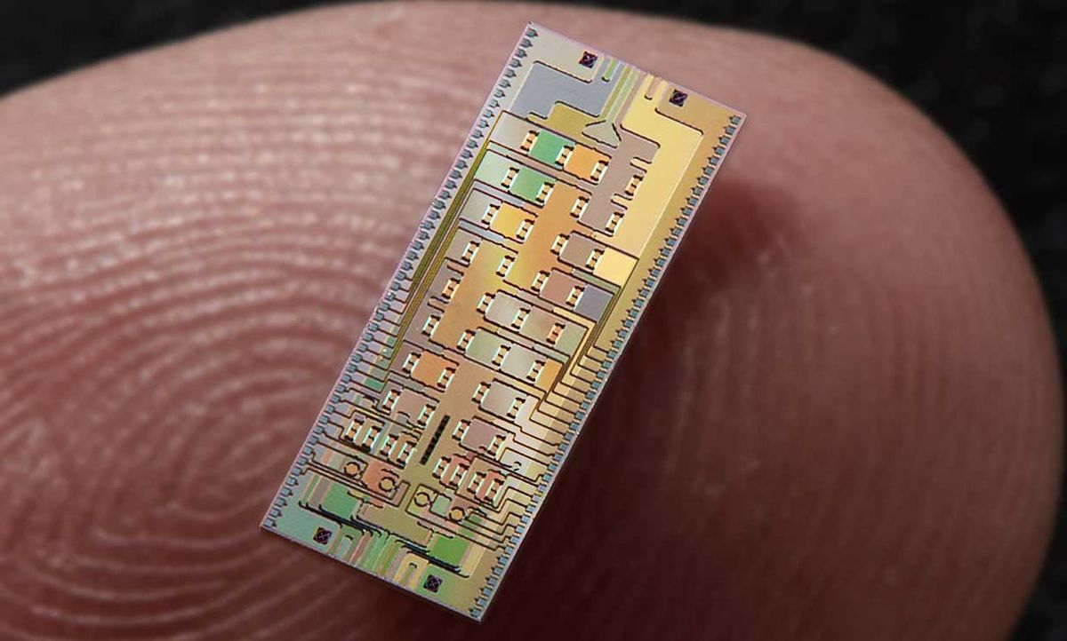

Quantum circuits
General framework:
Prepare a computational basis state $|0⋯0⟩∈{{(ℂ}^{2})}^{⊗n}.$
Apply a unitary matrix to obtain $\left|ψ\right\rangle ≔U\left|0⋯0\right\rangle$
Measure in the computational basis. For $x∈\{0,1\}^{n}$, $p\left(x\right)={\left|⟨x|ψ⟩\right|}^{2}$
Google Sycamore superconducting qubit chip.
n=53 qubits (with errors!!)
Xanadu X8 photonic chip
n=8 qubits (with errors!!)

Slide 6


Quantum circuits
General framework:
Prepare a computational basis state $|0⋯0⟩∈{{(ℂ}^{2})}^{⊗n}.$
Apply a unitary matrix to obtain $\left|ψ\right\rangle :=U|0⋯0⟩$
Measure in the computational basis. For $x∈\{0,1\}^{n}$, $p\left(x\right)={\left|⟨x|ψ⟩\right|}^{2}$.
The measurement destroys the state!
Need $Ω(2^{n})$ repetitions to approximate $p$.
Subtle power of quantum computer: You can sample from $p∈ℝ_{+}^{2^{n}}$

Slide 7


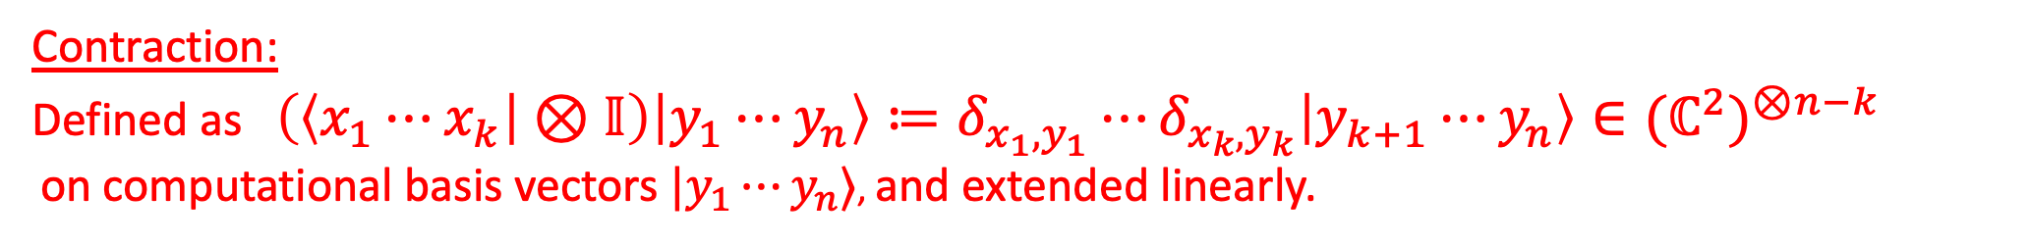
Quantum circuits
General framework:
Prepare a computational basis state ${\left|0⋯0\right\rangle }^{}∈{{(ℂ}^{2})}^{⊗n}.$
Apply a unitary matrix to obtain $\left|ψ\right\rangle :=U{\left|0⋯0\right\rangle }^{}$
Partially measure. For $x∈\{0,1\}^{k}, p\left(x\right)=||(\left\langle x | ⊗𝕀\right)|ψ⟩{ ||}^{2}$
$$k≤n$$
Contraction:
Defined as $\left(\left\langle x_{1}⋯x_{k} | ⊗𝕀\right) | y_{1}⋯y_{n}\right\rangle ≔δ_{x_{1},y_{1}}⋯δ_{x_{k},y_{k}}\left|y_{k+1}⋯y_{n}\right\rangle ∈{{(ℂ}^{2})}^{⊗n−k}$
on computational basis vectors $|y_{1}⋯y_{n}⟩$, and extended linearly.

Slide 8


Quantum circuits
General framework:
Prepare a computational basis state ${\left|0⋯0\right\rangle }^{}∈{{(ℂ}^{2})}^{⊗n}.$
Apply a unitary matrix to obtain $\left|ψ\right\rangle := U{\left|0⋯0\right\rangle }^{}$
Partially measure. For $x∈\{0,1\}^{k}$, $p\left(x\right)=||(\left\langle x | ⊗𝕀\right)|ψ⟩{ ||}^{2}$
$$k≤n$$
Partial measurement only partially destroys the state.
Leftover state is $\frac{1}{\sqrt{p\left(x\right)}}\left(\left\langle x | ⊗𝕀\right)U | 0⋯0\right\rangle ∈{{(ℂ}^{2})}^{⊗n−k}.$
Normalization

Slide 9

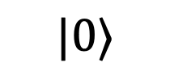


Quantum circuits
General framework:
Prepare a computational basis state $|0⟩∈{{(ℂ}^{2})}^{⊗n}.$
Apply a unitary matrix $U|0⟩$
Measure in the computational basis. For $x∈\{0,1\}^{k}$, $p\left(x\right)=||(⟨x|⊗𝕀)U\left|0\right\rangle {||}^{2}$
$$k$$
$$|0⟩$$
1
2
3

Slide 10
This talk: Classical simulation of Clifford+T circuits via stabilizer rank

Slide 11
This talk: Classical simulation of Clifford+T circuits via stabilizer rank

Slide 12


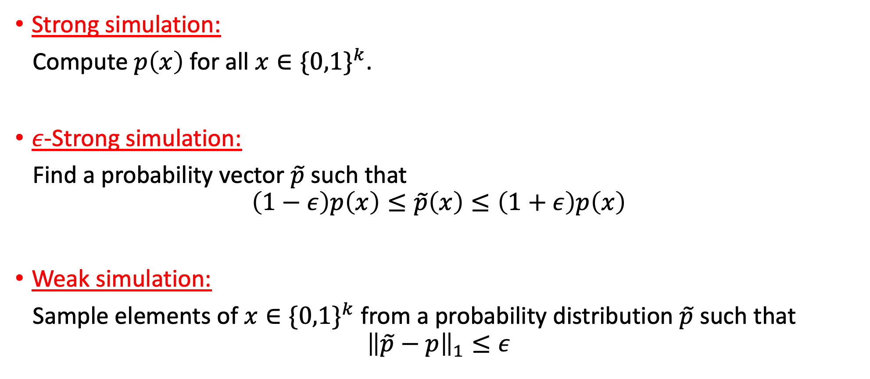


Types of simulation
Strong simulation:
Compute $p\left(x\right)$ for all $x∈\{0,1\}^{k}$.
$ε$-Strong simulation:
Find a probability vector $\tilde{p}$ such that
$$\left(1−ε\right)p\left(x\right)≤\tilde{p}\left(x\right)≤\left(1+ε\right)p\left(x\right)$$
Weak simulation:
Sample elements of $x∈\{0,1\}^{k}$ from a probability distribution $\tilde{p}$ such that
$${\left\|\tilde{p}−p\right\|}_{1}≤ε$$
$$x∈\{0,1\}^{k}$$
$$|0⟩$$
$$p\left(x\right)=||(\left\langle x | ⊗𝕀\right)U{\left|0\right\rangle }^{⊗n}{ ||}^{2}$$
for all $x∈\{0,1\}^{k}$.

Slide 13
This talk: Classical simulation of Clifford+T circuits via stabilizer rank

Slide 14
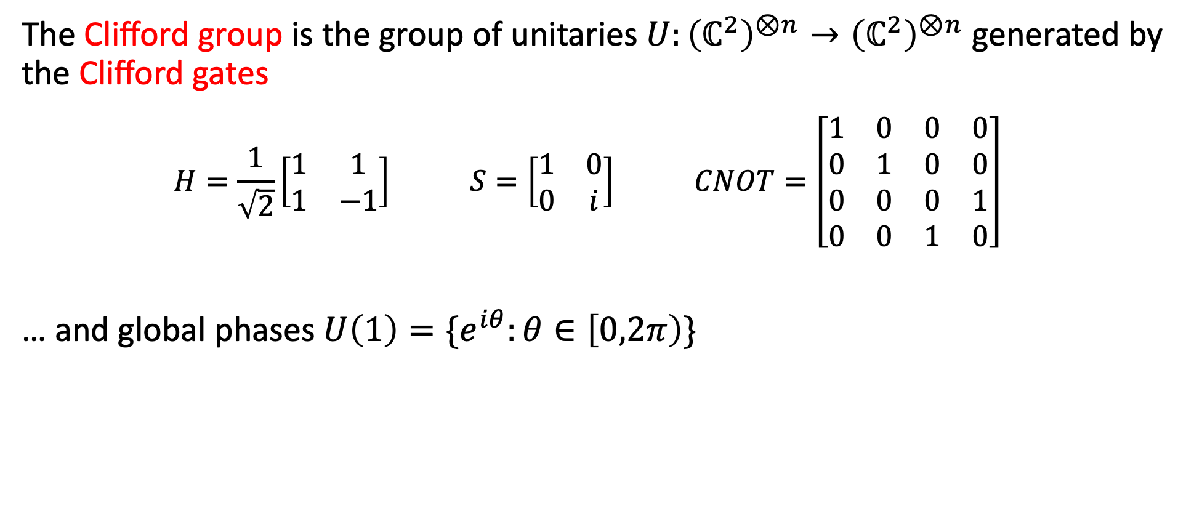
Clifford circuits
The Clifford group is the group of unitaries $U:{\left(ℂ^{2}\right)}^{⊗n}→{\left(ℂ^{2}\right)}^{⊗n}$ generated by the Clifford gates
$$H=\frac{1}{\sqrt{2}}\left[\begin{matrix}1 & 1 \\ 1 & −1\end{matrix}\right] S=\left[\begin{matrix}1 & 0 \\ 0 & i\end{matrix}\right] CNOT=\left[\begin{matrix}1 & 0 & 0 & 0 \\ 0 & 1 & 0 & 0 \\ 0 & 0 & 0 & 1 \\ 0 & 0 & 1 & 0\end{matrix}\right]$$
… and global phases $U\left(1\right)=\{e^{iθ}:θ∈\left[0,2π\right)\}$

Slide 15
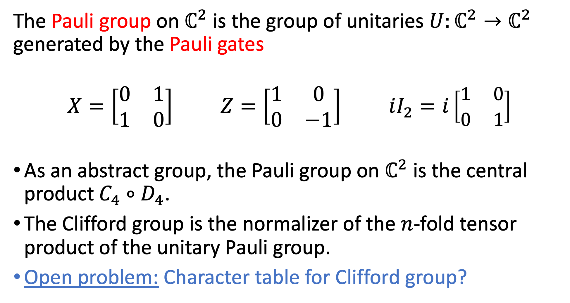
The Pauli group on $ℂ^{2}$ is the group of unitaries $U:ℂ^{2}→ℂ^{2}$ generated by the Pauli gates
$$X=\left[\begin{matrix}0 & 1 \\ 1 & 0\end{matrix}\right] Z=\left[\begin{matrix}1 & 0 \\ 0 & −1\end{matrix}\right] iI_{2}=i\left[\begin{matrix}1 & 0 \\ 0 & 1\end{matrix}\right]$$
As an abstract group, the Pauli group on $ℂ^{2}$ is the central product $C_{4}∘D_{4}$.
The Clifford group is the normalizer of the $n$-fold tensor product of the unitary Pauli group.
Open problem: Character table for Clifford group?

Slide 16
Why Clifford circuits?
Implementation
Error correction
Clifford + any other gate is dense in the unitary group
Standard set of gates

Slide 17
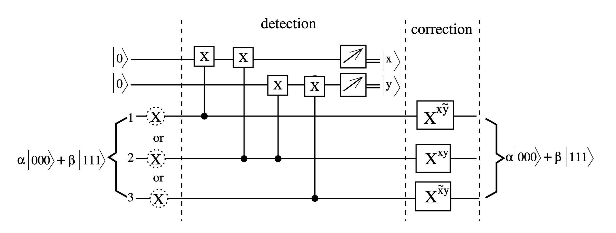
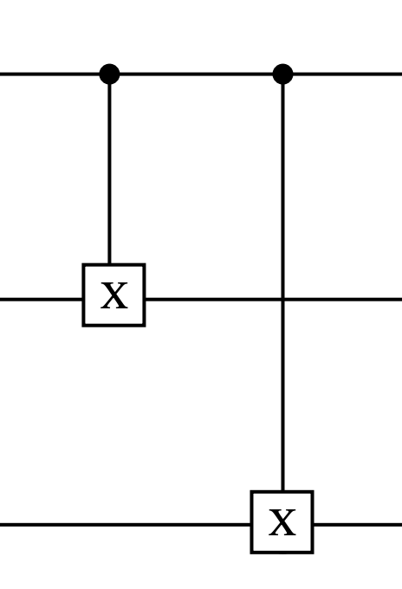
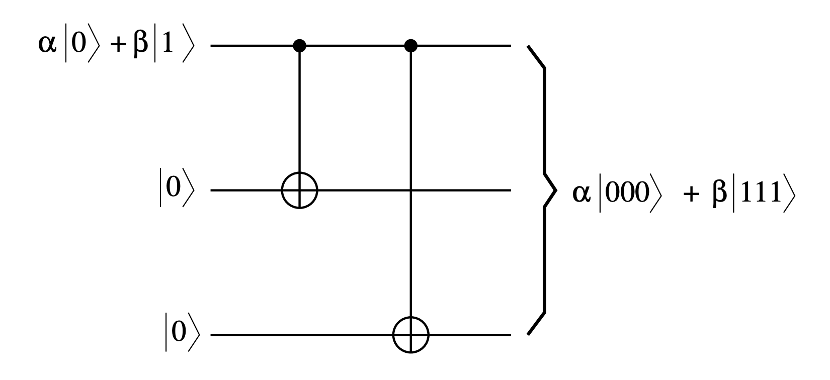


Correcting an $X=\left[\begin{matrix}0 & 1 \\ 1 & 0\end{matrix}\right]$ error with Clifford circuit
CNOT
$$α\left|000\right\rangle +β|111⟩$$
https://young.physics.ucsc.edu/150/error_corr.pdf

Slide 18
Classical simulation of Clifford circuits
Question: Given a classical description of a Clifford circuit
Can it be simulated efficiently on a classical computer?
$$|0⟩$$

Slide 19
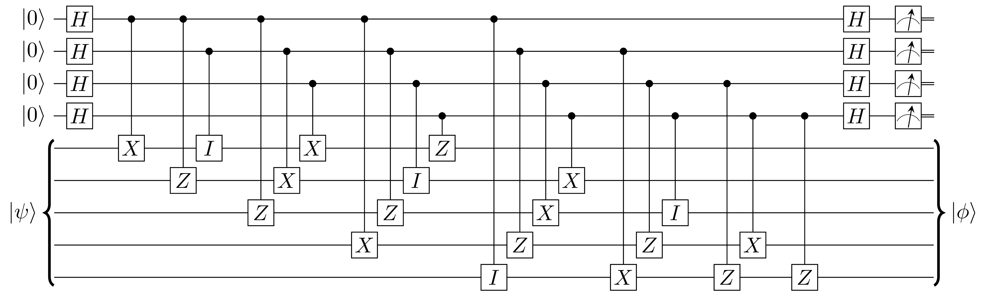
Classical simulation of Clifford circuits
Question: Given a classical description of a Clifford circuit
Can it be simulated efficiently on a classical computer?

Slide 20
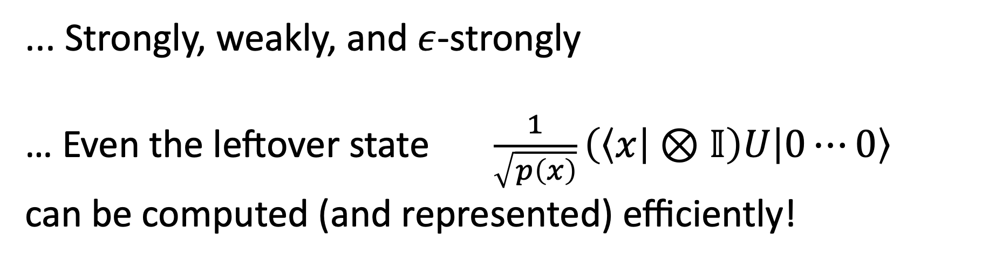
[Gottesman-Knill 98]: Yes. Clifford circuits can be efficiently simulated.
... Strongly, weakly, and $ε$-strongly
… Even the leftover state $\frac{1}{\sqrt{p\left(x\right)}}\left(\left\langle x | ⊗𝕀\right)U | 0⋯0\right\rangle$
can be computed (and represented) efficiently!

Slide 21

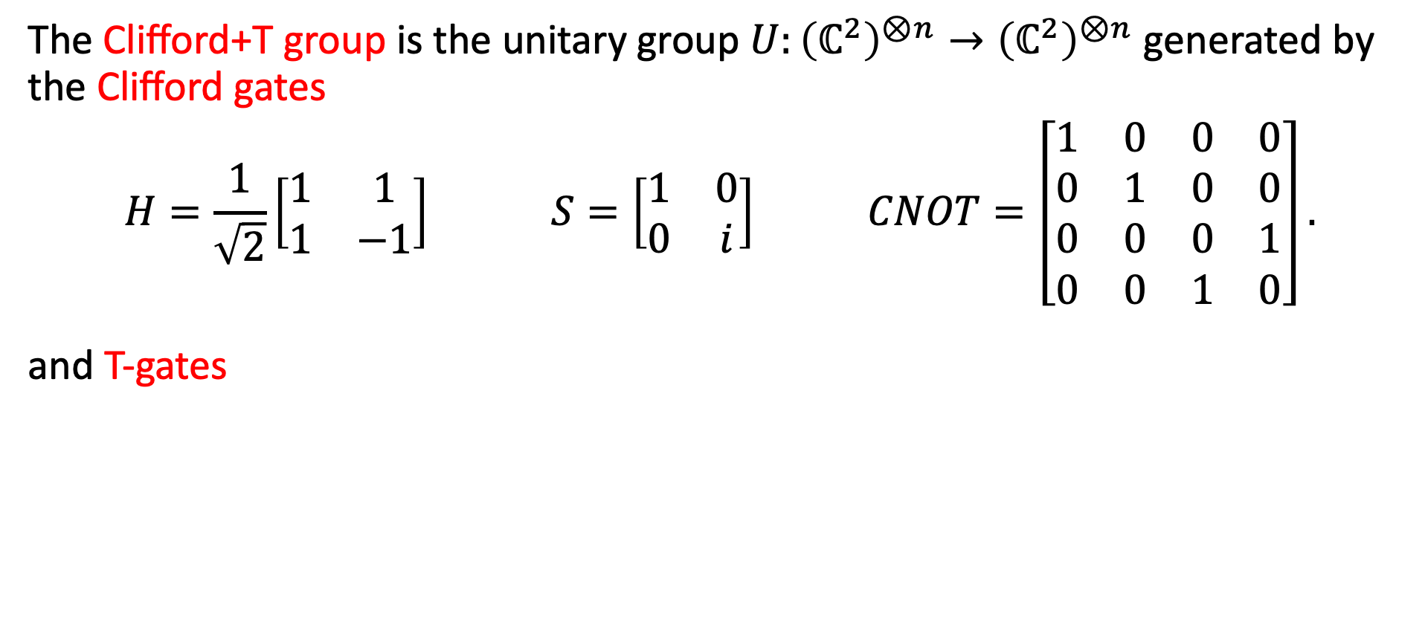
Clifford+T circuits
The Clifford+T group is the unitary group $U:{\left(ℂ^{2}\right)}^{⊗n}→{\left(ℂ^{2}\right)}^{⊗n}$ generated by the Clifford gates
$$H=\frac{1}{\sqrt{2}}\left[\begin{matrix}1 & 1 \\ 1 & −1\end{matrix}\right] S=\left[\begin{matrix}1 & 0 \\ 0 & i\end{matrix}\right] CNOT=\left[\begin{matrix}1 & 0 & 0 & 0 \\ 0 & 1 & 0 & 0 \\ 0 & 0 & 0 & 1 \\ 0 & 0 & 1 & 0\end{matrix}\right].$$
and T-gates
$$T=\left[\begin{matrix}1 & 0 \\ 0 & e^{iπ/4}\end{matrix}\right].$$

Slide 22
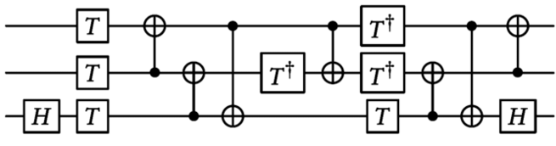
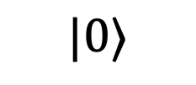
Classical simulation of Clifford+T circuits
Question: Given a classical description of a Clifford+T circuit
Can it be simulated efficiently on a classical computer?
$$|0⟩$$

Slide 23


Quantum circuits
General framework:
Prepare a computational basis state $|0⋯0⟩∈{{(ℂ}^{2})}^{⊗n}.$
Apply a small number of Clifford+T gates $U_{1}U_{2}…U_{s}|0⋯0⟩$
Measure in the computational basis. For $x∈\{0,1\}^{n}$, $p\left(x\right)={\left|⟨x\left|U_{1}U_{2}…U_{s}\right|0⋯0⟩\right|}^{2}$.
Subtle power of quantum computer: Can apply $U_{1}U_{2}…U_{s}$ efficiently, and sample from $p∈ℝ_{+}^{2^{n}}$.

Slide 24
This talk: Classical simulation of Clifford+T circuits via stabilizer rank

Slide 25
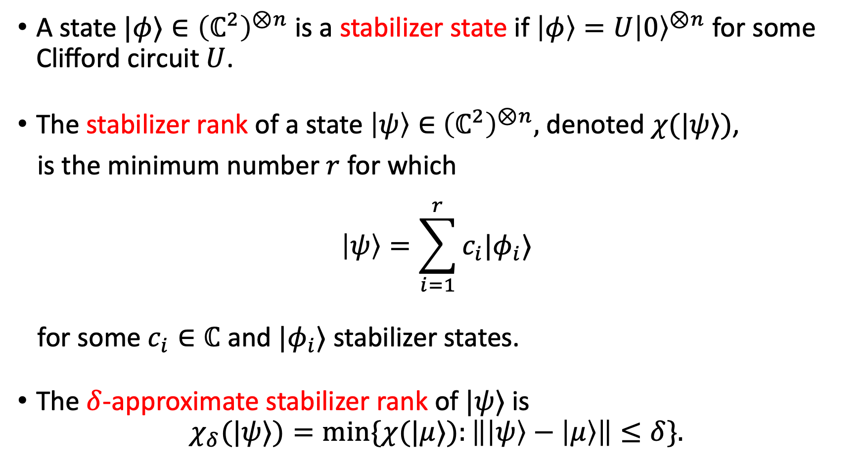
Stabilizer rank
A state $|φ⟩∈{\left(ℂ^{2}\right)}^{⊗n}$ is a stabilizer state if $\left|φ\right\rangle =U{\left|0\right\rangle }^{⊗n}$ for some Clifford circuit $U$.
The stabilizer rank of a state $\left|ψ\right\rangle ∈$ ${\left(ℂ^{2}\right)}^{⊗n},$ denoted $χ(|ψ⟩)$,
is the minimum number $r$ for which
$$\left|ψ\right\rangle =\sum_{i=1}^{r}{c_{i}|φ_{i}⟩}$$
for some $c_{i}∈ℂ$ and $|φ_{i}⟩$ stabilizer states.
The $δ$-approximate stabilizer rank of $|ψ⟩$ is
$$χ_{δ}(|ψ⟩)=min\{χ(|μ⟩):\left\|\left|ψ\right\rangle −\left|μ\right\rangle \right\|≤δ\}.$$

Slide 26
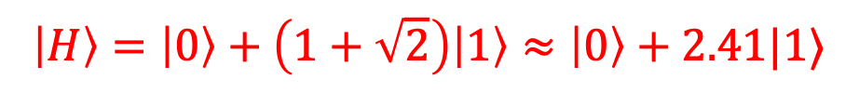

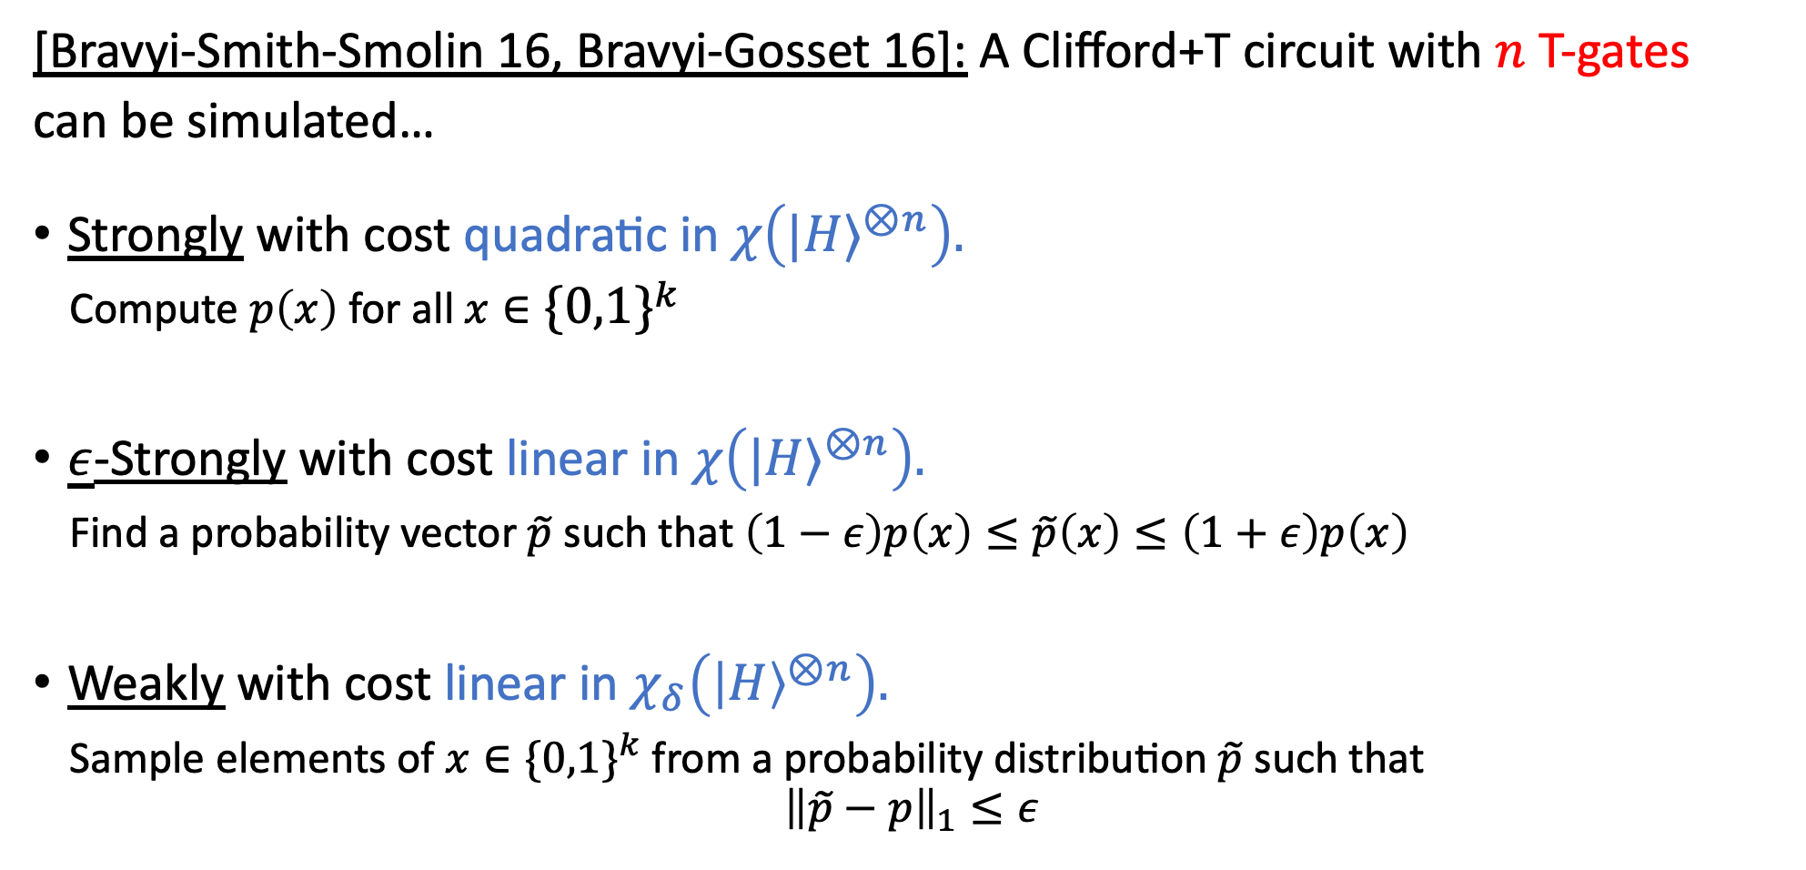
Stabilizer rank
$$\left|H\right\rangle =\left|0\right\rangle +\left(1+\sqrt{2}\right)\left|1\right\rangle ≈\left|0\right\rangle +2.41|1⟩$$
[Bravyi-Smith-Smolin 16, Bravyi-Gosset 16]: A Clifford+T circuit with $n$ T-gates
can be simulated…
Strongly with cost quadratic in $χ\left({|H⟩}^{⊗n}\right).$
Compute $p\left(x\right)$ for all $x∈\{0,1\}^{k}$
$\underline{ε}$-Strongly with cost linear in $χ\left({|H⟩}^{⊗n}\right).$
Find a probability vector $\tilde{p}$ such that $\left(1−ε\right)p\left(x\right)≤\tilde{p}\left(x\right)≤\left(1+ε\right)p\left(x\right)$
Weakly with cost linear in $χ_{δ}\left({\left|H\right\rangle }^{⊗n}\right).$
Sample elements of $x∈\{0,1\}^{k}$ from a probability distribution $\tilde{p}$ such that
$${\left\|\tilde{p}−p\right\|}_{1}≤ε$$
$$x∈\{0,1\}^{k}$$
$$|0⟩$$
$$p\left(x\right)=||(\left\langle x | ⊗𝕀\right)U{\left|0\right\rangle }^{⊗n}{ ||}^{2}$$

Slide 27
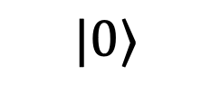
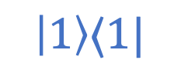


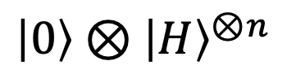

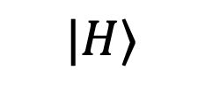

Proof idea
$$|0⟩$$
$$U$$
$$|H⟩$$
$$\left|1\right\rangle ⟨1|$$
Cliff+ $n$ T
$$̃$$
$$\left|0\right\rangle ⊗{\left|H\right\rangle }^{⊗n}$$
$$\tilde{U}$$
Cliff

Slide 28
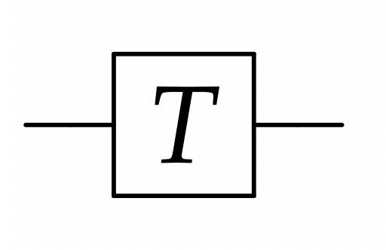


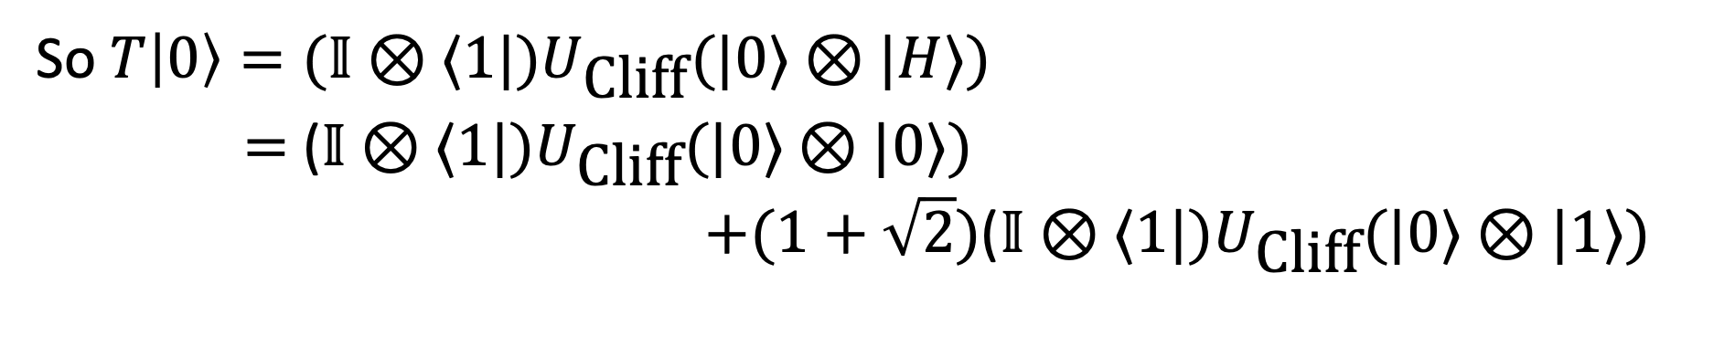

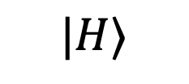
Proof idea
[GK98]: Clifford circuits can be efficiently simulated.
$$|0⟩$$
$$U$$
$$=(𝕀⊗⟨1|)U_{\text{Cliff}}(𝕀⊗|H⟩)$$
$$|ψ⟩$$
Cliff+ $n$ T
$$|H⟩$$
$$\left|1\right\rangle$$
So $T\left|0\right\rangle =(𝕀⊗⟨1|)U_{\text{Cliff}}(|0⟩⊗|H⟩)$
$=$ ($𝕀⊗⟨1|)U_{\text{Cliff}}(|0⟩⊗|0⟩)$
$$+(1+\sqrt{2})\text{(}𝕀⊗⟨1|)U_{\text{Cliff}}(|0⟩⊗|1⟩)$$

Slide 29
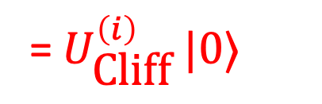
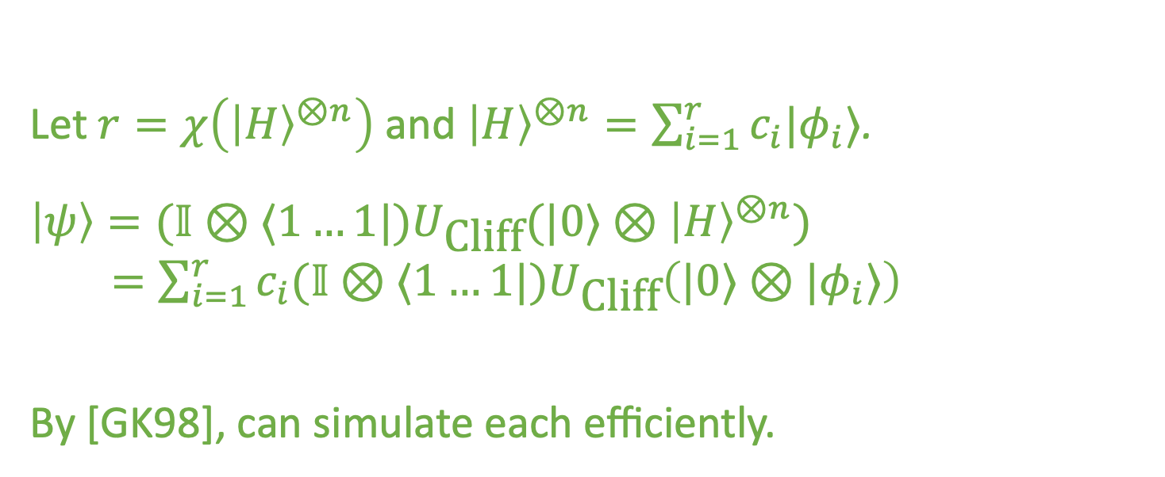
Proof idea
[GK98]: Clifford circuits can be efficiently simulated.
$$|0⟩$$
$$U$$
$$=(𝕀⊗⟨1|)U_{\text{Cliff}}(𝕀⊗|H⟩)$$
$$|ψ⟩$$
Cliff+ $n$ T
Let $r=χ\left({\left|H\right\rangle }^{⊗n}\right)$ and ${\left|H\right\rangle }^{⊗n}=\sum_{i=1}^{r}{c_{i}|φ_{i}⟩}$.
$\left|ψ\right\rangle =(𝕀⊗⟨1…1|)U_{\text{Cliff}}(|0⟩⊗{\left|H\right\rangle }^{⊗n})$
$=\sum_{i=1}^{r}{c_{i}(𝕀⊗⟨1…1|)U_{\text{Cliff}}\left(|0⟩⊗|φ_{i}⟩\right)}$
By [GK98], can simulate each efficiently.
= $U_{\text{Cliff}}^{\left(i\right)} |0⟩$

Slide 30

Proof idea
$$|0⟩$$
$$U$$
$$|H⟩$$
$$\left|1\right\rangle ⟨1|$$
Cliff+ $n$ T
Let $r=χ\left({\left|H\right\rangle }^{⊗n}\right)$ and ${\left|H\right\rangle }^{⊗n}=\sum_{i=1}^{r}{c_{i}|φ_{i}⟩}$.
$\left|ψ\right\rangle =\tilde{U}(|0⟩⊗{\left|H\right\rangle }^{⊗n})$ $=\sum_{i=1}^{r}{c_{i}\tilde{U}\left(|0⟩⊗|φ_{i}⟩\right)}$
By [GK98], can simulate measurements on each efficiently.
$$̃$$
$$\left|0\right\rangle ⊗{\left|H\right\rangle }^{⊗n}$$
$$\tilde{U}$$
Stabilizer state!
Cliff

Slide 31
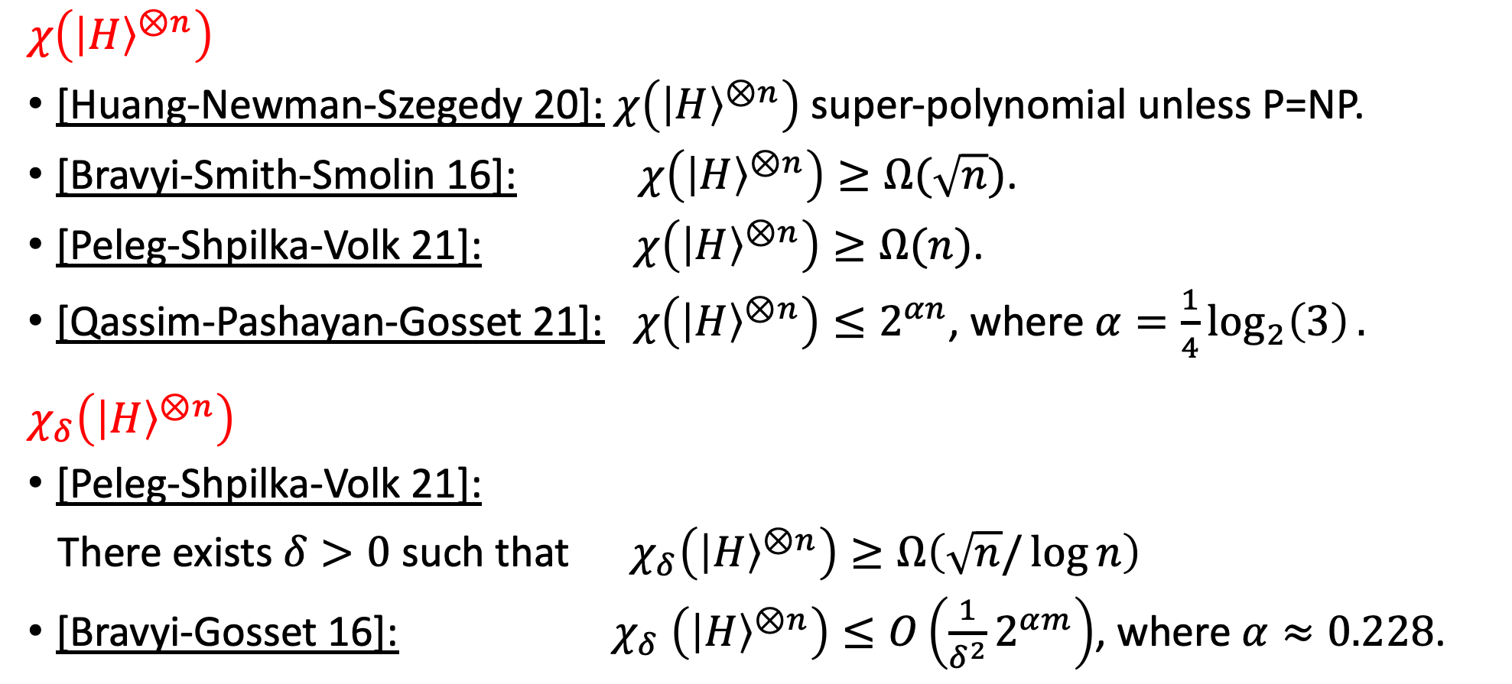
Known bounds on stabilizer rank
$$χ\left({\left|H\right\rangle }^{⊗n}\right)$$
[Huang-Newman-Szegedy 20]: $χ\left({\left|H\right\rangle }^{⊗n}\right)$ super-polynomial unless P=NP.
[Bravyi-Smith-Smolin 16]: $χ\left({\left|H\right\rangle }^{⊗n}\right)≥Ω(\sqrt{n})$.
[Peleg-Shpilka-Volk 21]: $χ\left({\left|H\right\rangle }^{⊗n}\right)≥Ω(n)$.
[Qassim-Pashayan-Gosset 21]: $χ\left({\left|H\right\rangle }^{⊗n}\right)≤2^{αn}$, where $α=\frac{1}{4}\log_{2}\left(3\right).$
$$χ_{δ}\left({\left|H\right\rangle }^{⊗n}\right)$$
[Peleg-Shpilka-Volk 21]:
There exists $δ>0$ such that $χ_{δ}\left({\left|H\right\rangle }^{⊗n}\right)≥Ω\left(\sqrt{n}/\log{n}\right)$
[Bravyi-Gosset 16]: $χ_{δ}$ $\left({\left|H\right\rangle }^{⊗n}\right)≤O\left(\frac{1}{δ^{2}}2^{αm}\right)$, where $α≈0.228$.
This talk: Alternate proofs up to log factor

Slide 32
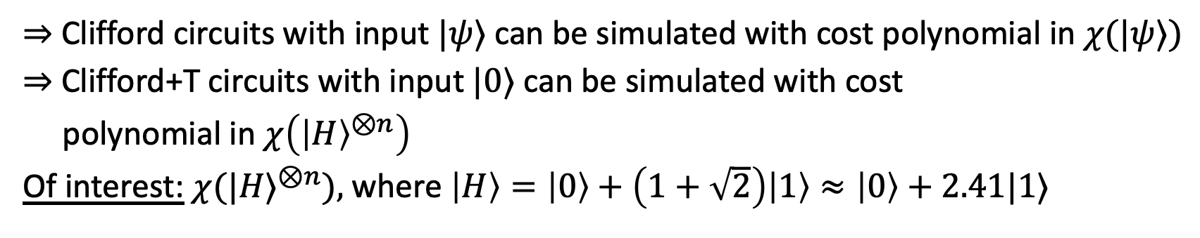
Motivation: Classical simulation of Clifford circuits
Gottesman-Knill Theorem: Clifford circuits with stabilizer state inputs can be simulated efficiently
$⇒$ Clifford circuits with input $|ψ⟩$ can be simulated with cost polynomial in $χ(|ψ⟩)$
$⇒$ Clifford+T circuits with input $|0⟩$ can be simulated with cost
polynomial in $χ\left({\left|H\right\rangle }^{⊗n}\right)$
Of interest: $χ{(|H⟩}^{⊗n}),$ where $\left|H\right\rangle =\left|0\right\rangle +\left(1+\sqrt{2}\right)\left|1\right\rangle ≈\left|0\right\rangle +2.41|1⟩$

Slide 33
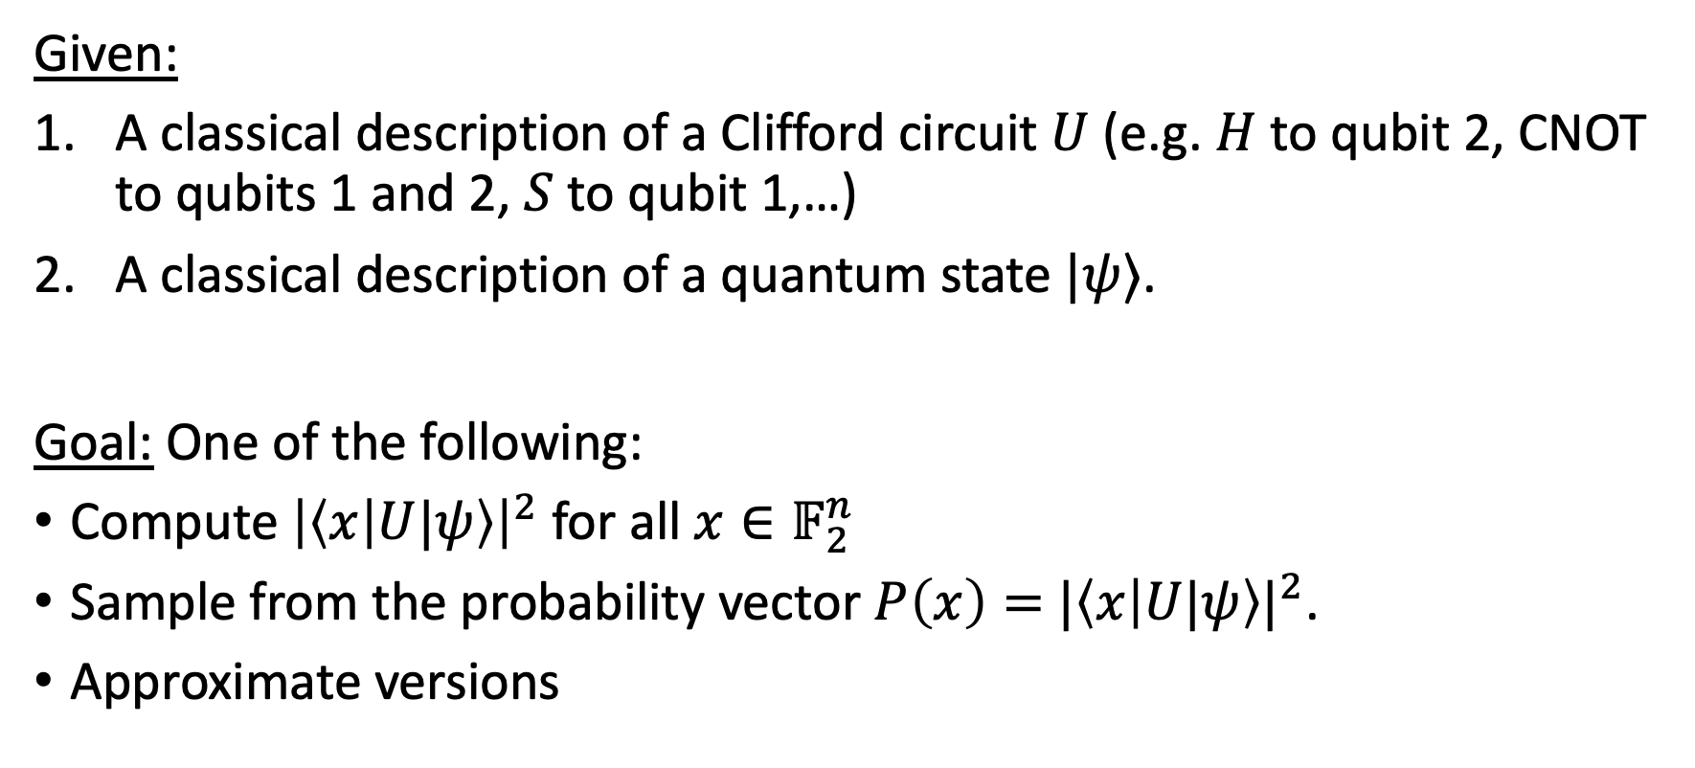
Motivation: Classical simulation of Clifford circuits
Given:
A classical description of a Clifford circuit $U$ (e.g. $H$ to qubit 2, CNOT to qubits 1 and 2, $S$ to qubit 1,…)
A classical description of a quantum state $|ψ⟩$.
Goal: One of the following:
Compute ${\left|\left\langle x | U|ψ\right\rangle \right|}^{2}$ for all $x∈𝔽_{2}^{n}$
Sample from the probability vector $P\left(x\right)=$ ${|\left\langle x | U|ψ\right\rangle |}^{2}$.
Approximate versions

Slide 34
Motivation: Classical simulation
Question: Which quantum circuits can be efficiently simulated on a classical computer?
Gottesman-Knill Theorem: Clifford circuits with stabilizer state inputs can be efficiently simulated.
… What about other circuits?

Slide 35
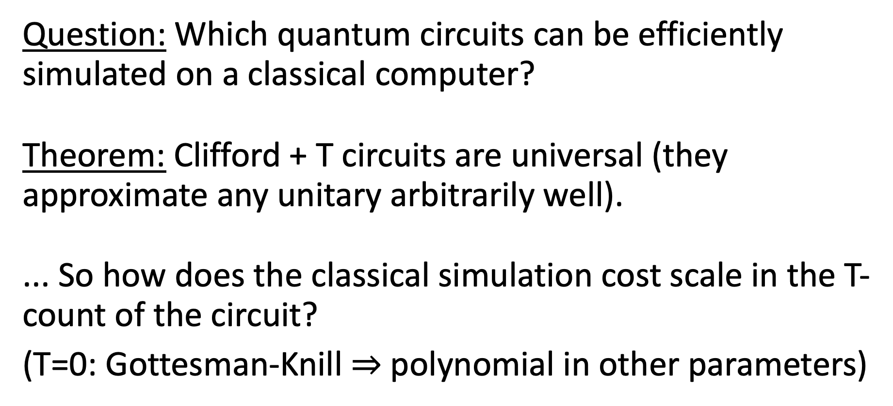
Motivation: Classical simulation
Question: Which quantum circuits can be efficiently simulated on a classical computer?
Theorem: Clifford + T circuits are universal (they approximate any unitary arbitrarily well).
... So how does the classical simulation cost scale in the T-count of the circuit?
(T=0: Gottesman-Knill $⇒$ polynomial in other parameters)

Slide 36
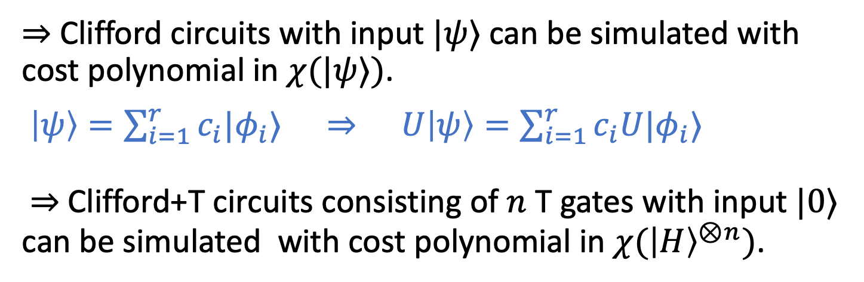
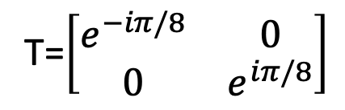
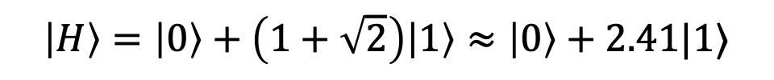
Motivation: Classical simulation of Clifford circuits
[Bravyi-Smith-Smolin 16] [Zhou-Leung-Chuang 00]
Gottesman-Knill Theorem: Clifford circuits with stabilizer state inputs can be simulated efficiently
$⇒$ Clifford circuits with input $|ψ⟩$ can be simulated with cost polynomial in $χ(|ψ⟩)$.
$\left|ψ\right\rangle =\sum_{i=1}^{r}{c_{i}|φ_{i}⟩} ⇒ U\left|ψ\right\rangle =\sum_{i=1}^{r}{c_{i}U|φ_{i}⟩}$
$⇒$ Clifford+T circuits consisting of $n$ T gates with input $|0⟩$ can be simulated with cost polynomial in ${χ(\left|H\right\rangle }^{⊗n})$.
$$\left|H\right\rangle =\left|0\right\rangle +\left(1+\sqrt{2}\right)\left|1\right\rangle ≈\left|0\right\rangle +2.41|1⟩$$
T=$\left[\begin{matrix}e^{−iπ/8} & 0 \\ 0 & e^{iπ/8}\end{matrix}\right]$

Slide 37
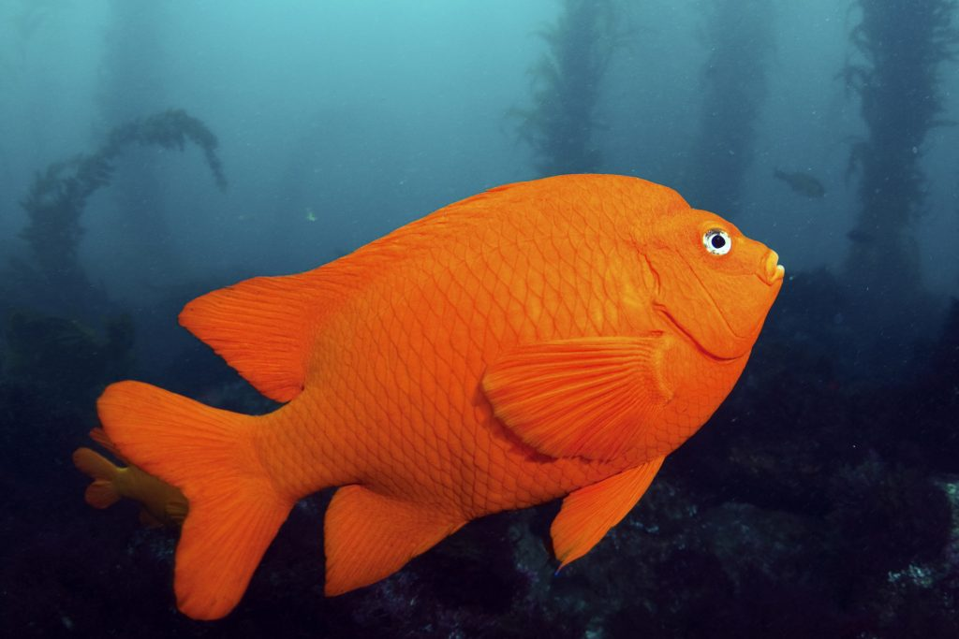
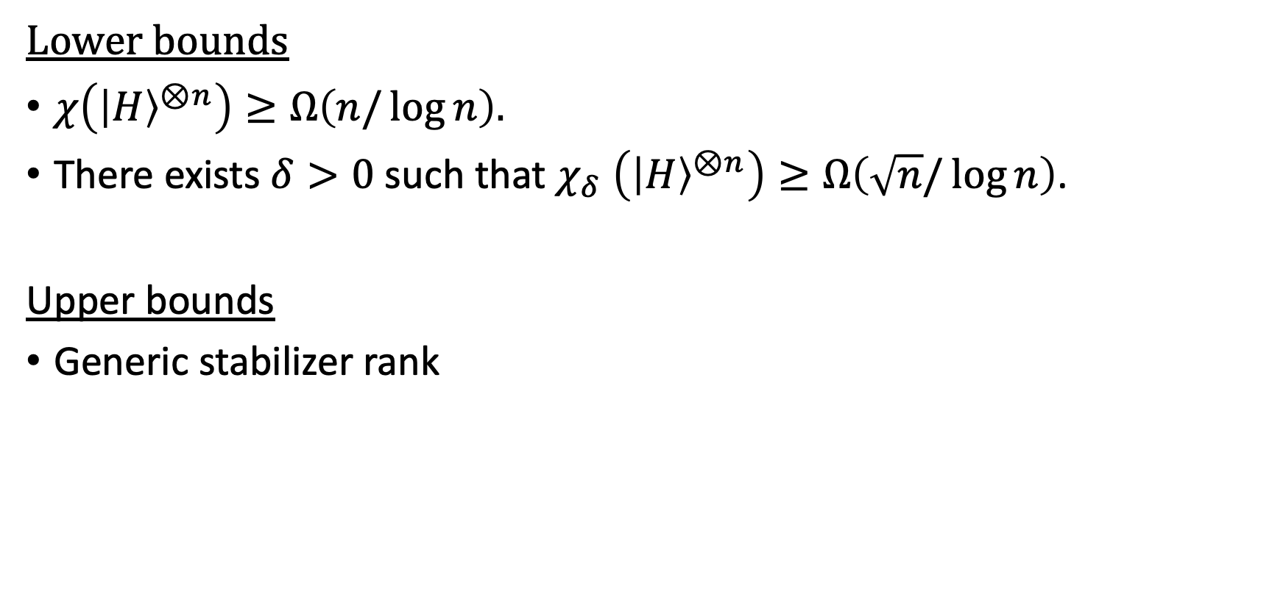
Rest of talk
Lower bounds
$χ\left({\left|H\right\rangle }^{⊗n}\right)≥Ω\left(n/\log{n}\right).$
There exists $δ>0$ such that $χ_{δ}$ $\left({\left|H\right\rangle }^{⊗n}\right)≥Ω\left(\sqrt{n}/\log{n}\right)$.
Upper bounds
Generic stabilizer rank
Match [Peleg, Shpilka, Volk 22] up to log factor
Image: https://fishingbooker.com/blog/california-state-fish-golden-trout-garibaldi/
Notes:
14min, 16 min, 32 min, 50 min

Slide 38
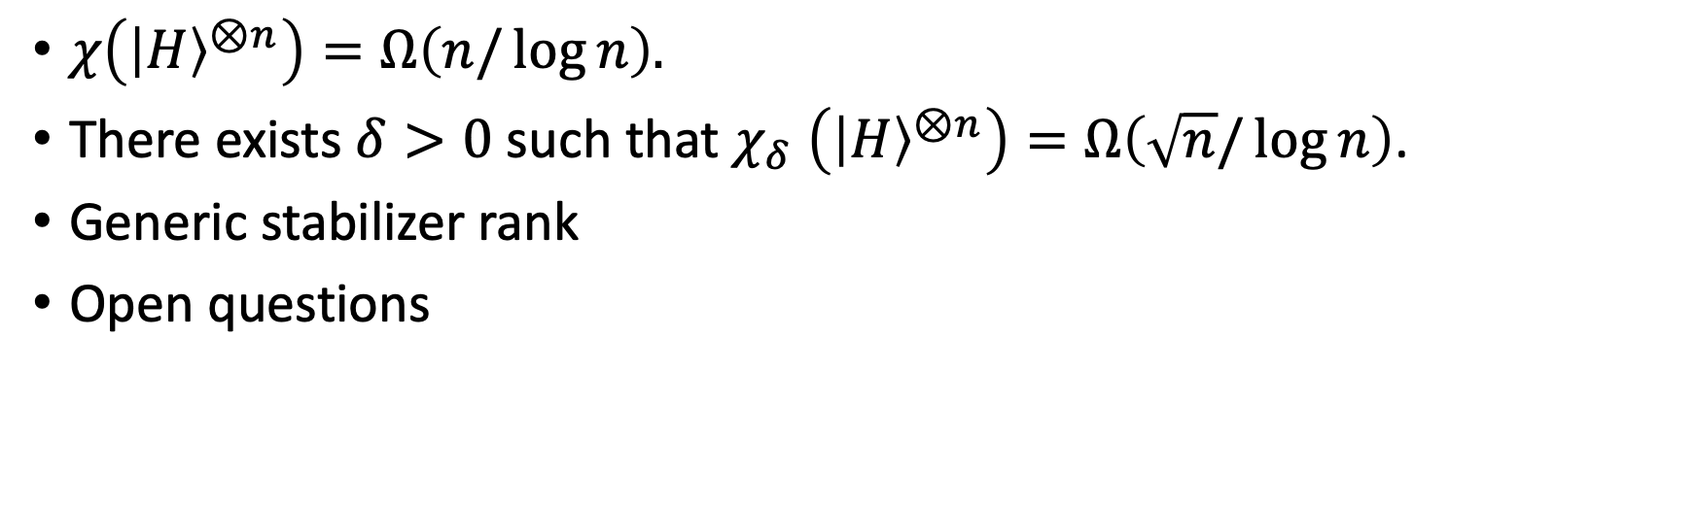
This talk
Match [Peleg, Shpilka, Volk 22] up to log factor
$χ\left({\left|H\right\rangle }^{⊗n}\right)=Ω\left(n/\log{n}\right).$
There exists $δ>0$ such that $χ_{δ}$ $\left({\left|H\right\rangle }^{⊗n}\right)=Ω\left(\sqrt{n}/\log{n}\right)$.
Generic stabilizer rank
Open questions
Outline:
Subset-sum representations
Moulton’s theorem
Results
Open questions
Image: https://fishingbooker.com/blog/california-state-fish-golden-trout-garibaldi/
Notes:
14min, 16 min, 32 min, 50 min

Slide 39
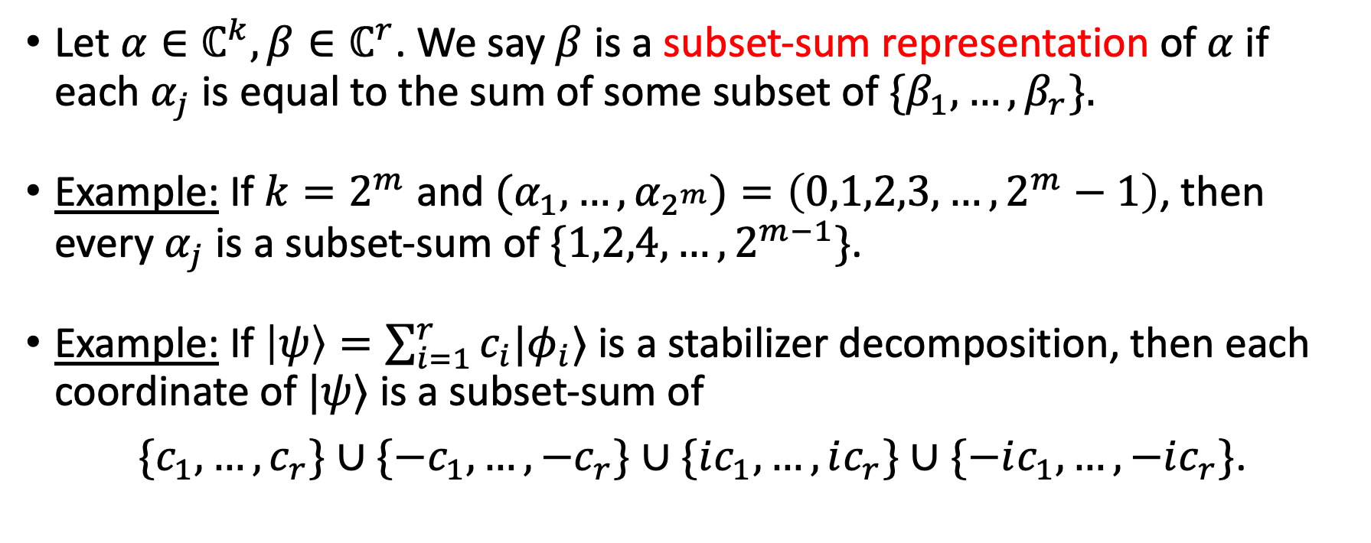

Subset-sum representations
Let $α∈ℂ^{k},β∈ℂ^{r}$. We say $β$ is a subset-sum representation of $α$ if each $α_{j}$ is equal to the sum of some subset of $\{β_{1},…,β_{r}\}.$
Example: If $k=2^{m}$ and $(α_{1},…, α_{2^{m}})=\left(0,1,2,3,…,2^{m}−1\right)$, then every $α_{j}$ is a subset-sum of $\{1,2,4, …,2^{m−1}\}$.
Example: If $\left|ψ\right\rangle =\sum_{i=1}^{r}{c_{i}|φ_{i}⟩}$ is a stabilizer decomposition, then each coordinate of $|ψ⟩$ is a subset-sum of
$\{c_{1},…,c_{r}\}∪\{−c_{1},…,−c_{r}\}∪\{ic_{1},…,ic_{r}\}∪\{−ic_{1},…,−ic_{r}\}$.
$|φ_{i}⟩$ stabilizer $⇒$coordinates are in $\{0,±1,±i\}$
Corollary: $4χ(|ψ⟩)≥$ the minimum size subset-sum representation of the coordinates of $\left|ψ\right\rangle .$

Slide 40
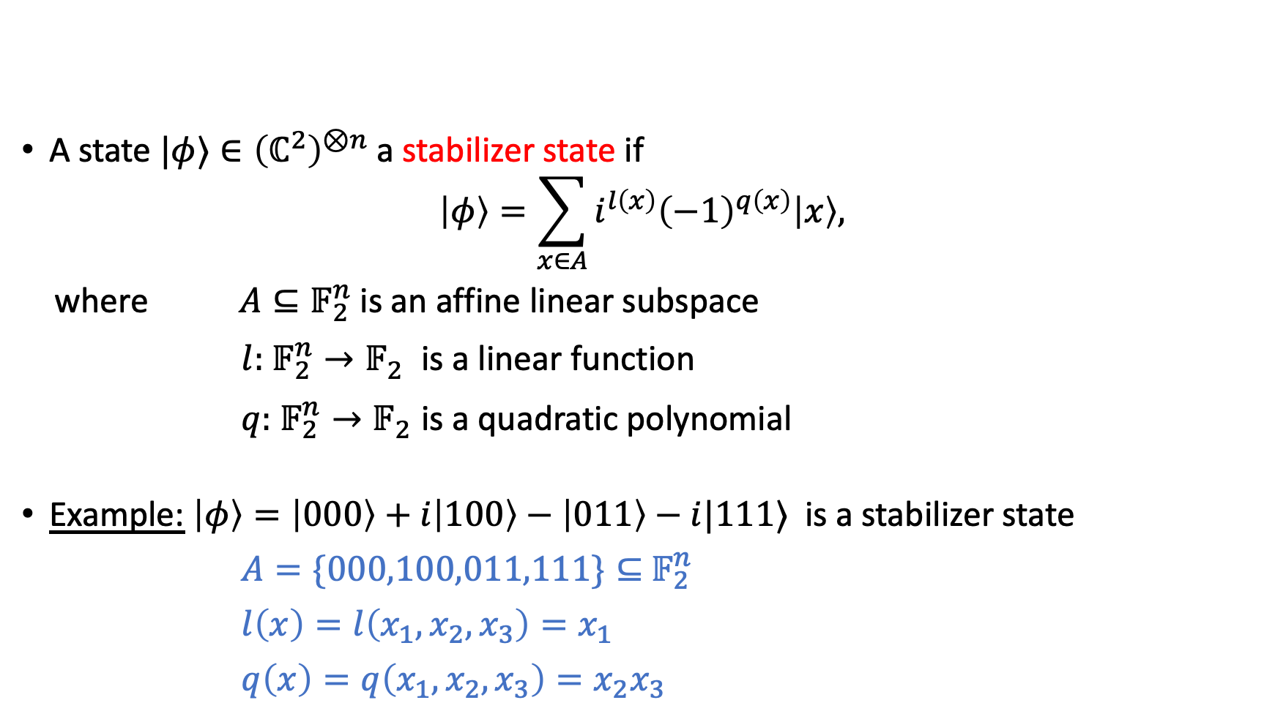
Stabilizer states
$|φ⟩$ stabilizer $⇒$coordinates are in $\{0,±1,±i\}$
A state $|φ⟩∈{\left(ℂ^{2}\right)}^{⊗n}$ a stabilizer state if
$$\left|φ\right\rangle =\sum_{x∈A}{i^{l\left(x\right)}{\left(−1\right)}^{q\left(x\right)}\left|x\right\rangle ,}$$
where $A⊆𝔽_{2}^{n}$ is an affine linear subspace
$l:$ $𝔽_{2}^{n}→𝔽_{2}^{}$ is a linear function
$q:$ $𝔽_{2}^{n}→𝔽_{2}^{}$is a quadratic polynomial
Example: $\left|φ\right\rangle =\left|000\right\rangle +i\left|100\right\rangle −\left|011\right\rangle −i|111⟩$ is a stabilizer state
$A=\{000,100,011,111\}⊆$ $𝔽_{2}^{n}$
$l\left(x\right)=l\left(x_{1},x_{2},x_{3}\right)=x_{1}$
$q\left(x\right)=q\left(x_{1},x_{2},x_{3}\right)=x_{2}x_{3}$

Slide 41
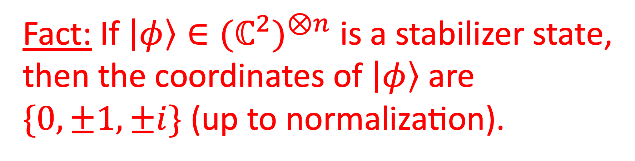
Fact: If $\left|φ\right\rangle ∈{{(ℂ}^{2})}^{⊗n}$ is a stabilizer state,
then the coordinates of $\left|φ\right\rangle$ are $\{0,±1,±i\}$ (up to normalization).

Slide 42


Theorem [Dehaene, De Moor 03]:
$\left|φ\right\rangle ∈{{(ℂ}^{2})}^{⊗n}$ is a stabilizer state $⟺\left|φ\right\rangle =\sum_{x∈A}{i^{l\left(x\right)}{\left(−1\right)}^{q\left(x\right)}\left|x\right\rangle ,}$
where $A⊆𝔽_{2}^{n}$ is an affine linear subspace
$l:$ $𝔽_{2}^{n}→𝔽_{2}^{}$ is a linear function
$q:$ $𝔽_{2}^{n}→𝔽_{2}^{}$is a quadratic polynomial
Identify $\{0,1\}^{n}$ with $𝔽_{2}^{n}$
Most results on stabilizer rank, and modern proofs of [GK98], use this characterization!

Slide 43

Subset-sum representations
Let $α∈ℂ^{k},β∈ℂ^{r}$. We say $β$ is a subset-sum representation of $α$ if each $α_{j}$ is equal to the sum of some subset of $\{β_{1},…,β_{r}\}.$
Example: $β=(1,2)$ is a subset-sum representation of $α=\left(1,2,3\right).$
Example: If $\left|ψ\right\rangle =\sum_{i=1}^{r}{c_{i}|φ_{i}⟩}$ is a stabilizer decomposition, then
$β=\left(c_{1},…,c_{r},−c_{1},…,−c_{r},ic_{1},…,ic_{r},−ic_{1},…,−ic_{r}\right)∈$ $ℂ^{4r}$
is a subset-sum representation of $|ψ⟩$.
$|φ_{i}⟩$ stabilizer $⇒$coordinates are in $\{0,±1,±i\}$
$⇒$ $χ\left(|ψ⟩\right)≥\frac{1}{4}⋅$ (the size of the smallest subset-sum rep of $\left|ψ\right\rangle$)

Slide 44


Subset-sum representations
Let $α∈ℂ^{k},β∈ℂ^{r}$. We say $β$ is a subset-sum representation of $α$ if each $α_{j}$ is equal to the sum of some subset of $\{β_{1},…,β_{r}\}.$
Example: If $k=2^{m}$ and $(α_{1},…, α_{2^{m}})=\left(0,1,2,3,…,2^{m}−1\right)$, then every $α_{i}$ is a subset-sum of $\{1,2,4, …,2^{m−1}\}$.
Trivially, $r≥\log_{2}⁡k$, since $\{β_{1},…,β_{r}\}$ has just $2^{r}$ different subsets.
Not tight: If $(α_{1},α_{2},α_{3},α_{4})=\left(0,1,2,4\right)$ and each $α_{i}$ is a subset-sum of $\{β_{1},β_{2}\}$, then
$β_{1}=1, β_{2}=2, β_{1}+β_{2}=3≠4$.
$$2=\log_{2}⁡4$$

Slide 45

Subset-sum representations
Question: Given $α_{1},…,α_{k}∈ℂ^{}$ distinct, what is the smallest number $r$ for which there exists $β_{1},…,β_{r}∈$ $ℂ$ such that every $α_{i}$ is a subset-sum of $\{β_{1},…,β_{r}\}$, i.e.
$α_{i}∈span_{𝔽_{2}}\{β_{1},…,β_{r}\}$?
Example: If $k=2^{m}$ and $(α_{1},…, α_{2^{m}})=\left(0,1,2,3,…,2^{m}−1\right)$, then every $α_{i}$ is a subset-sum of $\{1,2,4, …,2^{m−1}\}$.
Trivially, $r≥\log_{2}⁡k$, since $\{β_{1},…,β_{r}\}$ has just $2^{r}$ different subsets.
Not tight: If $(α_{1},α_{2},α_{3},α_{4})=\left(0,1,2,4\right)$ and each $α_{i}$ is a subset-sum of $\{β_{1},β_{2}\}$, then
$β_{1}=1, β_{2}=2, β_{1}+β_{2}=3≠4$.
$$2=\log_{2}⁡4$$

Slide 46




Lower bounds on the size of a subset-sum rep
Let $α∈ℂ^{k},β∈ℂ^{r}$. We say $β$ is a subset-sum representation of $α$ if each $α_{j}$ is equal to the sum of some subset of $\{β_{1},…,β_{r}\}.$
Trivially, $r≥\log_{2}⁡k$, since $\{β_{1},…,β_{r}\}$ has just $2^{r}$ different subsets.
Not tight: If $(α_{1},α_{2},α_{3},α_{4})=\left(0,1,2,4\right)$ and each $α_{i}$ is a subset-sum of $\{β_{1},β_{2}\}$, then
$β_{1}=1, β_{2}=2, β_{1}+β_{2}=3≠4$.
Theorem [Moulton]: If $2\left|α_{j}\right|≤\left|α_{j+1}\right|$ for all $j∈\{1,…, k−1\}$, then $r≥k/\log_{2}k$.
$$2=\log_{2}⁡4$$
$α$ exponentially increasing
Linear in $k$, instead of logarithmic!

Slide 47


















Lower bounds on the size of a subset-sum rep
Let $α∈ℂ^{k},β∈ℂ^{r}$. We say $β$ is a subset-sum representation of $α$ if each $α_{j}$ is equal to the sum of some subset of $\{β_{1},…,β_{r}\}.$
Trivially, $r≥\log_{2}⁡k$, since $\{β_{1},…,β_{r}\}$ has just $2^{r}$ different subsets.
Theorem [Moulton 01]: If $2\left|α_{j}\right|≤\left|α_{j+1}\right|$ for all $j∈\{1,…, k−1\}$, then $r≥k/\log_{2}k$.
Example: If $α=(2^{1},2^{2},…,2^{k})$, then $r≥k/\log_{2}k$
$α$ exponentially increasing
Linear in $k$, instead of logarithmic!
$$β_{1}$$
$$β_{2}$$
$$β_{3}$$
$$β_{4}$$
$$β_{5}$$
$$β_{6}$$
$$β_{7}$$
$$2^{1}$$
$$2^{2}$$
$$2^{3}$$
$$2^{4}$$
$$2^{5}$$
$$2^{6}$$
$$2^{7}$$
$$2^{8}$$

Slide 48

Lower bounds on the size of a subset-sum rep
Let $α∈ℂ^{k},β∈ℂ^{r}$. We say $β$ is a subset-sum representation of $α$ if each $α_{j}$ is equal to the sum of some subset of $\{β_{1},…,β_{r}\}.$
Trivially, $r≥\log_{2}⁡k$, since $\{β_{1},…,β_{r}\}$ has just $2^{r}$ different subsets.
Theorem [Moulton 01]: If $2\left|α_{j}\right|≤\left|α_{j+1}\right|$ for all $j∈\{1,…, k−1\}$, then $r≥k/\log_{2}k$.
Example: If $α=(2^{1},2^{2},…,2^{k})$, then $r≥k/\log_{2}k$
Theorem [Lovitz-Steffan]: If the coordinates of $|ψ⟩$ contain an exponentially increasing sequence of length $k$, then $χ(|ψ⟩)≥k/(4\log_{2}⁡k)$.
$α$ exponentially increasing
Linear in $k$, instead of logarithmic!

Slide 49


















$$2^{0}$$
$$2^{1}$$
$$2^{2}$$
$$2^{3}$$
$$2^{4}$$
$$2^{5}$$
$$2^{6}$$
$$2^{7}$$
$$2^{8}$$
||
$$α_{1}$$
||
$$α_{2}$$
||
$$α_{3}$$
||
$$α_{4}$$
||
$$α_{5}$$
||
$$α_{6}$$
||
$$α_{7}$$
||
$$α_{8}$$
||
$$α_{9}$$

Slide 50















Intuition for Moulton’s theorem
Let $α∈ℂ^{k},β∈ℂ^{r}$. We say $β$ is a subset-sum representation of $α$ if each $α_{j}$ is equal to the sum of some subset of $\{β_{1},…,β_{r}\}.$
Theorem [Moulton 01]: If $2\left|α_{j}\right|≤\left|α_{j+1}\right|$ for all $j∈\{1,…, k−1\}$, then $r≥k/\log_{2}k$.
Intuition: If we restrict $β_{1},…,β_{r}$ to be positive real numbers, then $r≥k.$
$$β_{1}$$
$$β_{2}$$
$$β_{3}$$
$$β_{4}$$
$$β_{5}$$
$$β_{6}$$
$$β_{7}$$
$$2^{0}$$
$$2^{1}$$
$$2^{2}$$
$$2^{3}$$
$$2^{4}$$
$$2^{5}$$
$$2^{6}$$
$$2^{7}$$
$$2^{8}$$
||
$$α_{1}$$
||
$$α_{2}$$
||
$$α_{3}$$
||
$$α_{4}$$
||
$$α_{5}$$
||
$$α_{6}$$
||
$$α_{7}$$
||
$$α_{8}$$

Slide 51
Intuition for Moulton’s theorem
Let $α∈ℂ^{k},β∈ℂ^{r}$. We say $β$ is a subset-sum representation of $α$ if each $α_{j}$ is equal to the sum of some subset of $\{β_{1},…,β_{r}\}.$
Theorem [Moulton 01]: If $2\left|α_{j}\right|≤\left|α_{j+1}\right|$ for all $j∈\{1,…, k−1\}$, then $r≥k/\log_{2}k$.
Intuition: If we restrict $β_{1},…,β_{r}$ to be positive real numbers, then $r≥k.$
$$β_{1}$$
$$β_{2}$$
$$β_{3}$$
$$β_{4}$$
$$β_{5}$$
$$β_{6}$$
$$β_{7}$$
$$2^{0}$$
$$2^{1}$$
$$2^{2}$$
$$2^{3}$$
$$2^{4}$$
$$2^{5}$$
$$2^{6}$$
$$2^{7}$$
$$2^{8}$$

Slide 52



Moulton’s theorem
Question: Given $α_{1},…,α_{k}∈ℂ^{}$ distinct, what is the smallest number $r$ for which there exists $β_{1},…,β_{r}∈$ $ℂ$ such that every $α_{i}$ is a subset-sum of $\{β_{1},…,β_{r}\}$, i.e.
$α_{i}∈span_{𝔽_{2}}\{β_{1},…,β_{r}\}$?
Theorem [Moulton]: If $2\left|α_{j}\right|≤\left|α_{j+1}\right|$ for all $j∈\{1,…, k−1\}$, then $r≥k/\log_{2}k$.
Example: If $\left(α_{1},…,α_{k}\right)=(1,2,4,…,2^{k−1})$, then $r≥k/\log_{2}k$
$α$ exponentially increasing
Linear in $k$, instead of logarithmic!

Slide 53



Moulton’s theorem
Question: Given $α_{1},…,α_{k}∈ℂ^{}$ distinct, what is the smallest number $r$ for which there exists $β_{1},…,β_{r}∈$ $ℂ$ such that every $α_{i}$ is a subset-sum of $\{β_{1},…,β_{r}\}$, i.e.
$α_{i}∈span_{𝔽_{2}}\{β_{1},…,β_{r}\}$?
Trivially, $r≥\log_{2}⁡k$, since $\{β_{1},…,β_{r}\}$ has just $2^{r}$ different subsets.
Not tight: If $(α_{1},α_{2},α_{3},α_{4})=\left(0,1,2,4\right)$ and each $α_{i}$ is a subset-sum of $\{β_{1},β_{2}\}$, then
$β_{1}=1, β_{2}=2, β_{1}+β_{2}=3≠4$.
Theorem [Moulton]: If $2\left|α_{j}\right|≤\left|α_{j+1}\right|$ for all $j,$ then $r≥k/\log_{2}k$.
$$2=\log_{2}⁡4$$
$α$ exponentially increasing

Slide 54



Lower bound on stabilizer rank
$α$ exponentially increasing
Theorem [Moulton]: If $α∈ℂ^{k}$ and $2\left|α_{j}\right|≤\left|α_{j+1}\right|$ for all $j,$ then for any subset-sum representation $β∈ℂ^{k}$, it holds that $r≥k/\log_{2}k$.
Corollary [Lovitz-Steffan]: $χ{(|H⟩}^{⊗n})≥n/(4 \log_{2}⁡n)$.
Proof: Since $\left|H\right\rangle ≈\left|0\right\rangle +2.41\left|1\right\rangle ,$
$${\left|H\right\rangle }^{⊗n}≈\left|0⋯0\right\rangle +\left(2.41\right)\left(\left|0⋯01\right\rangle +⋯+\left|10⋯0\right\rangle \right)+⋯+{\left(2.41\right)}^{n}\left|1⋯1\right\rangle .$$
If ${\left|H\right\rangle }^{⊗n}=\sum_{i=1}^{r}{c_{i}|φ_{i}⟩}$ is a stabilizer decomposition, then each ${\left(2.41\right)}^{j}$ is a subset-sum of
$\{c_{1},…,c_{r}\}∪\{−c_{1},…,−c_{r}\}∪\{ic_{1},…,ic_{r}\}∪\{−ic_{1},…,−ic_{r}\}$.
By Moulton’s theorem, $4r≥n/\log_{2}⁡n$.

Slide 55


Lower bound on stabilizer rank
Theorem [Lovitz-Steffan]: If the coordinates of $|ψ⟩$ contain an exponentially increasing sequence of length $k$, then $χ(|ψ⟩)≥k/(4\log_{2}⁡k)$.
Corollary [Lovitz-Steffan]: $χ{(|H⟩}^{⊗n})≥n/(4 \log_{2}⁡n)$.
Proof: Since $\left|H\right\rangle ≈\left|0\right\rangle +2.41\left|1\right\rangle ,$
$${\left|H\right\rangle }^{⊗n}≈\left|0⋯0\right\rangle +\left(2.41\right)\left(\left|0⋯01\right\rangle +⋯+\left|10⋯0\right\rangle \right)+⋯+{\left(2.41\right)}^{n}\left|1⋯1\right\rangle .$$
$⇒{\left|H\right\rangle }^{⊗n}$ contains the exponentially increasing sequence ${(2.41,2.41}^{2},…,{2.41}^{n})$
$⇒χ{(|H⟩}^{⊗n})≥n/(4 \log_{2}⁡n)$ by boxed theorem.

Slide 56


Lower bound on approximate stabilizer rank
The $δ$-approximate stabilizer rank of a normalized state $|ψ⟩$ is
$$χ_{δ}(|ψ⟩)=min\{χ(|μ⟩):\left\|\left|ψ\right\rangle −\left|μ\right\rangle \right\|≤δ\}.$$
Theorem [Lovitz-Steffan]: There exists $δ>0$ for which $χ_{δ}{(\left|H\right\rangle }^{⊗n})≥\sqrt{n}/\left(4\log_{2}{\sqrt{n}}\right).$
Proof sketch: Show that for $δ$ small enough, any state that is $δ$-close to ${\left|H\right\rangle }^{⊗n}$ must contain an exponentially increasing sequence of length $\sqrt{n}$ (Use De Moivre-Laplace).
Result follows from boxed theorem.

Slide 57


States with exponential stabilizer rank but constant approximate stabilizer rank
Theorem: The product state
$$\left|ψ_{n}\right\rangle =⨂_{i=1}^{n}{(\left|0\right\rangle +2^{2^{i−1}}}\left|1\right\rangle )$$
has exponential stabilizer rank $χ\left(|ψ_{n}⟩\right)≥2^{n}/\left(4n\right),$
but constant approximate stabilizer rank $χ_{δ}(|ψ_{n}⟩)=O(1)$ for any $δ>0$.
Question: Do there exist product states in with:
Stabilizer rank $2^{n}$ (the largest possible)
$δ$-approximate stabilizer rank 1 (the smallest possible)?
Yes

Slide 58











Super-linear lower bound on $χ\left({\left|H\right\rangle }^{⊗n}\right)$?
$$|0⟩$$
$$|0⟩$$
$$|0⟩$$
[BSS16] idea:
The T-count of a state $\left|ψ\right\rangle$ is the minimum number of T gates needed to prepare $\left|ψ\right\rangle$ with a Cliff+T circuit $U$ and post-selective comp. basis measurements.
Fact: If $|ψ⟩$ has T-count $n$, then $χ(|ψ⟩)≤χ\left({\left|H\right\rangle }^{⊗n}\right)$.
Proof:
$$|ψ⟩$$
Cliff+ $n$ T
$$|0⟩$$
$$̃$$
$$|0⟩$$
$$\left|0\right\rangle ⊗{\left|H\right\rangle }^{⊗n}$$
$$|ψ⟩$$
$$|H⟩$$
$$|0⟩$$
Cliff

Slide 59


Super-linear lower bound on $χ\left({\left|H\right\rangle }^{⊗n}\right)$?
$$|0⟩$$
$$U$$
[BSS16] idea:
The T-count of a state $\left|ψ\right\rangle$ is the minimum number $n$ of T gates needed to prepare $\left|ψ\right\rangle$ with a Cliff+T circuit $U$
Fact: If $|ψ⟩$ has T-count $n$, then $χ(|ψ⟩)≤χ\left({\left|H\right\rangle }^{⊗n}\right)$.
Proof:
$$|ψ⟩$$
Cliff+ $n$ T
$$=(𝕀⊗⟨1|)U_{\text{Cliff}}(𝕀⊗|H⟩)$$

Slide 60

Super-linear lower bound on $χ\left({\left|H\right\rangle }^{⊗n}\right)$?
[BSS16] idea:
The T-count of a state $\left|ψ\right\rangle$ is the minimum number $n$ of T gates needed to prepare $\left|ψ\right\rangle$ with a Cliff+T circuit $U$
Fact: If $|ψ⟩$ has T-count $n$, then $χ(|ψ⟩)≤χ\left({\left|H\right\rangle }^{⊗n}\right)$.
Proof:
Let $r=χ\left({\left|H\right\rangle }^{⊗n}\right)$ and ${\left|H\right\rangle }^{⊗n}=\sum_{i=1}^{r}{c_{i}|φ_{i}⟩}$.
$\left|ψ\right\rangle =(𝕀⊗⟨1…1|)U_{\text{Cliff}}(|0⟩⊗{\left|H\right\rangle }^{⊗n})$
$=\sum_{i=1}^{r}{c_{i}(𝕀⊗⟨1…1|)U_{\text{Cliff}}\left(|0⟩⊗|φ_{i}⟩\right)}$
… so $χ(|ψ⟩)≤r$.
$$|0⟩$$
$$U$$
$$|ψ⟩$$
Cliff+ $n$ T
Stabilizer state!

Slide 61

Super-linear lower bound on $χ\left({\left|H\right\rangle }^{⊗n}\right)$?
Fact: If $|ψ⟩$ has T-count $n$, then $χ(|ψ⟩)≤χ\left({\left|H\right\rangle }^{⊗n}\right)$.
[BSS16] idea: For each $n$, if there exists a state $\left|ψ_{n}\right\rangle$ that:
1. Has T-count $n$
2. Satisfies $χ(|ψ_{n}⟩)≥n^{1+ε}$
… then $χ\left({\left|H\right\rangle }^{⊗n}\right)≥χ(|ψ_{n}⟩)≥n^{1+ε}$
Super-linear
1
2

Slide 62


Dead end for super-linear lower bound on $χ\left({\left|H\right\rangle }^{⊗n}\right)$
[BSS16] idea: For each $n$, if there exists a state $\left|ψ_{n}\right\rangle$ that:
1. Has T-count $n$
2. Contains an exponentially-increasing sequence of coordinates of length $n^{1+ε}$
… then $χ\left({\left|H\right\rangle }^{⊗n}\right)≥χ(|ψ_{n}⟩)≥n^{1+ε}/(4\log_{2}⁡(n^{1+ε}))$
… But such states $\left|ψ_{n}\right\rangle$ do not exist [Beverland-Campbell-Howard-Kliuchnikov 2020]
1
2
Super-linear

Slide 63

Super-linear lower bound on $χ\left({\left|H\right\rangle }^{⊗n}\right)$?
Fact: If $|ψ⟩$ has T-count $n$, then $χ(|ψ⟩)≤χ\left({\left|H\right\rangle }^{⊗n}\right)$.
[BSS16] idea: For each $n$, if there exists a state $\left|ψ_{n}\right\rangle$ that:
1. Has T-count $n$
2. Every subset-sum rep of $\left|ψ_{n}\right\rangle$ has size at least $n^{1+ε}$
… then $χ\left({\left|H\right\rangle }^{⊗n}\right)≥χ(|ψ_{n}⟩)≥{\frac{1}{4}n}^{1+ε}$
[Beverland-Campbell-Howard-Kliuchnikov 2020]: A state of T-count $n$ can have an exponentially increasing sequence of length at most $O\left(n\right).$
Super-linear
1
2

Slide 64

Rest of talk
Lower bounds
$χ\left({\left|H\right\rangle }^{⊗n}\right)≥Ω\left(n/\log{n}\right).$
There exists $δ>0$ such that $χ_{δ}$ $\left({\left|H\right\rangle }^{⊗n}\right)≥Ω\left(\sqrt{n}/\log{n}\right)$.
Upper bounds
Generic stabilizer rank
Match [Peleg, Shpilka, Volk 22] up to log factor
Image: https://fishingbooker.com/blog/california-state-fish-golden-trout-garibaldi/
Notes:
14min, 16 min, 32 min, 50 min

Slide 65

Upper bounds: Generic stabilizer rank
Let $χ_{n}=\max{\{χ\left({\left|ψ\right\rangle }^{⊗n}\right):\left|ψ\right\rangle ∈ℂ^{2}\}}$ be the $n$-th generic stabilizer rank.
$χ_{n}≥max⁡\{n+1, χ\left({\left|H\right\rangle }^{⊗n}\right)\}$ Question: Super-linear lower bound on $χ_{n}$?
Fact: $χ\left({\left|ψ\right\rangle }^{⊗n}\right)=χ_{n}$ for all but finitely many $\left|ψ\right\rangle ∈ℂ^{2}$ (up to scale).
Proposition [Lovitz-Steffan]: $χ_{n}=O\left(2^{n/2}\right)$
(Slight improvement of recent bound $O(\left(n+1\right)2^{n/2})$ of [Qassim-Pashayan-Gosset 21])
Fact: There exists a single set of $χ_{n}$ stabilizer states that can be superimposed to produce any state of the form ${\left|ψ\right\rangle }^{⊗n}$. Q: Describe such a set?

Slide 66


Summary
Classical simulation of Clifford+T circuits via stabilizer rank
Lower bounds
$χ\left({\left|H\right\rangle }^{⊗n}\right)≥Ω\left(n/\log{n}\right).$
There exists $δ>0$ such that $χ_{δ}$ $\left({\left|H\right\rangle }^{⊗n}\right)≥Ω\left(\sqrt{n}/\log{n}\right)$.
Upper bounds
Generic stabilizer rank
Match [Peleg, Shpilka, Volk 22] up to log factor
https://thumbs.dreamstime.com/b/goldfish-gold-fish-bowl-cute-cartoon-character-happy-145738808.jpg

Slide 67
New techniques for bounding stabilizer rank
Benjamin Lovitz* Vincent Steffan**
*NSF Postdoc, Northeastern University
**QMATH, University of Copenhagen
Portland State Computer Science
November 11, 2022
arXiv:2110.07781

