Slide 1
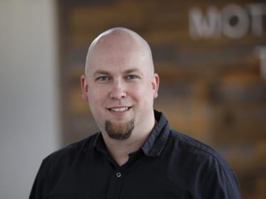
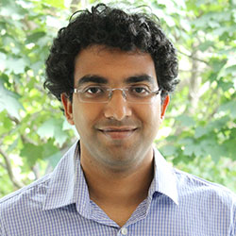

Nullstellensatz-inspired algorithms for certifying entanglement of subspaces
Nathaniel Johnston¹ Benjamin Lovitz² Aravindan Vijayaraghavan³
1. Mount Allison University and University of Guelph
2. NSF Postdoc, Northeastern University
3. Northwestern University
November 25, 2022
arXiv:2210.16389

Slide 2

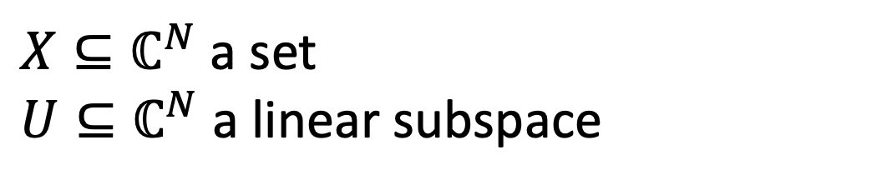


$X⊆ℂ^{N}$ a set
$U⊆ℂ^{N}$ a linear subspace
Describe $U∩X?$
$$U$$
$$X$$

Slide 3
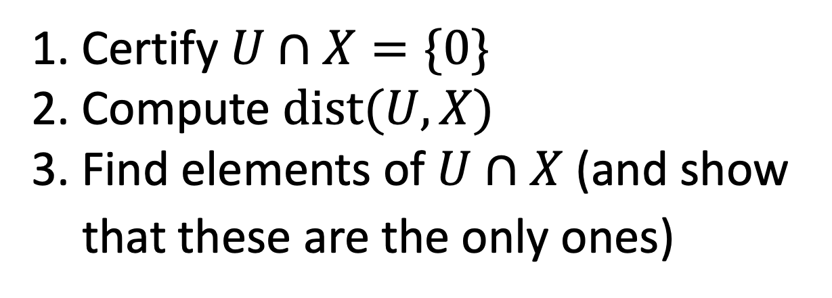
$X⊆ℂ^{N}$ a set
$U⊆ℂ^{N}$ a linear subspace
Describe $U∩X?$
$$U$$
$$X$$
1. Certify $U∩X=\{0\}$
2. Compute $dist(U,X)$
3. Find elements of $U∩X$ (and show that these are the only ones)

Slide 4
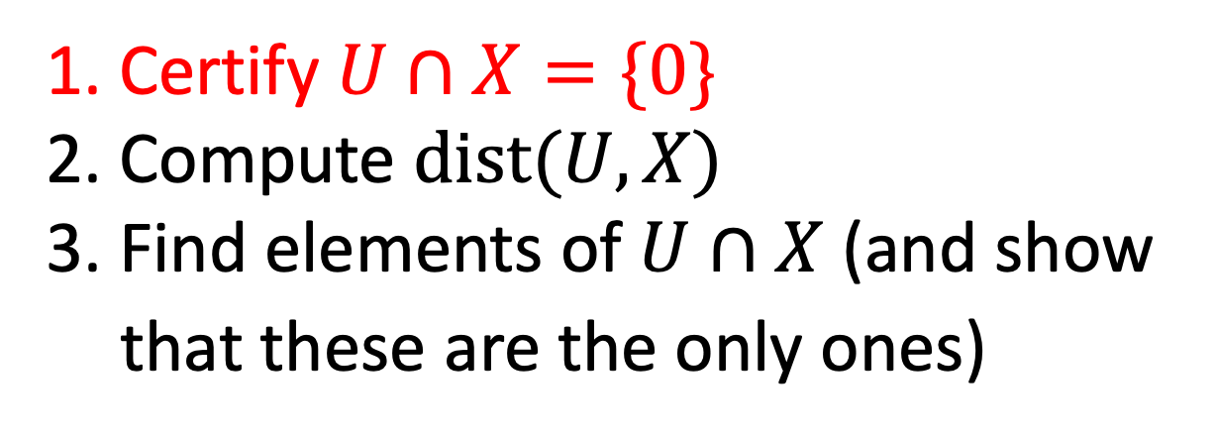
$X⊆ℂ^{N}$ a set
$U⊆ℂ^{N}$ a linear subspace
Describe $U∩X?$
$$U$$
$$X$$
1. Certify $U∩X=\{0\}$
2. Compute $dist(U,X)$
3. Find elements of $U∩X$ (and show that these are the only ones)

Slide 5
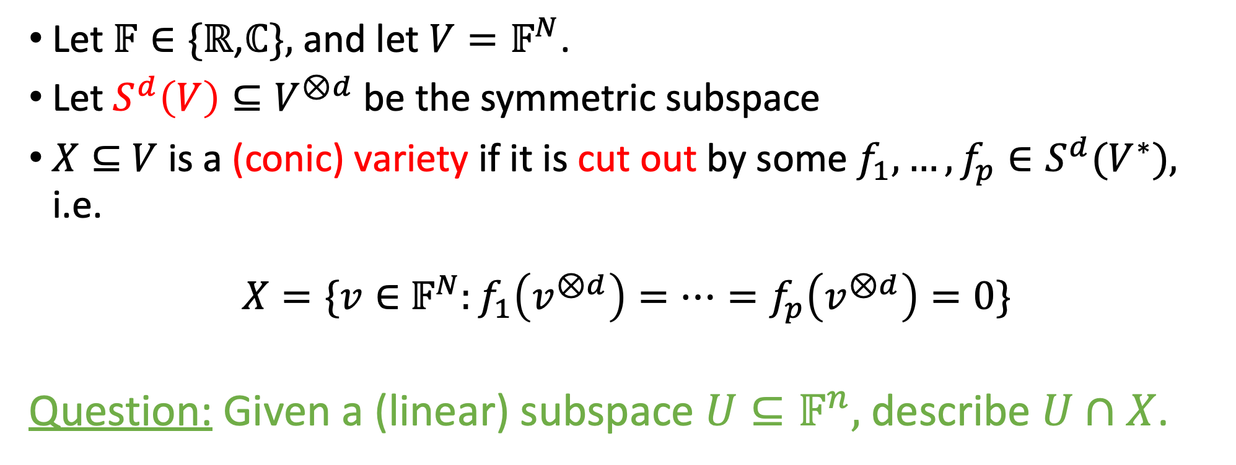

Intersecting a subspace with a variety
Let $𝔽∈\{ℝ$,$ℂ\},$ and let $V=𝔽^{N}$.
Let $S^{d}\left(V\right)⊆V^{⊗d}$ be the symmetric subspace
$X⊆$ $V$ is a (conic) variety if it is cut out by some $f_{1},…,f_{p}∈S^{d}(V^{∗}),$ i.e.
$X=\{v∈$ $𝔽^{N}:f_{1}\left(v^{⊗d}\right)=…=f_{p}\left(v^{⊗d}\right)=0\}$
Question: Given a (linear) subspace $U⊆𝔽^{n},$ describe $U∩X$.
Dual space to $S^{d}(V)$

Slide 6
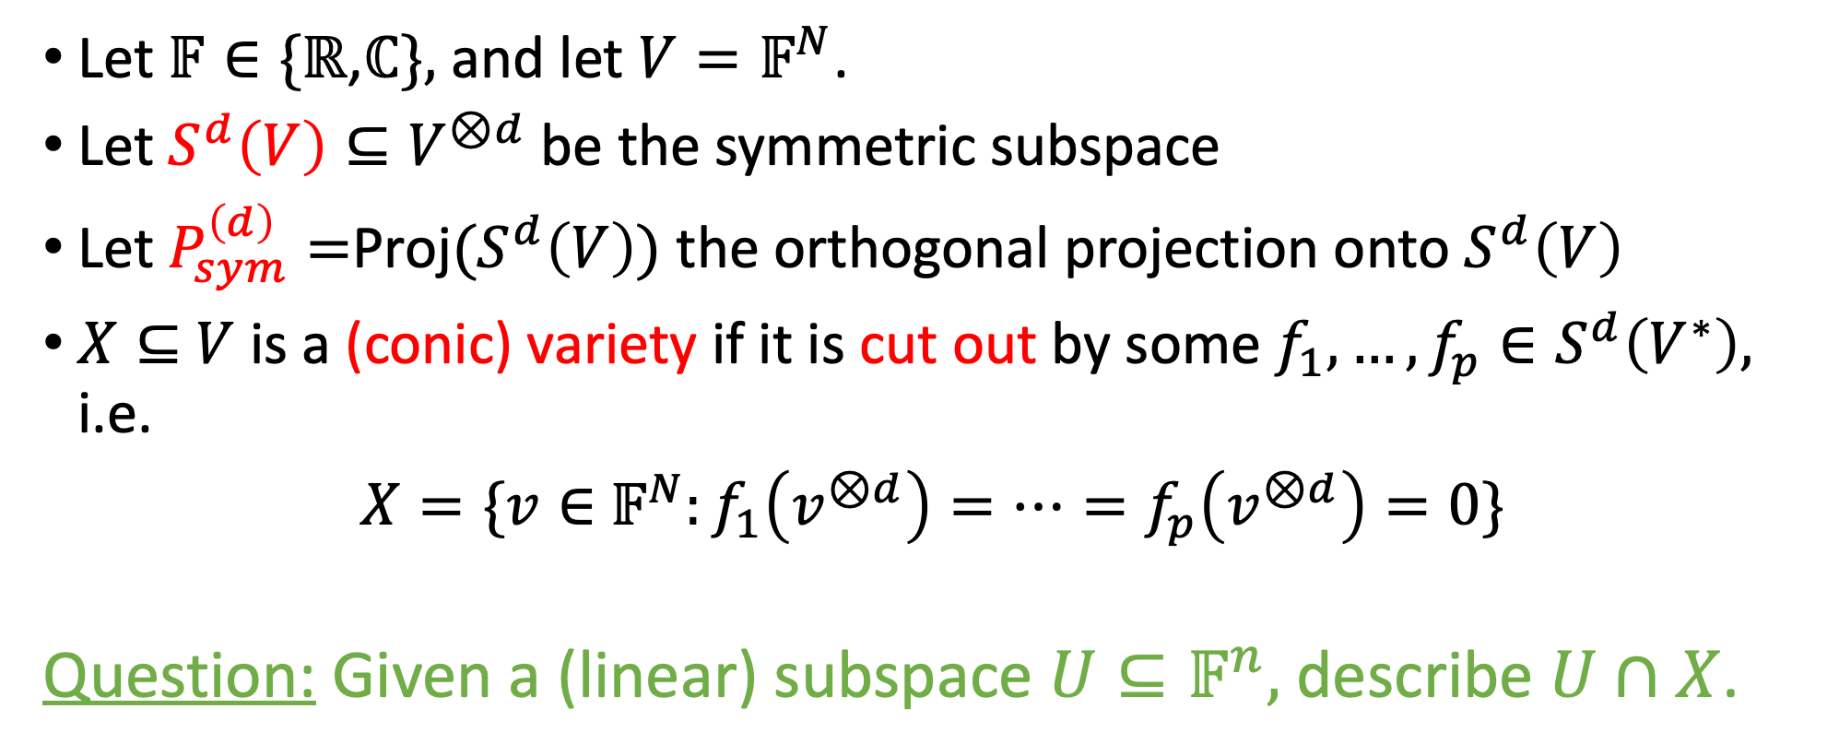

Intersecting a subspace with a variety
Let $𝔽∈\{ℝ$,$ℂ\},$ and let $V=𝔽^{N}$.
Let $S^{d}\left(V\right)⊆V^{⊗d}$ be the symmetric subspace
Let $P_{sym}^{\left(d\right)}=$Proj$(S^{d}\left(V\right))$ the orthogonal projection onto $S^{d}\left(V\right)$
$X⊆$ $V$ is a (conic) variety if it is cut out by some $f_{1},…,f_{p}∈S^{d}\left(V^{∗}\right),$ i.e.
$X=\{v∈$ $𝔽^{N}:f_{1}\left(v^{⊗d}\right)=…=f_{p}\left(v^{⊗d}\right)=0\}$
Question: Given a (linear) subspace $U⊆𝔽^{n},$ describe $U∩X$.
Dual space to $S^{d}(V)$

Slide 7
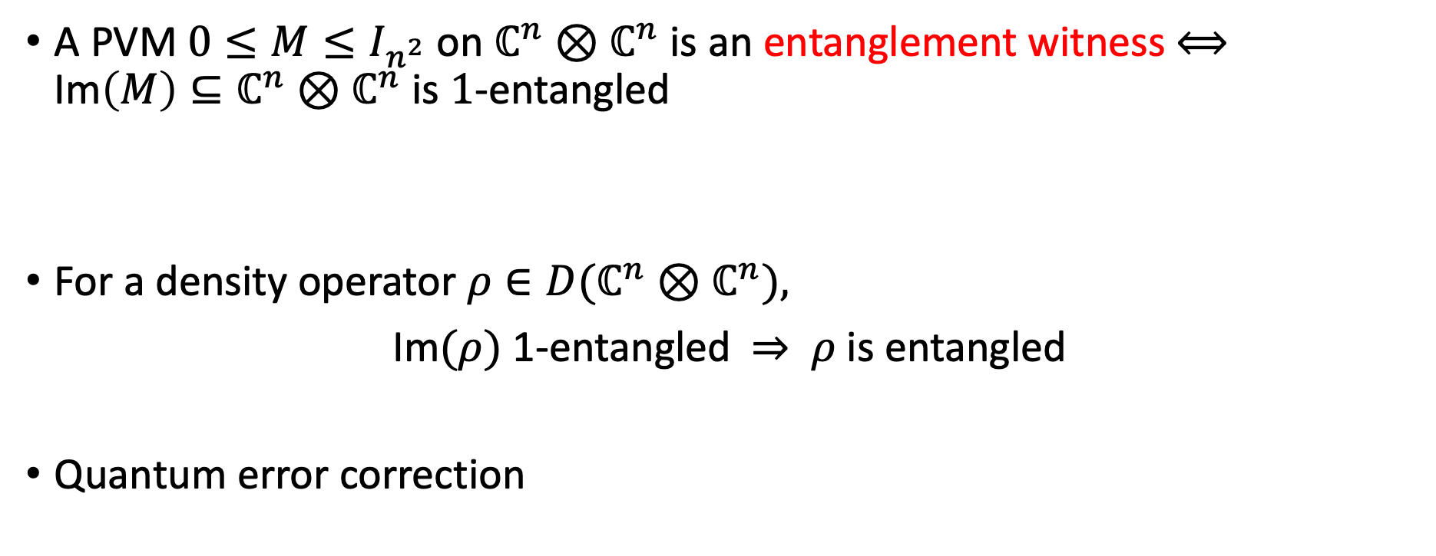
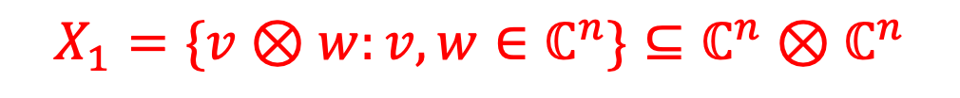
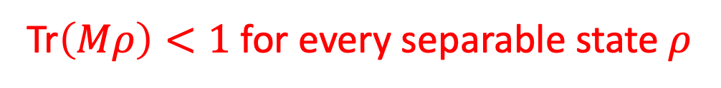
$$X_{1}=\{v⊗w:v,w∈ℂ^{n}\}⊆ℂ^{n}⊗ℂ^{n}$$
Def: $U⊆ℂ^{n}⊗ℂ^{n}$is 1-entangled if $U∩X_{1}=\{0\}.$
Applications:
A PVM $0≤M≤I_{n^{2}}$ on $ℂ^{n}⊗ℂ^{n}$ is an entanglement witness $⟺^{}$ Im$\left(M\right)⊆ℂ^{n}⊗ℂ^{n}$ is $1$-entangled
For a density operator $ρ∈D(ℂ^{n}⊗ℂ^{n}),$
Im$(ρ)$ 1-entangled $⇒$ $ρ$ is entangled
Quantum error correction
Tr$\left(Mρ\right)<1$ for every separable state $ρ$
range criterion

Slide 8
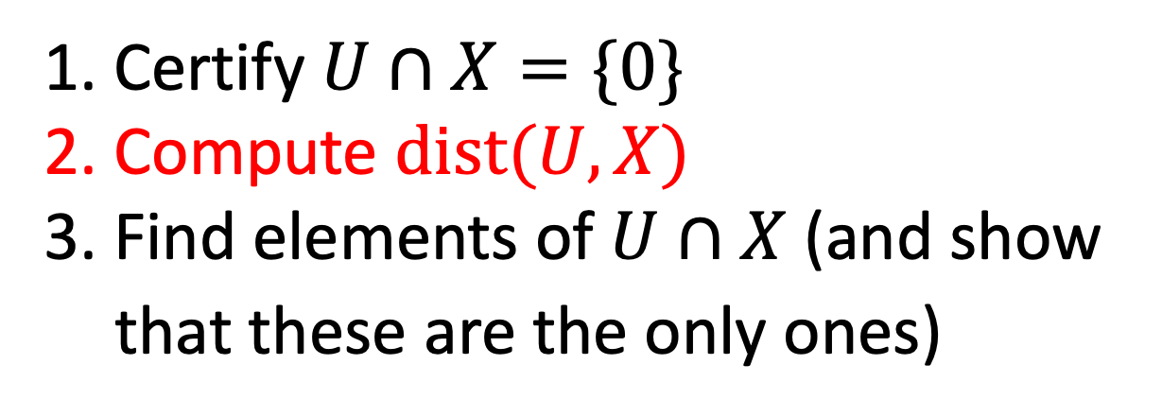

$X⊆ℂ^{N}$ a set
$U⊆ℂ^{N}$ a linear subspace
Describe $U∩X?$
$$U$$
$$dist\left(U,X\right)$$
$$X$$
1. Certify $U∩X=\{0\}$
2. Compute $dist(U,X)$
3. Find elements of $U∩X$ (and show that these are the only ones)

Slide 9
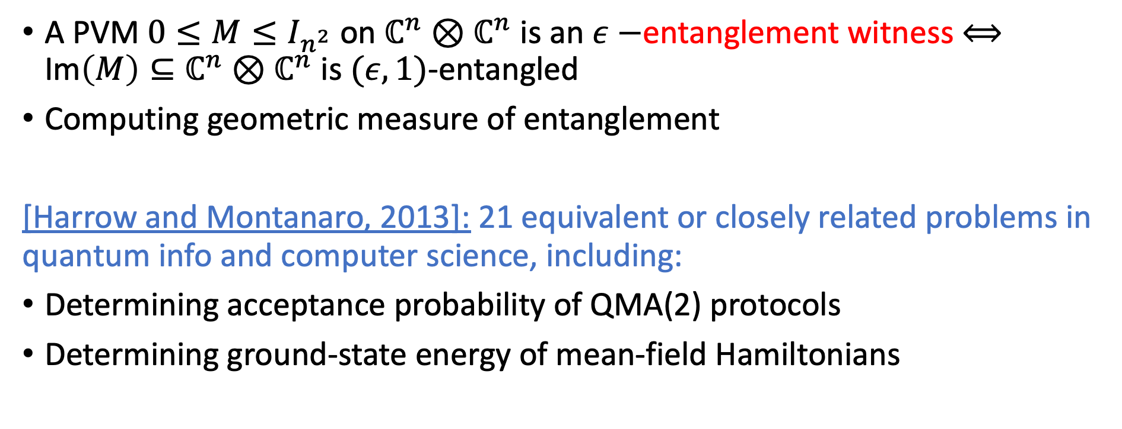
$$X_{1}=\{v⊗w:v,w∈ℂ^{n}\}⊆ℂ^{n}⊗ℂ^{n}$$
Def: $U⊆ℂ^{n}⊗ℂ^{n}$is ($ε,1)$-entangled if $dist\left(U,X_{1}\right)>ε$
Applications:
Tr$\left(Mρ\right)<1−ε$ for every separable state $ρ$
A PVM $0≤M≤I_{n^{2}}$ on $ℂ^{n}⊗ℂ^{n}$ is an $ε−$entanglement witness $⟺^{}$ Im$\left(M\right)⊆ℂ^{n}⊗ℂ^{n}$ is $(ε,1)$-entangled
Computing geometric measure of entanglement
[Harrow and Montanaro, 2013]: 21 equivalent or closely related problems in quantum info and computer science, including:
Determining acceptance probability of QMA(2) protocols
Determining ground-state energy of mean-field Hamiltonians

Slide 10


Application: Computing the Geometric measure of entanglement/Injective tensor norm
$$T$$
$$T∈ℂ^{n}⊗ℂ^{n}⊗ℂ^{n}$$
$$dist\left(T,X_{1}\right)$$
$$X_{1}=\{u⊗v⊗w :u,v,w∈ℂ^{n}\}$$

Slide 11
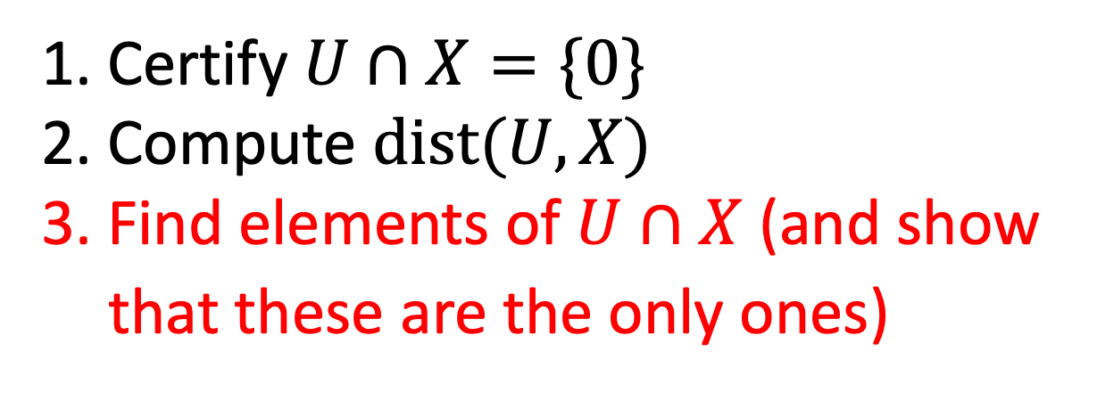
$X⊆ℂ^{N}$ a set
$U⊆ℂ^{N}$ a linear subspace
Describe $U∩X?$
$$U$$
$$dist\left(U,X\right)$$
$$X$$
1. Certify $U∩X=\{0\}$
2. Compute $dist(U,X)$
3. Find elements of $U∩X$ (and show that these are the only ones)

Slide 12
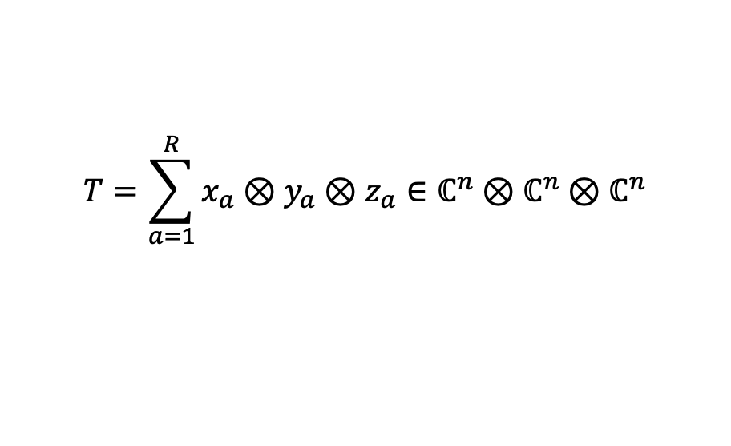
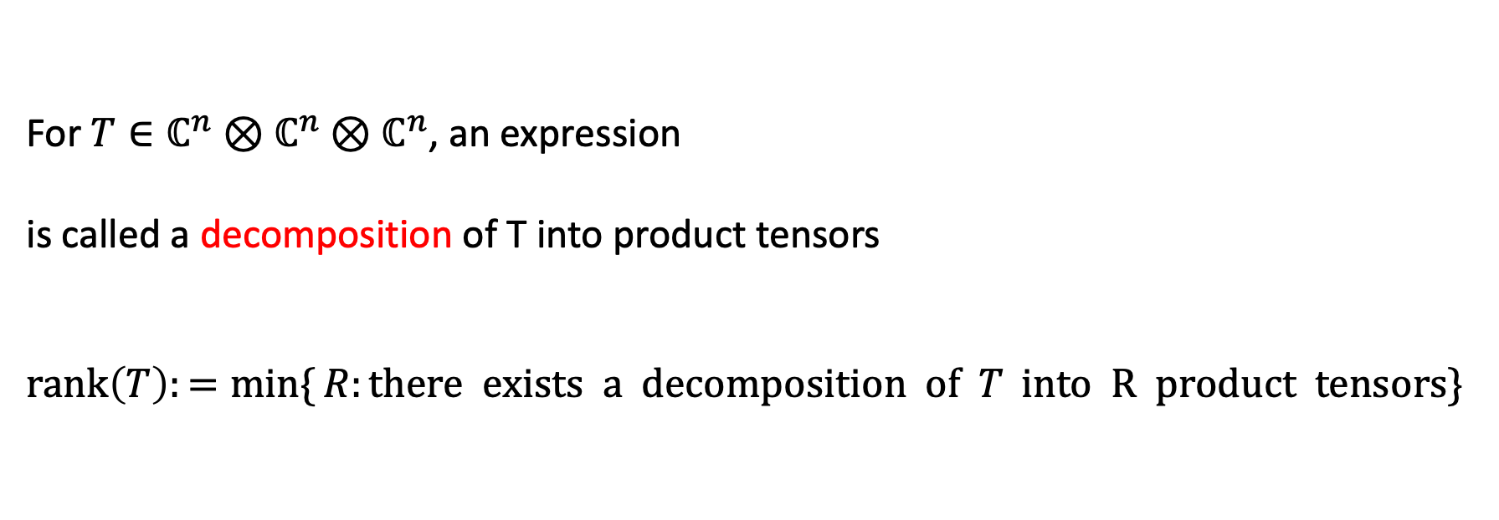
Tensor decompositions
For $T∈ℂ^{n}⊗ℂ^{n}⊗ℂ^{n}$, an expression
is called a decomposition of T into product tensors
$$\text{rank}\left(T\right):=\min{\{}R:there exists a decomposition of T \text{into} \text{R} \text{product} \text{tensors}\}$$
$$T=\sum_{a=1}^{R}{x_{a}}⊗y_{a}⊗z_{a}∈ℂ^{n}⊗ℂ^{n}⊗ℂ^{n}$$

Slide 13
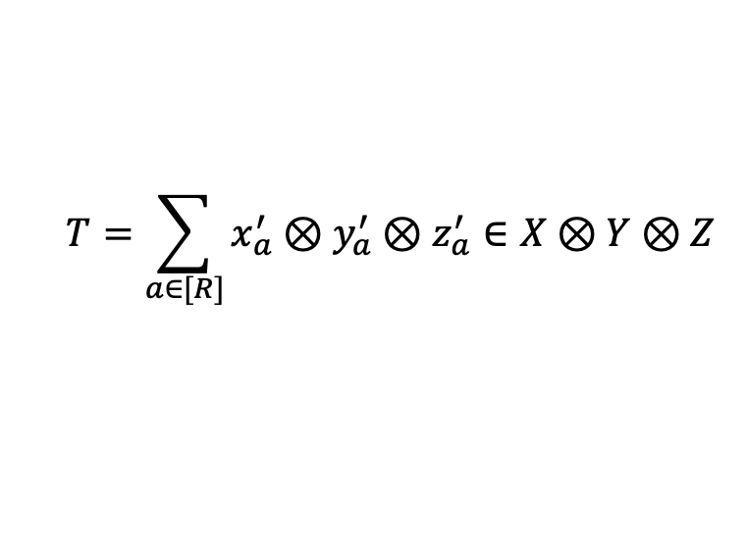
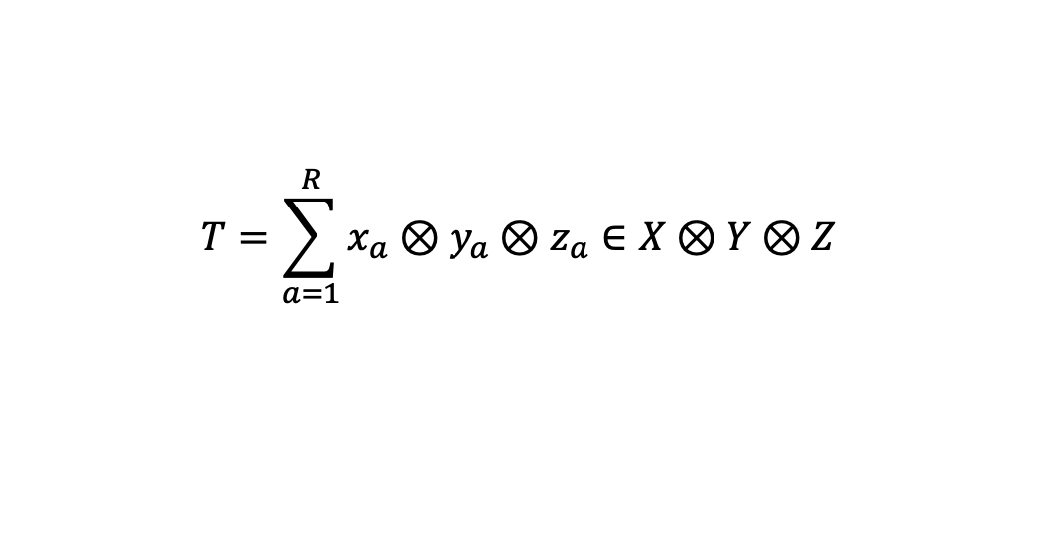
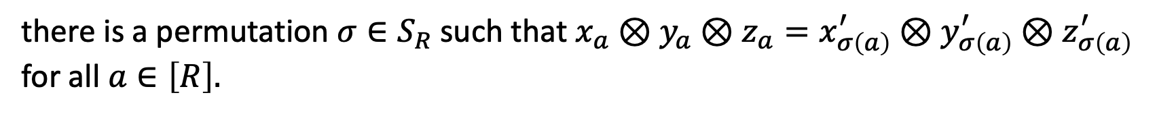
Uniqueness of tensor decompositions
A rank decomposition
$$T=\sum_{a=1}^{R}{x_{a}}⊗y_{a}⊗z_{a}∈X⊗Y⊗Z$$
is called the unique (rank) decomposition of T if for any other decomposition
$$T=\sum_{a∈[R]}{x_{a}^{′}}⊗y_{a}^{′}⊗z_{a}^{′}∈X⊗Y⊗Z$$
there is a permutation $σ∈S_{R}$ such that $x_{a}⊗y_{a}⊗z_{a}=x_{σ\left(a\right)}^{′}⊗y_{σ\left(a\right)}^{′}⊗z_{σ\left(a\right)}^{′}$ for all $a∈\left[R\right].$

Slide 16

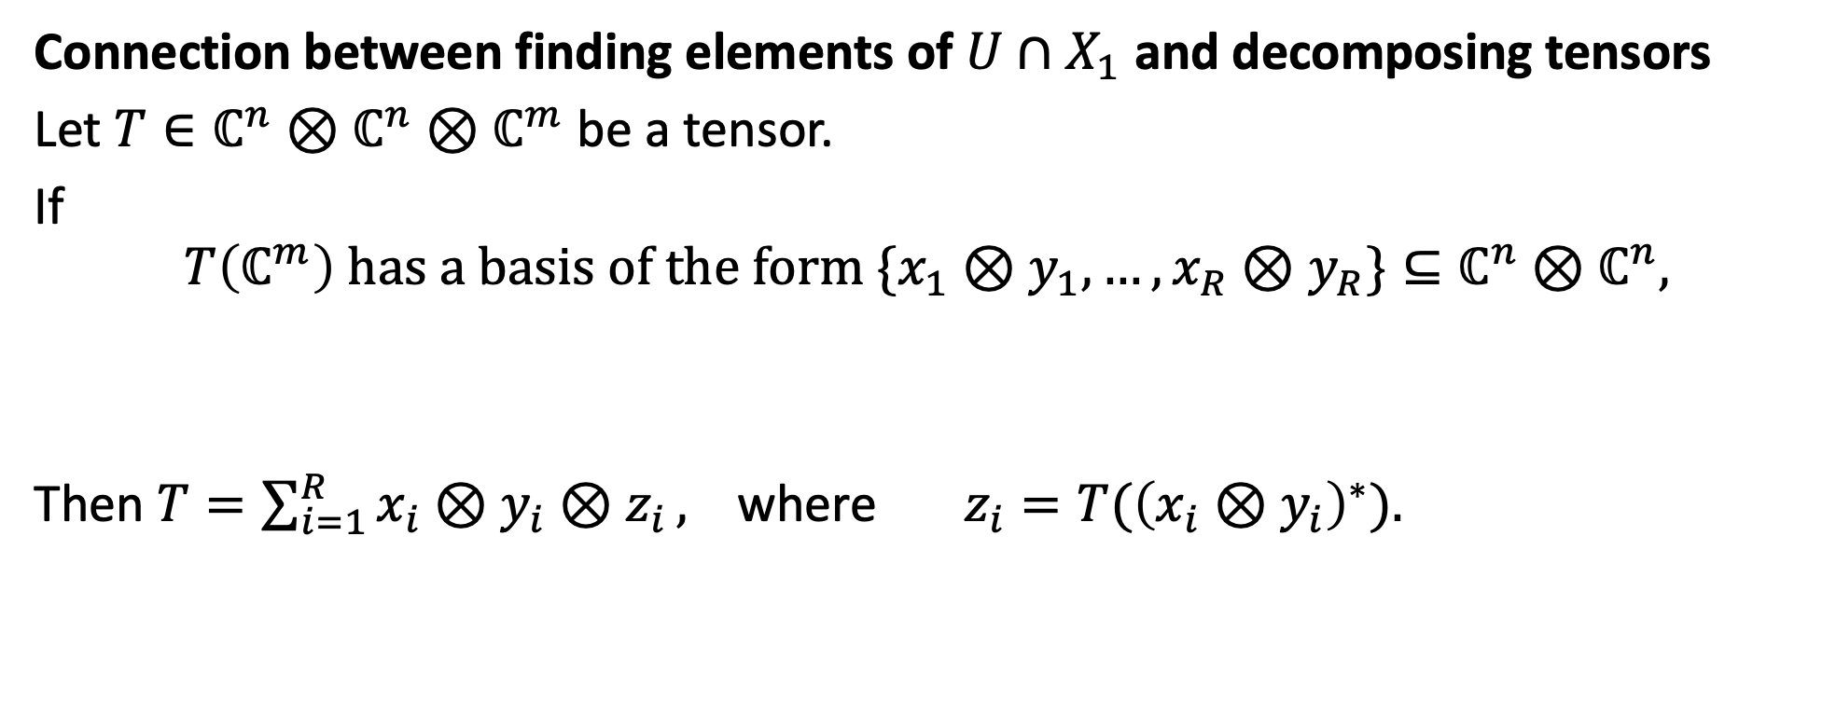
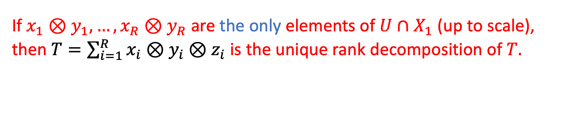
Connection between finding elements of $U∩X_{1}$ and decomposing tensors
Let $T∈ℂ^{n}⊗ℂ^{n}⊗ℂ^{m}$ be a tensor.
If
$$T\left(ℂ^{m}\right) has a basis of the form \{x_{1}⊗y_{1},…, x_{R}⊗y_{R}\}⊆ℂ^{n}⊗ℂ^{n},$$
Then $T=\sum_{i=1}^{R}{x_{i}⊗y_{i}⊗z_{i}},$ where $z_{i}=T({\left(x_{i}⊗y_{i}\right)}^{∗}).$
…So, algorithms for finding elements of $U∩X$ lead to tensor decomposition algorithms
If $x_{1}⊗y_{1},…, x_{R}⊗y_{R}$ are the only elements of $U∩X_{1}$ (up to scale), then $T=\sum_{i=1}^{R}{x_{i}⊗y_{i}⊗z_{i}}$ is the unique rank decomposition of $T.$

Slide 17

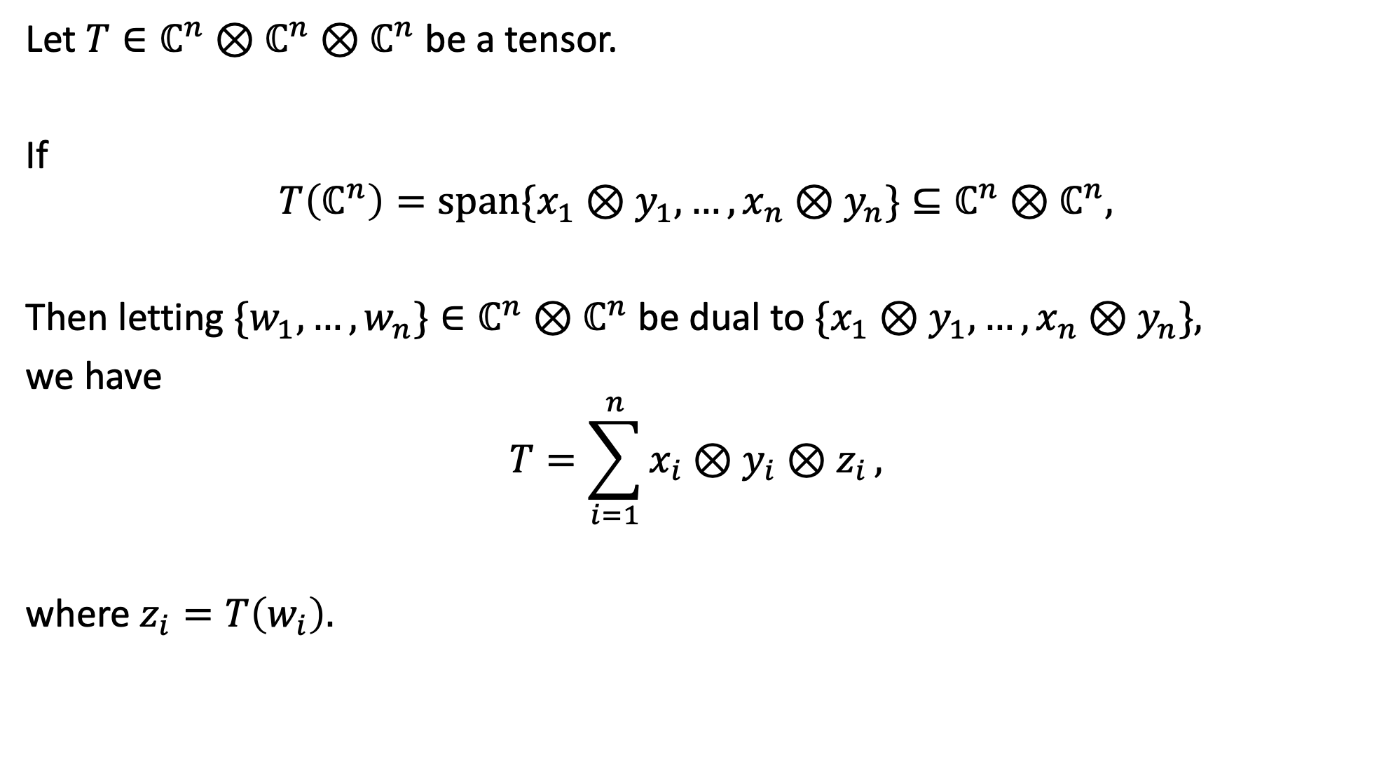
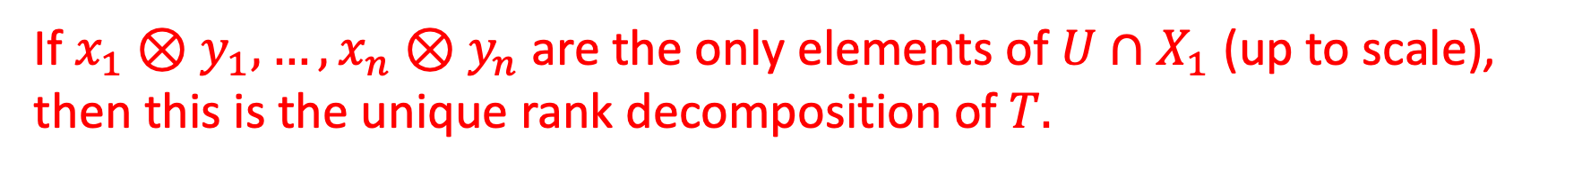
Let $T∈ℂ^{n}⊗ℂ^{n}⊗ℂ^{n}$ be a tensor.
If
$$T\left(ℂ^{n}\right)=span\{x_{1}⊗y_{1},…, x_{n}⊗y_{n}\}⊆ℂ^{n}⊗ℂ^{n},$$
Then letting $\{w_{1},…,w_{n}\}∈ℂ^{n}⊗ℂ^{n}$ be dual to $\{x_{1}⊗y_{1},…, x_{n}⊗y_{n}\},$
we have
$$T=\sum_{i=1}^{n}{x_{i}⊗y_{i}⊗z_{i}},$$
where $z_{i}=T\left(w_{i}\right).$
…So, algorithms for finding elements of $U∩X$ lead to tensor decomposition algorithms
If $x_{1}⊗y_{1},…, x_{n}⊗y_{n}$ are the only elements of $U∩X_{1}$ (up to scale), then this is the unique rank decomposition of $T.$

Slide 18

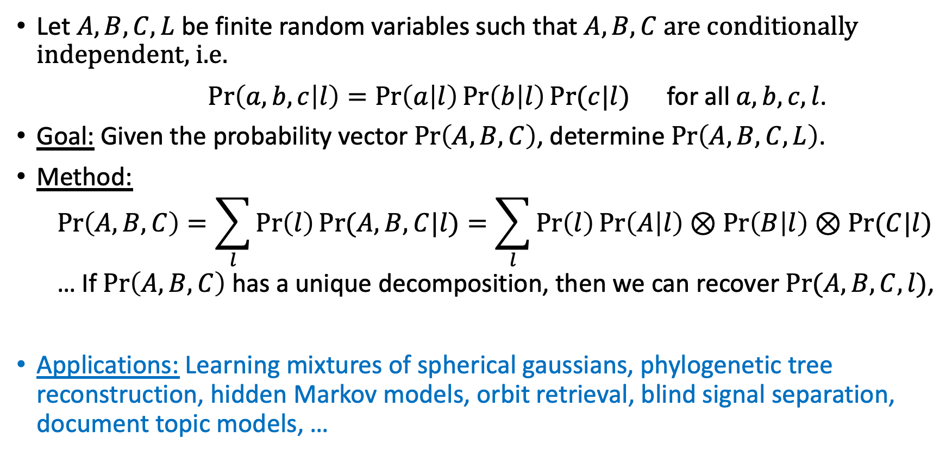
Application: Latent parameter learning
$L$ is for latent
Let $A,B,C,L$ be finite random variables such that $A,B,C$ are conditionally independent, i.e.
$Pr\left(a,b,c | l\right)=\operatorname{Pr}\left(a | l\right)\operatorname{Pr}\left(b | l\right)Pr⁡(c|l)$ for all $a,b,c,l$.
Goal: Given the probability vector $\operatorname{Pr}\left(A,B,C\right)$, determine $\operatorname{Pr}\left(A,B,C,L\right)$.
Method:
  $$\operatorname{Pr}\left(A,B,C\right)=\sum_{l}{\operatorname{Pr}\left(l\right)Pr⁡(A,B,C|l)}=\sum_{l}{\operatorname{Pr}\left(l\right)\operatorname{Pr}\left(A | l\right)⊗\operatorname{Pr}\left(B | l\right)⊗Pr⁡(C|l)}$$
  … If $\operatorname{Pr}\left(A,B,C\right)$ has a unique decomposition, then we can recover $\operatorname{Pr}{(A,B,C,l)}$,
Applications: Learning mixtures of spherical gaussians, phylogenetic tree reconstruction, hidden Markov models, orbit retrieval, blind signal separation, document topic models, …

Slide 19

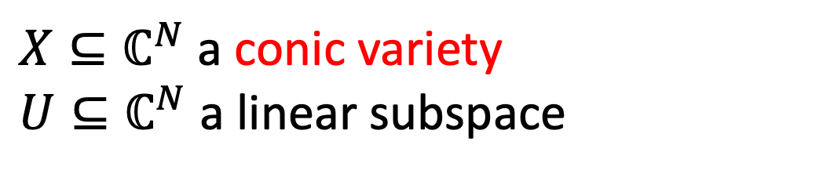
$X⊆ℂ^{N}$ a conic variety
$U⊆ℂ^{N}$ a linear subspace
Describe $U∩X?$
This talk: These problems are easy* if $U$ is generic and $\dim{(U)}$ is not too large
$$U$$
$$X$$
1. Certify $U∩X=\{0\}$
2. Compute $dist(U,X)$
3. Find elements of $U∩X$ (and show that these are the only ones)

Slide 20
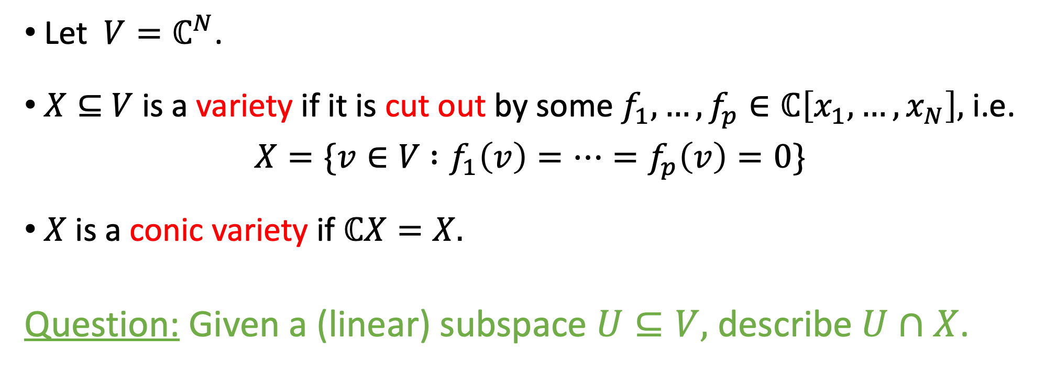
Intersecting a subspace with a variety
Let $V=ℂ^{N}$.
$X⊆$ $V$ is a variety if it is cut out by some $f_{1},…,f_{p}∈ℂ\left[x_{1},…,x_{N}\right],$ i.e.
$X=\{v∈V$ $:f_{1}\left(v\right)=…=f_{p}\left(v\right)=0\}$
$X$ is a conic variety if $ℂX=X.$
Question: Given a (linear) subspace $U⊆V,$ describe $U∩X$.

Slide 21
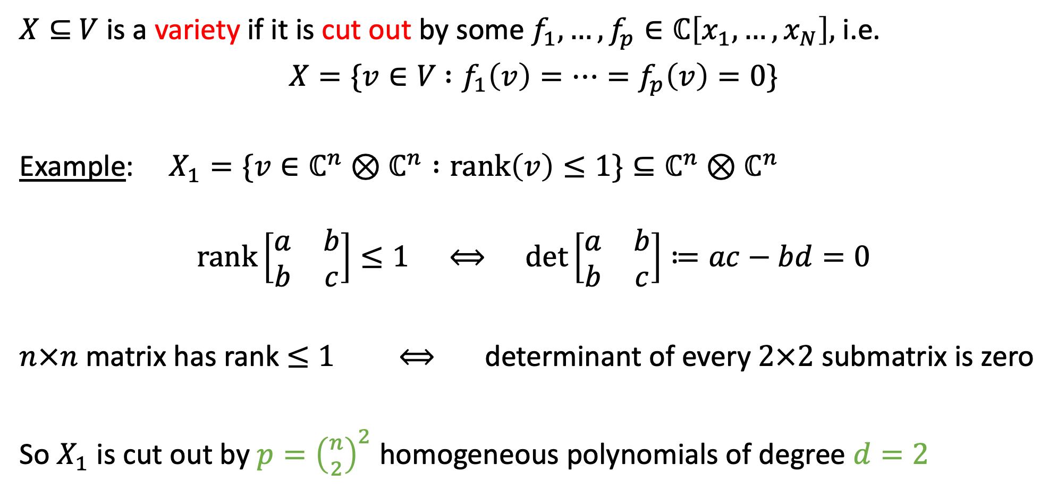
$X⊆$ $V$ is a variety if it is cut out by some $f_{1},…,f_{p}∈ℂ\left[x_{1},…,x_{N}\right],$ i.e.
$X=\{v∈V$ $:f_{1}\left(v\right)=…=f_{p}\left(v\right)=0\}$
Example: $X_{1}=\{v∈ℂ^{n}⊗ℂ^{n} :rank\left(v\right)≤1\}⊆ℂ^{n}⊗ℂ^{n}$
$$rank\left[\begin{matrix}a & b \\ b & c\end{matrix}\right]≤1 ⟺ \det\left[\begin{matrix}a & b \\ b & c\end{matrix}\right]≔ac−bd=0$$
$n×n$ matrix has rank $≤1$ $⟺$ determinant of every $2×2$ submatrix is zero
So $X_{1}$ is cut out by ${p=\left({n \atop 2}\right)}^{2}$ homogeneous polynomials of degree $d=2$

Slide 22
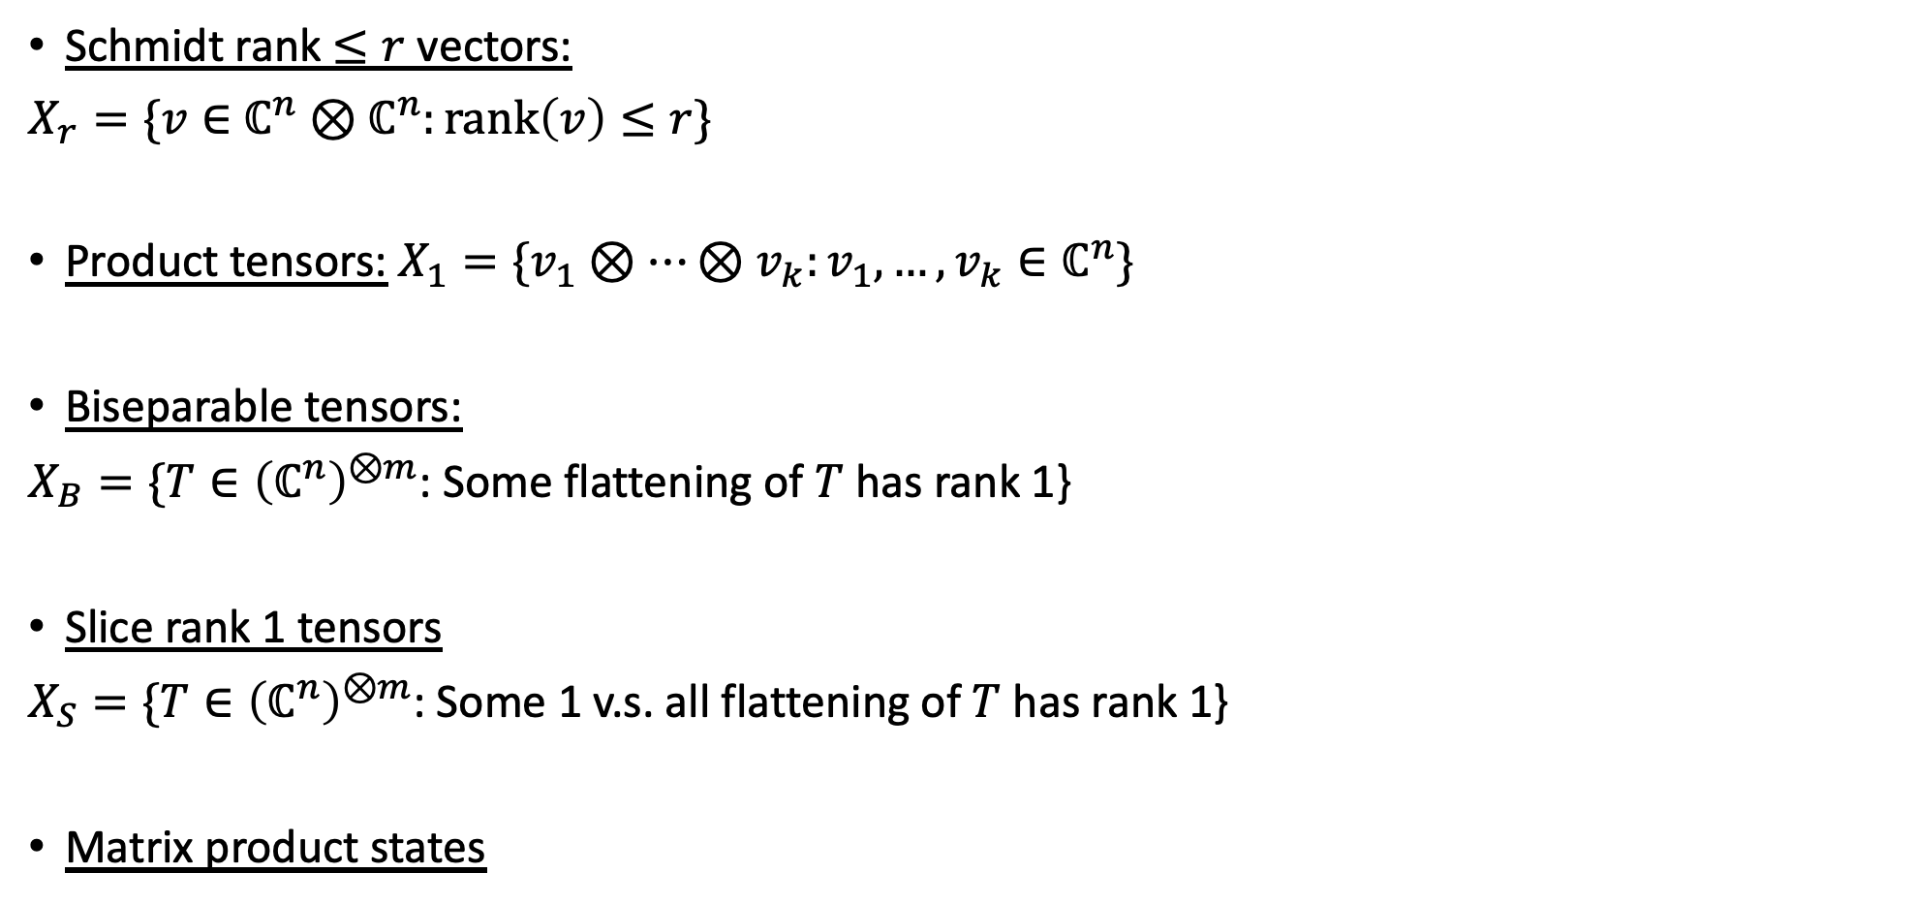
Other examples…
Schmidt rank $≤r$ vectors:
$X_{r}=\{v∈$ $ℂ^{n}⊗ℂ^{n}:\text{rank}\left(v\right)≤r\}$
Product tensors: $X_{1}=\{v_{1}⊗…⊗v_{k}:v_{1},…,v_{k}∈ℂ^{n}\}$
Biseparable tensors:
$X_{B}=\{T∈{\left(ℂ^{n}\right)}^{⊗m}$: Some flattening of $T$ has rank 1}
Slice rank 1 tensors
$X_{S}=\{T∈{\left(ℂ^{n}\right)}^{⊗m}$: Some 1 v.s. all flattening of $T$ has rank 1}
Matrix product states

Slide 23
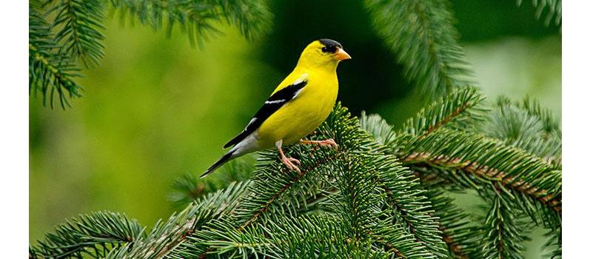
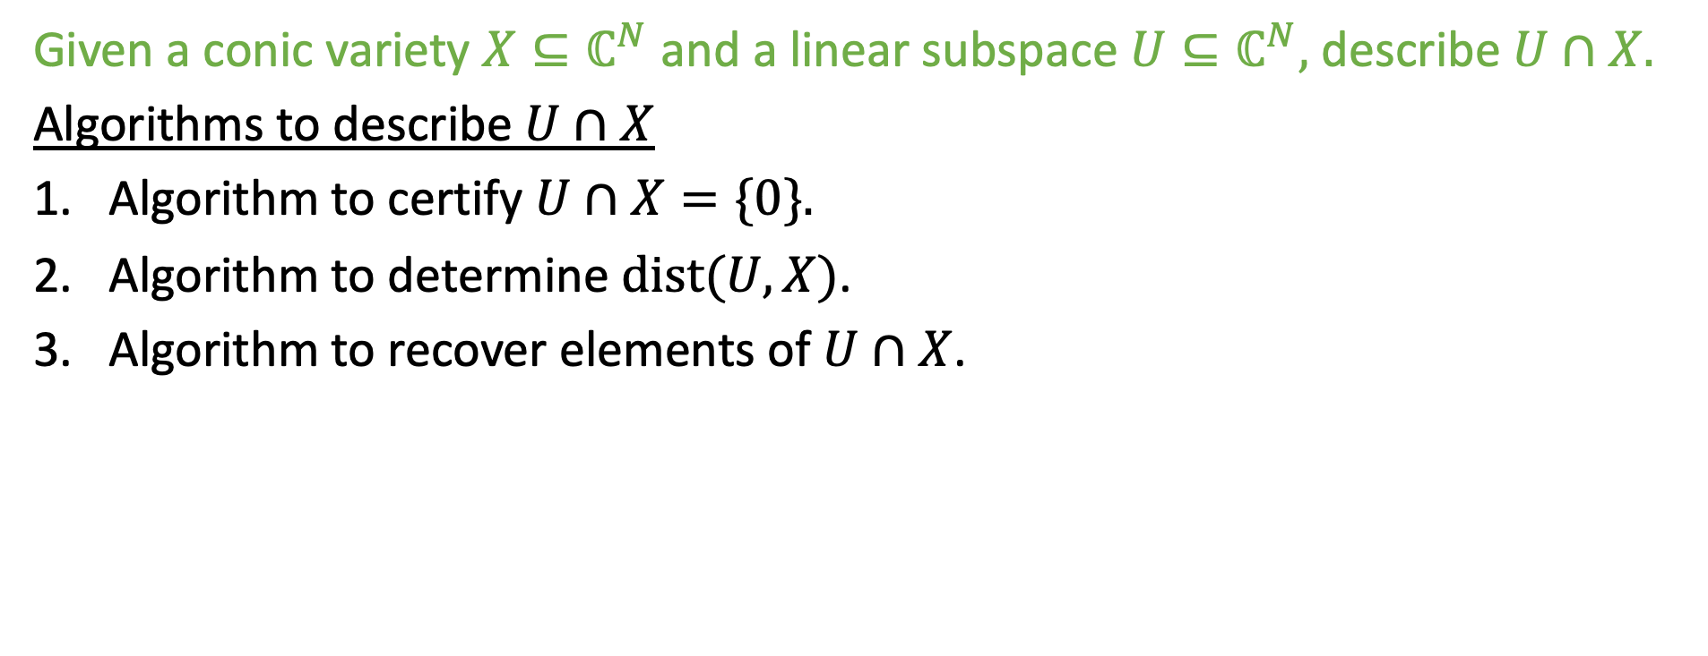
Outline
Given a conic variety $X⊆ℂ^{N}$ and a linear subspace $U⊆ℂ^{N},$ describe $U∩X.$
Algorithms to describe $U∩X$
Algorithm to certify $U∩X=\{0\}.$
Algorithm to determine $dist(U,X)$.
Algorithm to recover elements of $U∩X$.

Slide 24

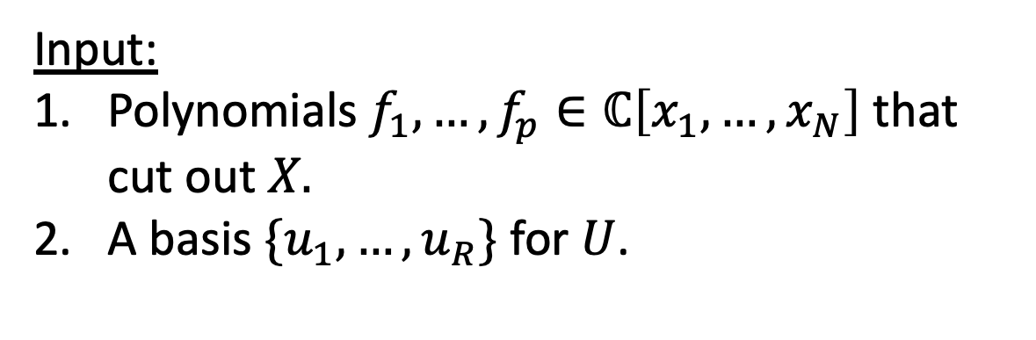


Part 1: Algorithm to certify $U∩X=\{0\}$
Input:
Polynomials $f_{1},…,f_{p}∈ℂ\left[x_{1},…,x_{N}\right]$ that cut out $X.$
A basis $\{u_{1},…,u_{R}\}$ for $U$.
$$U$$
$$X$$
Output: Proof that $U∩X=\{0\}$

Slide 25
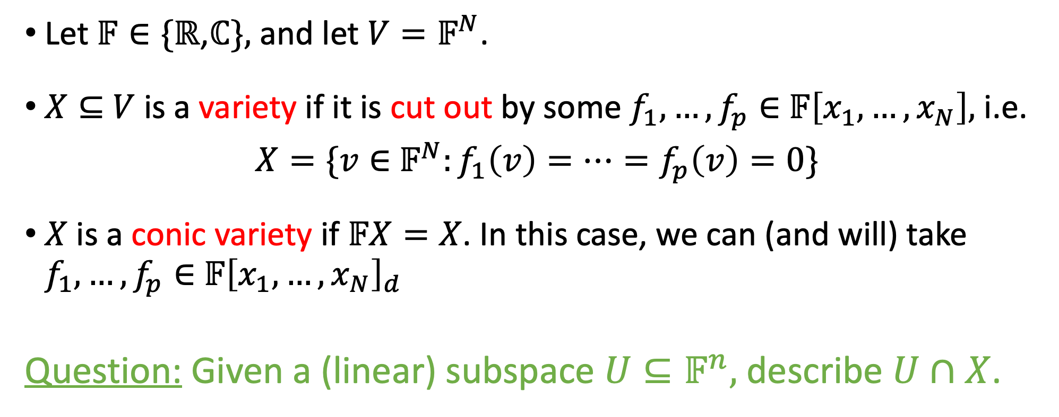

Intersecting a subspace with a variety
Let $𝔽∈\{ℝ$,$ℂ\},$ and let $V=𝔽^{N}$.
$X⊆$ $V$ is a variety if it is cut out by some $f_{1},…,f_{p}∈$ $𝔽\left[x_{1},…,x_{N}\right],$ i.e.
$X=\{v∈$ $𝔽^{N}:f_{1}\left(v\right)=…=f_{p}\left(v\right)=0\}$
$X$ is a conic variety if $𝔽X=X$. In this case, we can (and will) take $f_{1},…,f_{p}∈$ $𝔽{\left[x_{1},…,x_{N}\right]}_{d}$
Question: Given a (linear) subspace $U⊆𝔽^{n},$ describe $U∩X$.
Homogeneous degree-$d$ polynomials

Slide 26
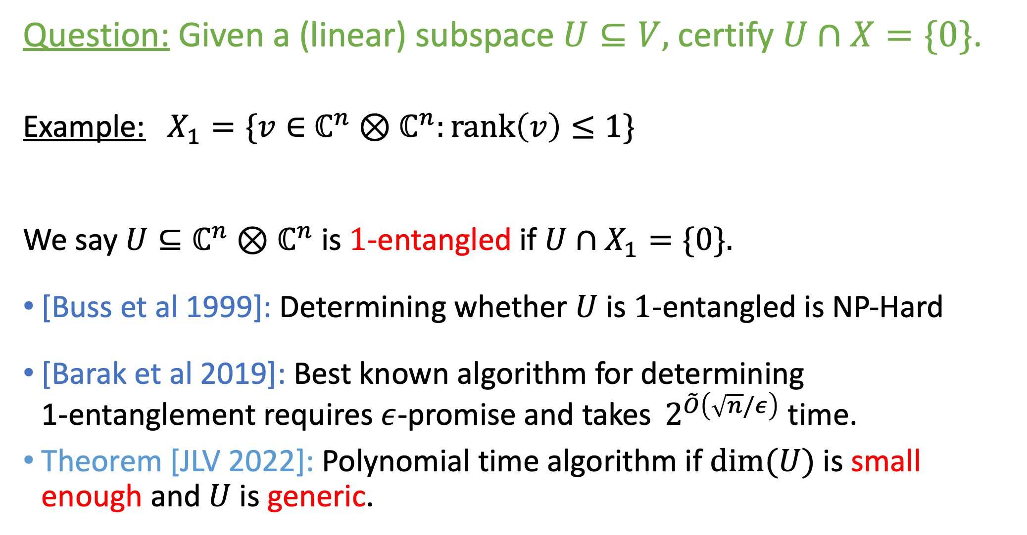
Question: Given a (linear) subspace $U⊆V,$ certify $U∩X=\{0\}$.
Example: $X_{1}=\{v∈$ $ℂ^{n}⊗ℂ^{n}:\text{rank}\left(v\right)≤1\}$
We say $U⊆ℂ^{n}⊗ℂ^{n}$is $1$-entangled if $U∩X_{1}=\{0\}.$
[Buss et al 1999]: Determining whether $U$ is $1$-entangled is NP-Hard
[Barak et al 2019]: Best known algorithm for determining 1-entanglement requires $ε$-promise and takes $⁡2^{\tilde{O}\left(\sqrt{n}/ε\right)}$ time.
Theorem [JLV 2022]: Polynomial time algorithm if $dim⁡(U)$ is small enough and $U$ is generic.
Schmidt rank

Slide 27
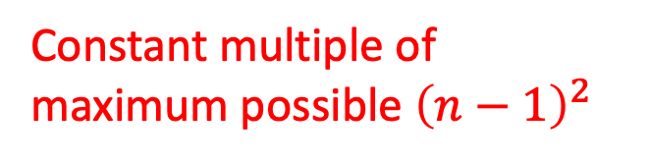
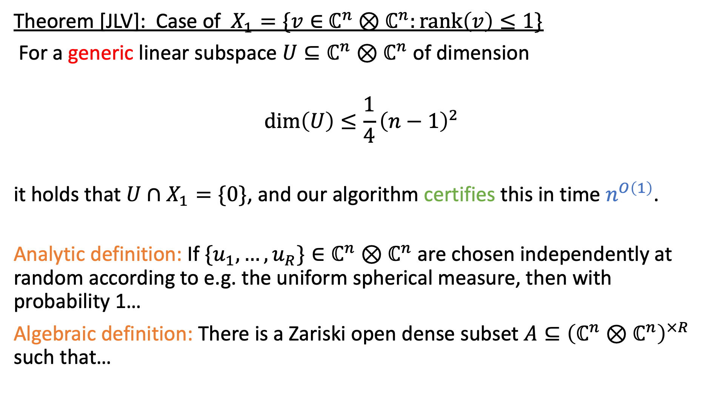
Theorem [JLV]: Case of $X_{1}=\{v∈$ $ℂ^{n}⊗ℂ^{n}:\text{rank}\left(v\right)≤1\}$
For a generic linear subspace $U⊆ℂ^{n}⊗ℂ^{n}$ of dimension
$$\dim\left(U\right)≤\frac{1}{4}{\left(n−1\right)}^{2}$$
it holds that $U∩X_{1}=\{0\}$, and our algorithm certifies this in time $n^{O\left(1\right)}$.
Analytic definition: If $\{u_{1},…,u_{R}\}∈ℂ^{n}⊗ℂ^{n}$ are chosen independently at random according to e.g. the uniform spherical measure, then with probability 1…
Algebraic definition: There is a Zariski open dense subset $A⊆{\left(ℂ^{n}⊗ℂ^{n}\right)}^{×R}$ such that…
Constant multiple of maximum possible ${\left(n−1\right)}^{2}$

Slide 28
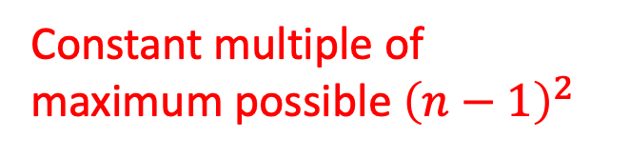
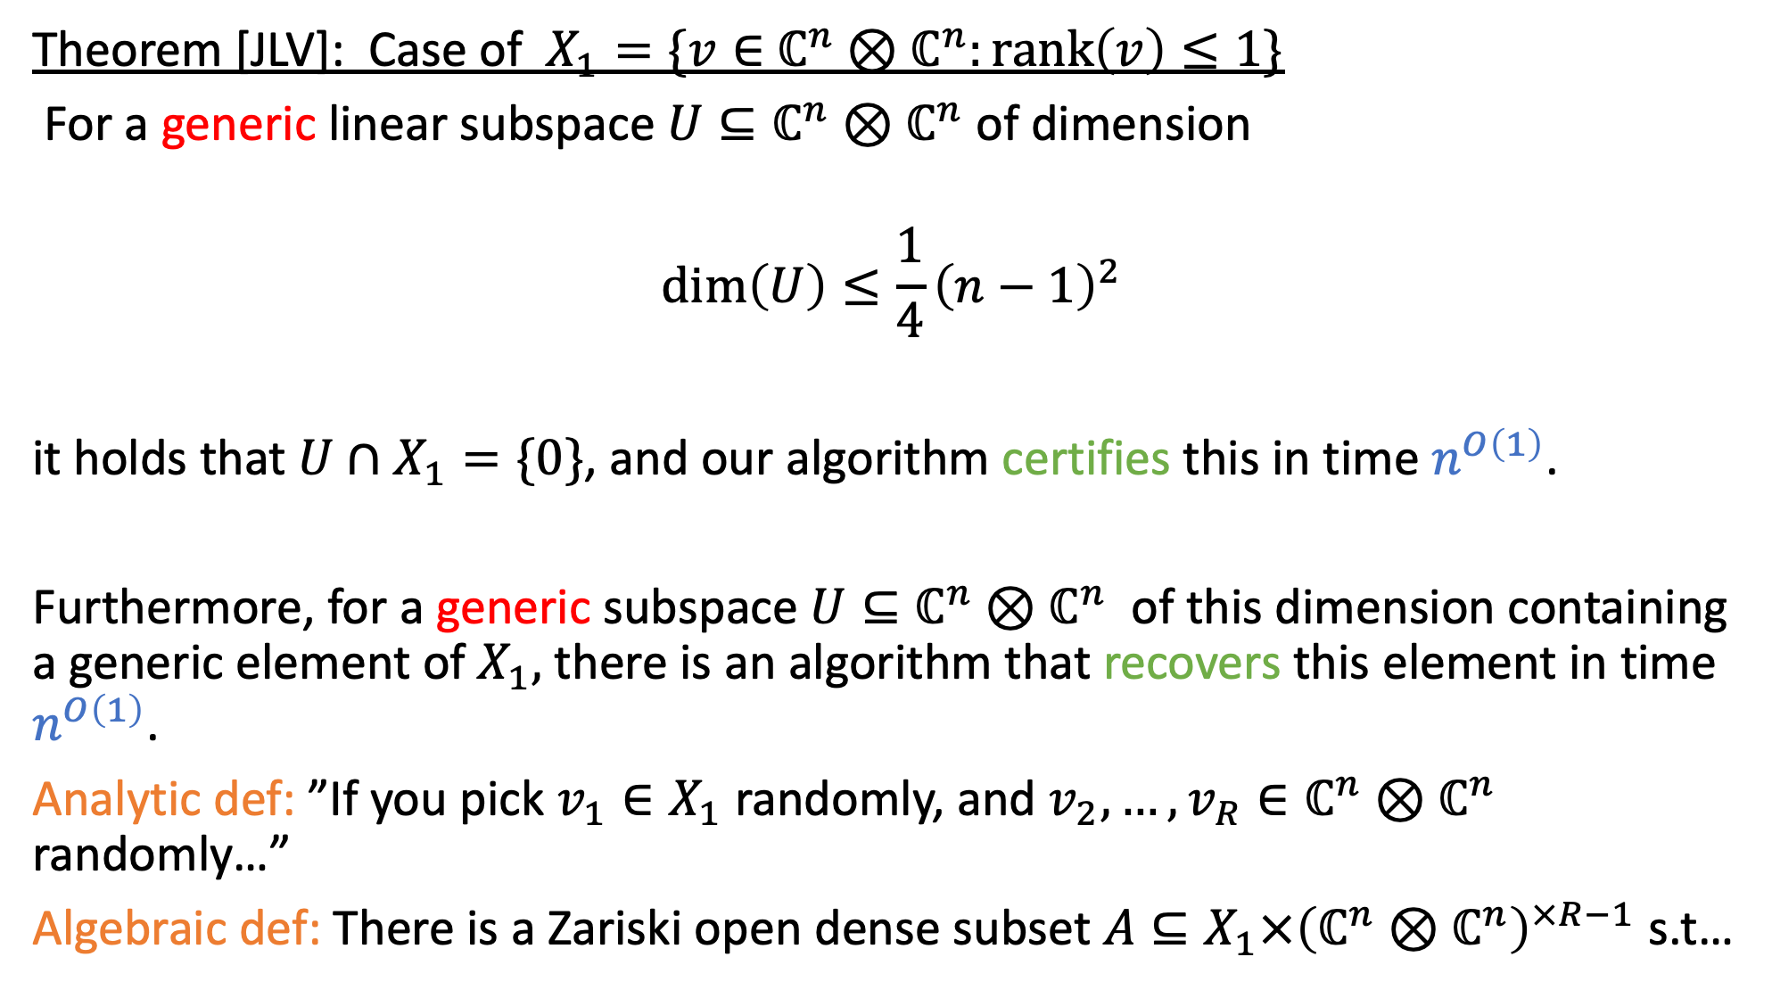
Theorem [JLV]: Case of $X_{1}=\{v∈$ $ℂ^{n}⊗ℂ^{n}:\text{rank}\left(v\right)≤1\}$
For a generic linear subspace $U⊆ℂ^{n}⊗ℂ^{n}$ of dimension
$$\dim\left(U\right)≤\frac{1}{4}{\left(n−1\right)}^{2}$$
it holds that $U∩X_{1}=\{0\}$, and our algorithm certifies this in time $n^{O\left(1\right)}$.
Furthermore, for a generic subspace $U⊆ℂ^{n}⊗ℂ^{n}$ of this dimension containing a generic element of $X_{1},$ there is an algorithm that recovers this element in time $n^{O\left(1\right)}$.
Analytic def: ”If you pick $v_{1}∈X_{1}$ randomly, and $v_{2},…,v_{R}∈ℂ^{n}⊗ℂ^{n}$ randomly…”
Algebraic def: There is a Zariski open dense subset $A⊆{X_{1}×\left(ℂ^{n}⊗ℂ^{n}\right)}^{×R−1}$ s.t…
Constant multiple of maximum possible ${\left(n−1\right)}^{2}$

Slide 29

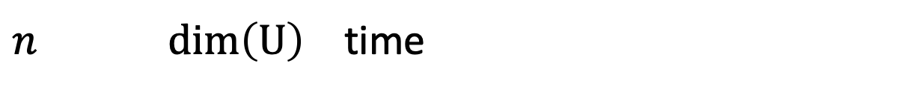
Algorithm performance to certify $U∩X_{1}=\{0\}$
$n$ $dim\left(U\right)$ time

Slide 30
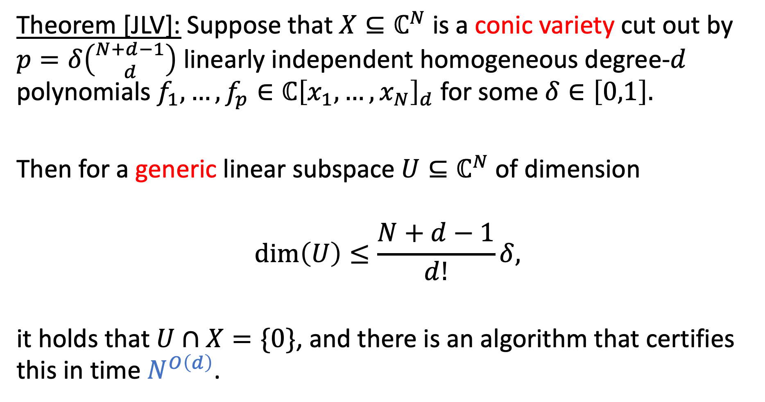

More general statement for arbitrary $X$
Theorem [JLV]: Suppose that $X⊆ℂ^{N}$ is a conic variety cut out by $p=δ\left({N+d−1 \atop d}\right)$ linearly independent homogeneous degree-$d$ polynomials $f_{1},…,f_{p}∈ℂ{\left[x_{1},…,x_{N}\right]}_{d}$ for some $δ∈\left[0,1\right].$
Then for a generic linear subspace $U⊆ℂ^{N}$ of dimension
$$\dim\left(U\right)≤\frac{N+d−1}{d!}δ,$$
it holds that $U∩X=\{0\}$, and there is an algorithm that certifies this in time $N^{O\left(d\right)}$.

Slide 31
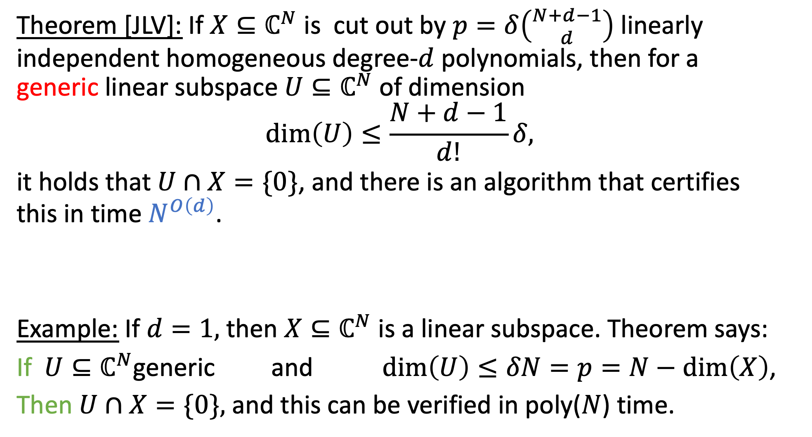

Theorem [JLV]: If $X⊆ℂ^{N}$ is cut out by $p=δ\left({N+d−1 \atop d}\right)$ linearly independent homogeneous degree-$d$ polynomials, then for a generic linear subspace $U⊆ℂ^{N}$ of dimension
$$\dim\left(U\right)≤\frac{N+d−1}{d!}δ,$$
it holds that $U∩X=\{0\}$, and there is an algorithm that certifies this in time $N^{O\left(d\right)}$.
Example: If $d=1,$ then $X⊆ℂ^{N}$ is a linear subspace. Theorem says:
If $U{⊆ℂ}^{N}$generic and $\dim\left(U\right)≤δN=p=N−\dim\left(X\right)$,
Then $U∩X=\{0\},$ and this can be verified in poly($N$) time.
Not bad: Takes $\left({N+d−1 \atop d}\right)$ time just to read off degree-$d$ polynomials

Slide 32
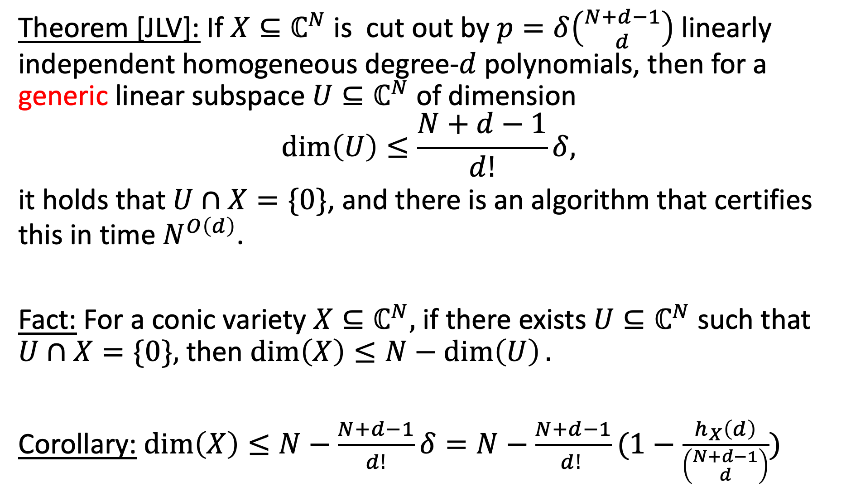



Theorem [JLV]: If $X⊆ℂ^{N}$ is cut out by $p=δ\left({N+d−1 \atop d}\right)$ linearly independent homogeneous degree-$d$ polynomials, then for a generic linear subspace $U⊆ℂ^{N}$ of dimension
$$\dim\left(U\right)≤\frac{N+d−1}{d!}δ,$$
it holds that $U∩X=\{0\}$, and there is an algorithm that certifies this in time $N^{O\left(d\right)}$.
Fact: For a conic variety $X⊆ℂ^{N},$ if there exists $U⊆ℂ^{N}$ such that $U∩X=\{0\},$ then $\dim\left(X\right)≤N−\dim\left(U\right).$
Corollary: $\dim\left(X\right)≤N−\frac{N+d−1}{d!}δ=N−\frac{N+d−1}{d! }(1−\frac{h_{X}\left(d\right)}{\left({N+d−1 \atop d}\right)})$
Hilbert function of $X$
Krull dimension of $X$
Maximize $δ$

Slide 33
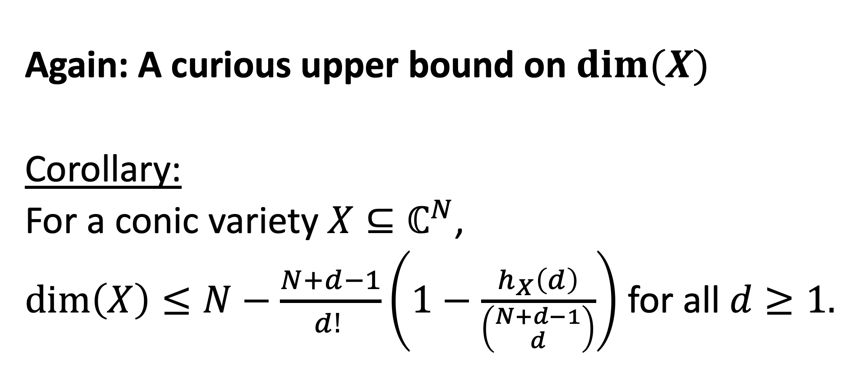
Again: A curious upper bound on $dim⁡(X)$
Corollary:
For a conic variety $X⊆ℂ^{N}$,
$\dim\left(X\right)≤N−\frac{N+d−1}{d! }\left(1−\frac{h_{X}\left(d\right)}{\left({N+d−1 \atop d}\right)}\right)$ for all $d≥1.$

Slide 34
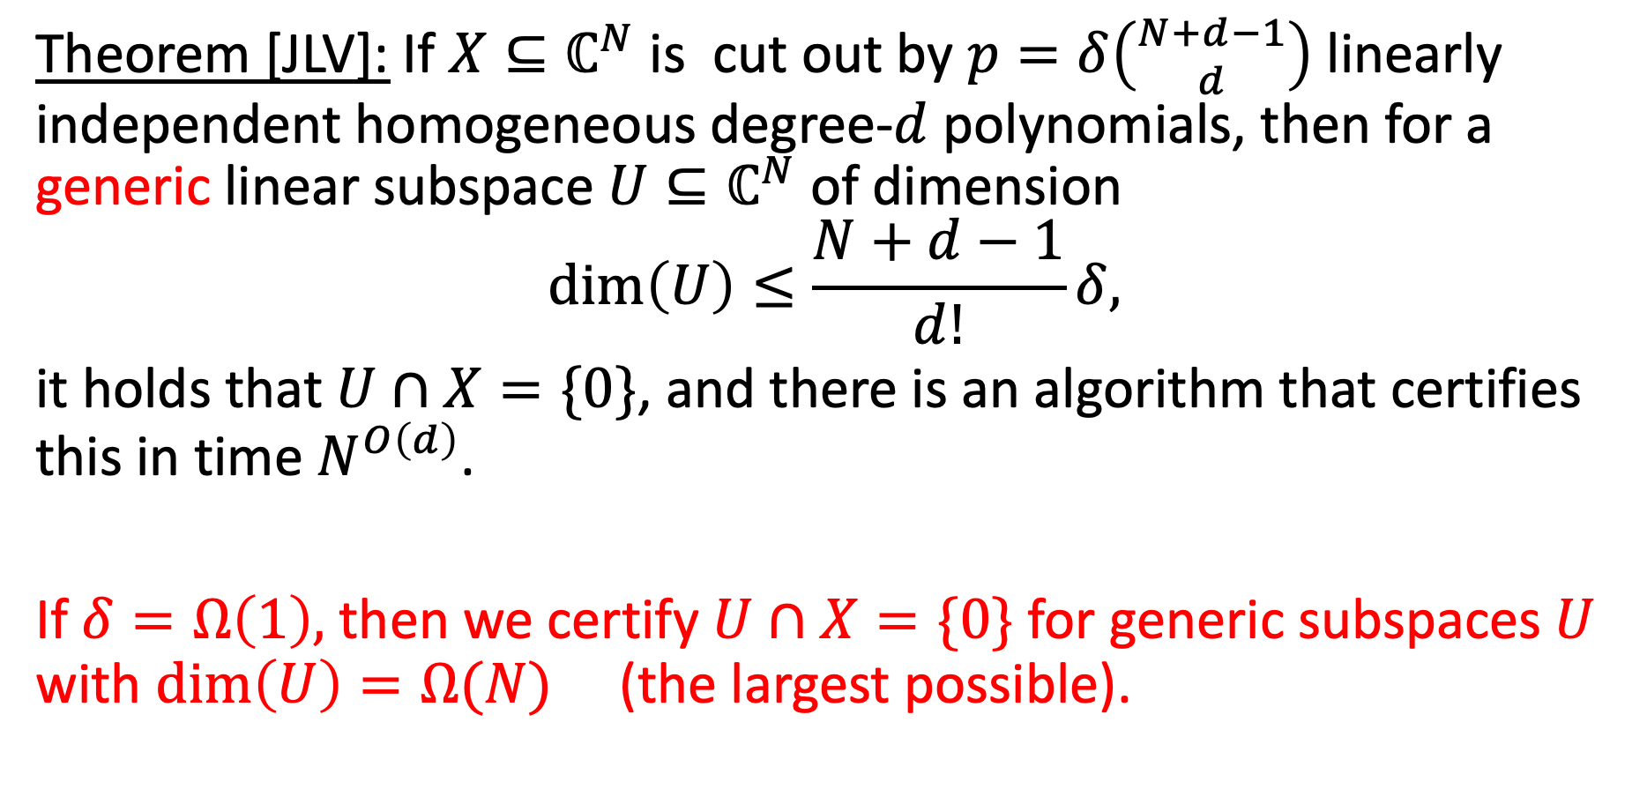
Theorem [JLV]: If $X⊆ℂ^{N}$ is cut out by $p=δ\left({N+d−1 \atop d}\right)$ linearly independent homogeneous degree-$d$ polynomials, then for a generic linear subspace $U⊆ℂ^{N}$ of dimension
$$\dim\left(U\right)≤\frac{N+d−1}{d!}δ,$$
it holds that $U∩X=\{0\}$, and there is an algorithm that certifies this in time $N^{O\left(d\right)}$.
If $δ=Ω\left(1\right),$ then we certify $U∩X=\{0\}$ for generic subspaces $U$ with $\dim\left(U\right)=Ω(N)$ (the largest possible).

Slide 35
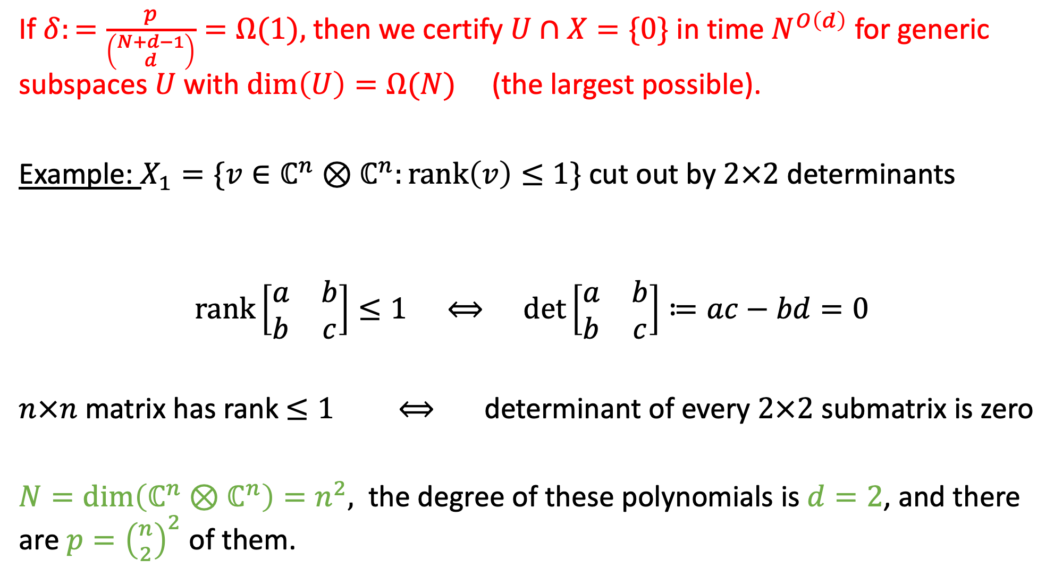
If $δ:=\frac{p}{\left({N+d−1 \atop d}\right)}=Ω(1),$ then we certify $U∩X=\{0\}$ in time $N^{O\left(d\right)}$ for generic subspaces $U$ with $\dim\left(U\right)=Ω(N)$ (the largest possible).
Example: $X_{1}=\{v∈ℂ^{n}⊗ℂ^{n}:rank\left(v\right)≤1\}$ cut out by $2×2$ determinants
$$rank\left[\begin{matrix}a & b \\ b & c\end{matrix}\right]≤1 ⟺ \det\left[\begin{matrix}a & b \\ b & c\end{matrix}\right]≔ac−bd=0$$
$n×n$ matrix has rank $≤1$ $⟺$ determinant of every $2×2$ submatrix is zero
$N=\dim\left(ℂ^{n}⊗ℂ^{n}\right)=n^{2},$ the degree of these polynomials is $d=2$, and there are ${p=\left({n \atop 2}\right)}^{2}$ of them.

Slide 36
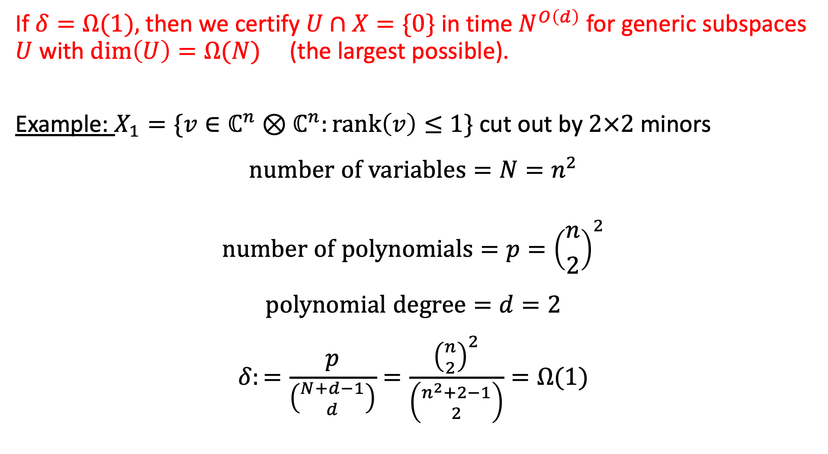
If $δ=Ω(1),$ then we certify $U∩X=\{0\}$ in time $N^{O\left(d\right)}$ for generic subspaces $U$ with $\dim\left(U\right)=Ω(N)$ (the largest possible).
Example: $X_{1}=\{v∈ℂ^{n}⊗ℂ^{n}:rank\left(v\right)≤1\}$ cut out by $2×2$ minors
$$number of variables=N=n^{2}$$
$$number of polynomials=p={\left({n \atop 2}\right)}^{2}$$
$$polynomial degree=d=2$$
$$δ:=\frac{p}{\left({N+d−1 \atop d}\right)}=\frac{{\left({n \atop 2}\right)}^{2}}{\left({n^{2}+2−1 \atop 2}\right)}=Ω(1)$$
So we certify $U∩X_{1}=\{0\}$ in time $n^{O\left(d\right)}$ for generic subspaces $U$ with $\dim\left(U\right)=Ω(n^{2})$

Slide 37

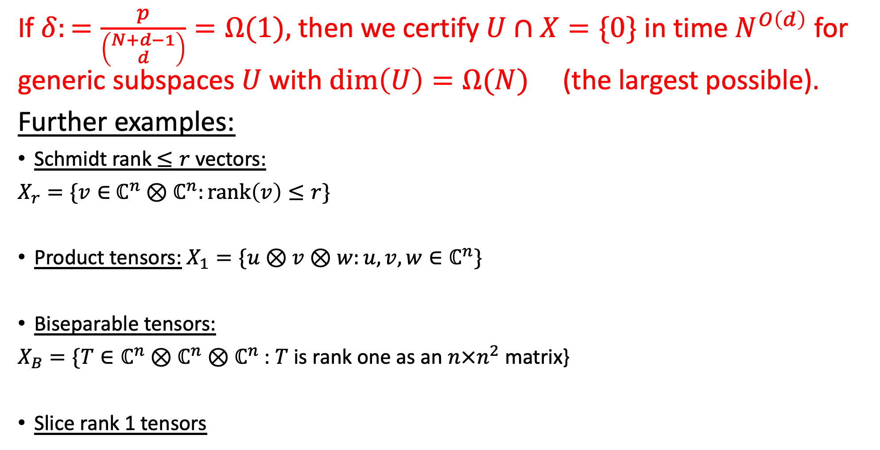
If $δ:=\frac{p}{\left({N+d−1 \atop d}\right)}=Ω(1),$ then we certify $U∩X=\{0\}$ in time $N^{O\left(d\right)}$ for generic subspaces $U$ with $\dim\left(U\right)=Ω(N)$ (the largest possible).
Further examples:
Schmidt rank $≤r$ vectors:
$X_{r}=\{v∈$ $ℂ^{n}⊗ℂ^{n}:\text{rank}\left(v\right)≤r\}$
Product tensors: $X_{1}=\{u⊗v⊗w:u,v,w∈ℂ^{n}\}$
Biseparable tensors:
$X_{B}=\{T∈ℂ^{n}⊗ℂ^{n}⊗ℂ^{n}$ : $T$ is rank one as an $n×n^{2}$ matrix}
Slice rank 1 tensors
$$\dim\left(U\right)=Ω_{r}\left(n^{2}\right)$$
$$\dim\left(U\right)=Ω\left(n^{3}\right)$$
$$\dim\left(U\right)=Ω\left(n^{3}\right)$$
$$\dim\left(U\right)=Ω\left(n^{3}\right)$$

Slide 38
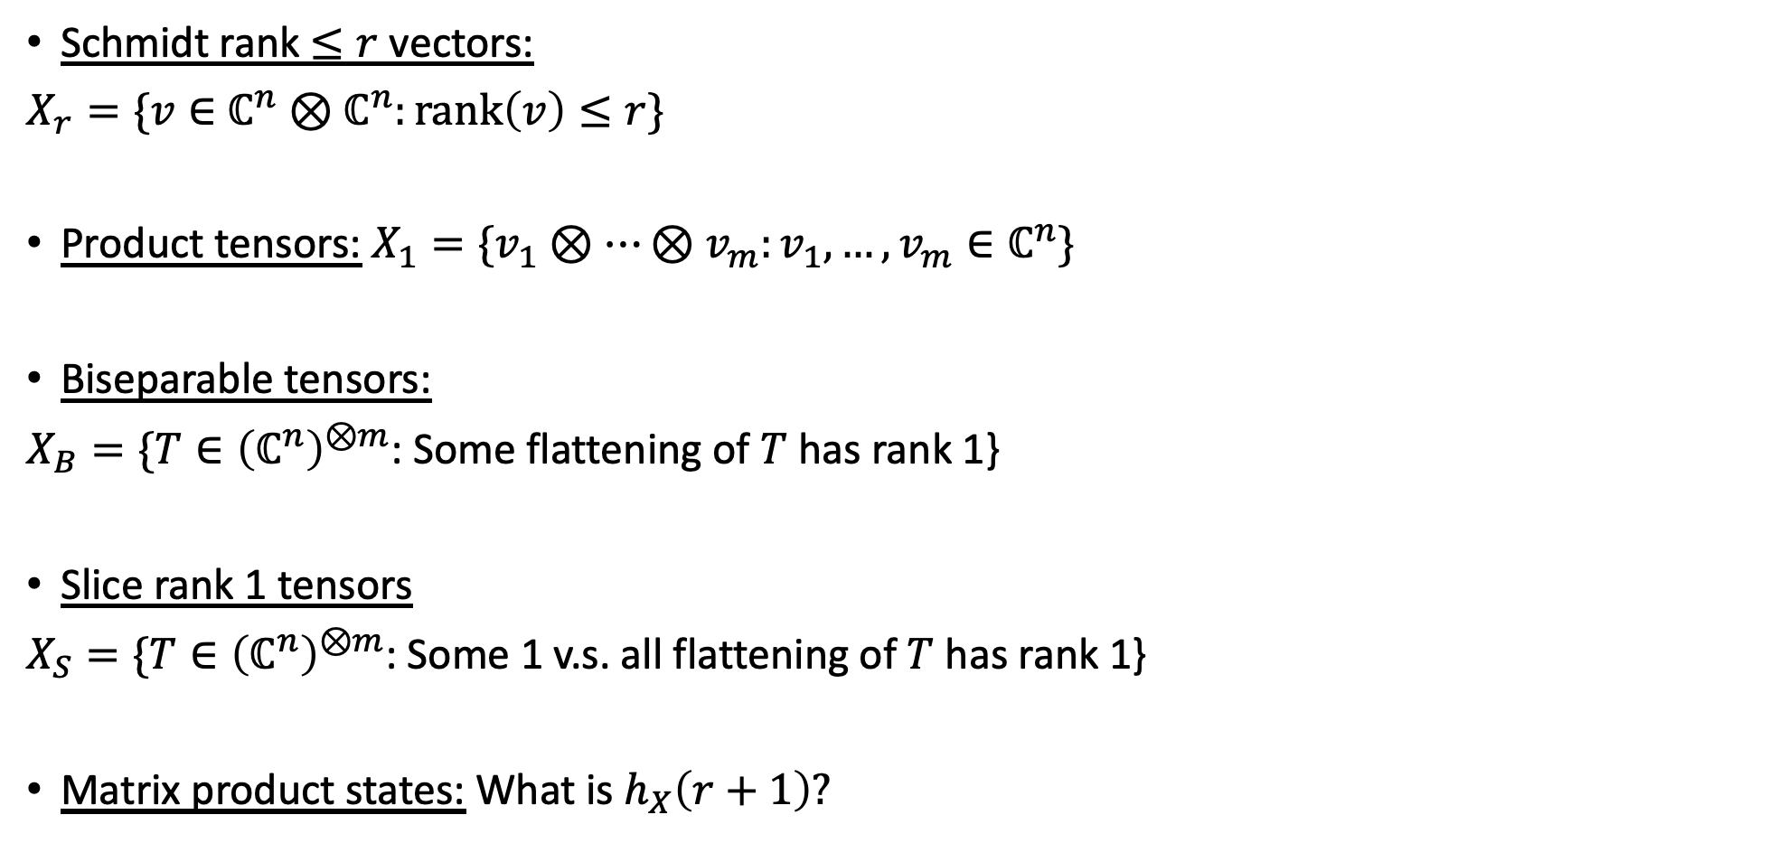

Other examples…
All in poly(N) time
Schmidt rank $≤r$ vectors:
$X_{r}=\{v∈$ $ℂ^{n}⊗ℂ^{n}:\text{rank}\left(v\right)≤r\}$
Product tensors: $X_{1}=\{v_{1}⊗…⊗v_{m}:v_{1},…,v_{m}∈ℂ^{n}\}$
Biseparable tensors:
$X_{B}=\{T∈{\left(ℂ^{n}\right)}^{⊗m}$: Some flattening of $T$ has rank 1}
Slice rank 1 tensors
$X_{S}=\{T∈{\left(ℂ^{n}\right)}^{⊗m}$: Some 1 v.s. all flattening of $T$ has rank 1}
Matrix product states: What is $h_{X}\left(r+1\right)?$
$$\dim\left(U\right)=Ω_{r}\left(n^{2}\right)$$
$$\dim\left(U\right)\sim \frac{1}{4}n^{m}$$
$$\dim\left(U\right)\sim \frac{1}{4}n^{m}$$
$$\dim\left(U\right)\sim \frac{1}{4}n^{m}$$
$$\dim\left(U\right)\sim \frac{1}{4}n^{m}$$

Slide 39
The Algorithm (Nullstellensatz Certificate)

Slide 40
Part 1: Algorithm to certify $U∩X=\{0\}$
Input:
Polynomials $f_{1},…,f_{p}∈ℂ\left[x_{1},…,x_{N}\right]$ that cut out $X.$
A basis $\{u_{1},…,u_{R}\}$ for $U$.
$$U$$
$$X$$
Output: Proof that $U∩X=\{0\}$

Slide 41


Question: Given a conic variety $X⊆V$ cut out by
$f_{1},…,f_{p}∈𝔽\left[x_{1},…,x_{N}\right],$
and a basis $\{u_{1},…,u_{R}\}$ for a subspace $U⊆𝔽^{N},$ describe $U∩X.$
Example: $X_{r}=\{v∈$ $𝔽^{n}⊗𝔽^{n}:\text{rank}\left(v\right)≤r\}$
We say $U∈𝔽^{n}⊗𝔽^{n}$is $r$-entangled if $U∩X_{r}=\{0\}.$
[Buss et al 1999]: Determining whether $U$ is $r$-entangled is NP-Hard
[Barak et al 2019]: Best known algorithm for $X_{1}$requires $ε$-promise and takes $⁡2^{\tilde{O}\left(\sqrt{n}/ε\right)}$ time.
Rank when $v$ is viewed as an $n×n$ matrix

Slide 42

Outline
Given a conic variety $X⊆ℂ^{N}$ and a linear subspace $U⊆ℂ^{N},$ describe $U∩X.$
Part 1: Algorithms to describe $U∩X$
Algorithm to determine whether $U∩X=\{0\}.$
Algorithm to recover elements of $U∩X$.
Algorithm to determine $dist(U,X)$.
Part 2: Genericity guarantees for algorithms 1 & 2
Algorithms 1 & 2 take poly(N) time in most cases.

Slide 43

The symmetric subspace
Let $S^{d}\left(V\right)⊆V^{⊗d}$ be the symmetric subspace
$S^{d}\left(V\right)=${$T={\left(T_{i_{1},…,i_{d}}\right)}_{i_{j}∈\left[N\right]}∈V^{⊗d}: σ\left(T\right)≔{\left(T_{i_{σ\left(1\right)},…,i_{σ\left(d\right)}}\right)}_{i_{j}∈\left[N\right]}=T ∀σ∈𝔖_{d}$}
Example: $v^{⊗d}∈S^{d}(V)$ for all $v∈V$
Example: $v_{1}⊗v_{2}+v_{2}⊗v_{1}∈S^{2}\left(V\right)$ for all $v_{1},v_{2}∈V$
Non-example: $v_{1}⊗v_{2}−v_{2}⊗v_{1}∉S^{2}\left(V\right)$

Slide 44

The symmetric subspace
Let $S^{d}\left(V\right)⊆V^{⊗d}$ be the symmetric subspace
$S^{d}\left(V\right)=${$T={\left(T_{i_{1},…,i_{d}}\right)}_{i_{j}∈\left[N\right]}∈V^{⊗d}:T={\left(T_{i_{σ\left(1\right)},…,i_{σ\left(d\right)}}\right)}_{i_{j}∈\left[N\right]} \text{for} \text{all} σ∈𝔖_{d}$}
$P_{d,V}^{∨}:V^{⊗d}→V^{⊗d}$ orthogonal projection onto $S^{d}\left(V\right)$

Slide 45

The symmetric subspace
Let $S^{d}\left(V\right)⊆V^{⊗d}$ be the symmetric subspace
$S^{d}\left(V\right)=${$T={\left(T_{i_{1},…,i_{d}}\right)}_{i_{j}∈\left[N\right]}∈V^{⊗d}:T={\left(T_{i_{σ\left(1\right)},…,i_{σ\left(d\right)}}\right)}_{i_{j}∈\left[N\right]} \text{for} \text{all} σ∈𝔖_{d}$}
$P_{d}^{∨}:V^{⊗d}→V^{⊗d}$ orthogonal projection onto $S^{d}\left(V\right)$
$$P_{d}^{∨}=\frac{1}{d!}\sum_{1≤i_{1}≤…≤i_{d}≤N}{\left(\sum_{σ∈𝔖_{d}}{|i_{σ\left(1\right)}⋯i_{σ\left(d\right)}⟩}\right)\left(\sum_{σ∈𝔖_{d}}{\left\langle i_{σ\left(1\right)}⋯i_{σ\left(d\right)}\right|}\right)}$$

Slide 46

The symmetric subspace
Let $S^{d}\left(V\right)⊆V^{⊗d}$ be the symmetric subspace
$S^{d}\left(V\right)=${$T={\left(T_{i_{1},…,i_{d}}\right)}_{i_{j}∈\left[N\right]}∈V^{⊗d}:T={\left(T_{i_{σ\left(1\right)},…,i_{σ\left(d\right)}}\right)}_{i_{j}∈\left[N\right]} \text{for} \text{all} σ∈𝔖_{d}$}
$P_{d,V}^{∨}:V^{⊗d}→V^{⊗d}$ orthogonal projection onto $S^{d}\left(V\right)$
Basis for $S^{d}\left(V\right):$ $B_{d,V}^{∨}≔\{P_{d,V}^{∨}\left(\left|i_{1}\right\rangle ⊗⋯⊗|i_{d}\right\rangle ):1≤i_{1}≤…≤i_{d}≤N\}$

Slide 47


A characterization of conic varieties
Fact/Definition: For a subset $X⊆V,$ the following are equivalent:
$X$ is a conic variety
There exists $d∈ℕ$ and an orthogonal projection $Ψ_{X}^{d}:V^{⊗d}→V^{⊗d}$ such that:
  $Ψ_{X}^{d}$is symmetric: Im$\left(Ψ_{X}^{d}\right)⊆S^{d}(V)$
  $X=\{v∈V:v^{⊗d}∈\text{Im}\left(Ψ_{X}^{d}\right)$}
Why? If $X$ is cut out by $f_{1},…,f_{p}∈S^{d}\left(V^{∗}\right),$ let
$$v∈X ⟺ f_{1}\left(v^{⊗d}\right)=…=f_{p}\left(v^{⊗d}\right)=0 ⟺ v^{⊗d}∈\text{Im}\left(Ψ_{X}^{d}\right)$$
$$S^{d}\left(V^{∗}\right)≅𝔽{\left[x_{1},…,x_{N}\right]}_{d}$$
$$Ψ_{X}^{d}=Proj\left(\bigcap_{i=1}^{p}{Ker⁡\left(f_{i}\right)}\right)$$

Slide 48

Fact/Definition: For a subset $X⊆V,$ the following are equivalent:
$X$ is a conic variety
There exists $d∈ℕ$ and an orthogonal projection $Ψ_{X}^{d}:V^{⊗d}→V^{⊗d}$ such that:
  $Ψ_{X}^{d}$is symmetric: Im$\left(Ψ_{X}^{d}\right)⊆S^{d}(V)$
  $X=\{v∈V:v^{⊗d}∈\text{Im}\left(Ψ_{X}^{d}\right)$}
Example: $X_{1}=\{v⊗w : v,w∈ℂ^{n}\}⊆ℂ^{n}⊗ℂ^{n}$
$d=2$
$Ψ_{X}^{2}=Proj( S^{2}\left(ℂ^{n}\right)⊗S^{2}\left(ℂ^{n}\right))$
$X_{1}=\{v∈ℂ^{n}⊗ℂ^{n}:v^{⊗2}∈S^{2}\left(ℂ^{n}\right)⊗S^{2}\left(ℂ^{n}\right)$}

Slide 49

Fact/Definition: For a subset $X⊆V,$ the following are equivalent:
$X$ is a conic variety
There exists $d∈ℕ$ and an orthogonal projection $Ψ_{X}^{d}:V^{⊗d}→V^{⊗d}$ such that:
  $Ψ_{X}^{d}$is symmetric: Im$\left(Ψ_{X}^{d}\right)⊆S^{d}(V)$
  $X=\{v∈V:v^{⊗d}∈\text{Im}\left(Ψ_{X}^{d}\right)$}
WLOG, you can take $Ψ_{X}^{d}=span\{v^{⊗d}:v∈X\}$
Example: $X_{1}=\{v⊗w : v,w∈ℂ^{n}\}⊆ℂ^{n}⊗ℂ^{n}$
$Ψ_{X}^{1}=Proj span\{v⊗w : v,w∈ℂ^{n}\}=ℂ^{n}⊗ℂ^{n}$
$Ψ_{X}^{2}=Proj span\{{\left(v⊗w\right)}^{⊗2} : v,w∈ℂ^{n}\}=S^{2}\left(ℂ^{n}\right)⊗S^{2}\left(ℂ^{n}\right)$
$X_{1}=\{v∈ℂ^{n}⊗ℂ^{n}:v^{⊗2}∈S^{2}\left(ℂ^{n}\right)⊗S^{2}\left(ℂ^{n}\right)$}

Slide 50

Conic varieties
Fact/Definition: For a subset $X⊆V,$ the following are equivalent:
$X$ is a conic variety
There exists $d∈ℕ$ and an orthogonal projection $Ψ_{X}^{d}:V^{⊗d}→V^{⊗d}$ such that $X=\{v∈V:v^{⊗d}∈\text{Im}\left(Ψ_{X}^{d}\right)$}
Why? If $X$ is cut out by $f_{1},…,f_{p}∈S^{d}\left(V^{∗}\right),$ let
$$v∈X ⟺ f_{1}\left(v^{⊗d}\right)=…=f_{p}\left(v^{⊗d}\right)=0 ⟺ v^{⊗d}∈\text{Im}\left(Ψ_{X}^{d}\right)$$
$$S^{d}\left(V^{∗}\right)≅𝔽{\left[x_{1},…,x_{N}\right]}_{d}$$
$$Ψ_{X}^{d}=Proj\left(\bigcap_{i=1}^{p}{Ker⁡\left(f_{i}\right)}\right)$$

Slide 51

Algorithm to determine whether $U∩X=\{0\}$
Obvervation:

Slide 52

Algorithm to determine whether $U∩X=\{0\}$
Preliminary fact: A polynomial $f∈𝔽{\left[x_{1},…,x_{N}\right]}_{d}$ defines a linear function ${(𝔽^{N})}^{⊗d}$ by setting
$$f\left(v^{⊗d}\right):=f(v)$$

Slide 53


Question: Given a conic variety $X=\{v∈V:v^{⊗d}∈\text{Im}\left(Ψ_{X}^{d}\right)\}⊆V$
and a basis $\{u_{1},…,u_{R}\}$ for a subspace $U⊆ℂ^{N},$ is $U∩X=\{0\}?$
Algorithm:
1. If $\text{Im}\left(Ψ_{X}^{d}\right)∩S^{d}\left(U\right)=\{0\}$, output YES
2. Otherwise, output I DON’T KNOW
Correctness: If $\text{Im}\left(Ψ_{X}^{d}\right)∩S^{d}\left(U\right)=\{0\},$ then $U∩X=\{0\}.$
Proof: If $u∈U∩X,$ then $u^{⊗d}∈\text{Im}(Ψ_{X}^{d})∩S^{d}\left(U\right)$.
$S^{d}\left(U\right)=U^{⊗d}∩S^{d}\left(V\right)$
$=span\{P_{d,V}^{∨}\left(u_{i_{1}}⊗…⊗u_{i_{d}}\right):1≤i_{1}≤…≤i_{d}≤R\}$

Slide 54

Theorem [JLV]: If $X⊆ℂ^{N}$ is cut out by $p=δ\left({N+d−1 \atop d}\right)$ linearly independent homogeneous degree-$d$ polynomials, then for a generic linear subspace $U⊆ℂ^{N}$ of dimension
$$\dim\left(U\right)≤\frac{N+d−1}{d!}δ,$$
it holds that $\text{Im}\left(Ψ_{X}^{d}\right)∩S^{d}\left(U\right)=\{0\}$.
Proof idea: Given a subspace $W:=Im\left(Ψ_{X}^{d}\right)⊆S^{d}(ℂ^{N})$, show that a (generic) subspace of the form $S^{d}(U)$, for $\dim\left(U\right)$ not too large, satisfies $W∩S^{d}\left(U\right)=\{0\}.$
(1)

Slide 55



Proof idea: Given a subspace $W⊆S^{d}(ℂ^{N})$, show that a (generic) subspace of the form $S^{d}(U)$, for $\dim\left(U\right)$ not too large, satisfies $W∩S^{d}\left(U\right)=\{0\}.$
One might hope that you could take $R≔\dim\left(U\right)$ maximal for which
$$\dim\left(W\right)+\left({N+R−1 \atop R}\right)≤\left({N+d−1 \atop d}\right)$$
$${dim⁡(S}^{d}(U))$$
$${dim⁡(S}^{d}(ℂ^{N}))$$

Slide 56

Proof idea: Given a subspace $W⊆S^{d}(ℂ^{N})$, show that a (generic) subspace of the form $S^{d}(U)$, for $\dim\left(U\right)$ not too large, satisfies $W∩S^{d}\left(U\right)=\{0\}.$
One might hope that you could take $R≔\dim\left(U\right)$ maximal for which
$$\dim\left(W\right)+\left({N+R−1 \atop R}\right)≤\left({N+d−1 \atop d}\right)$$
3 3 6
Not true! Take $N=3,d=2$, $W=S^{2}\left(ℂ^{2}\right){⊆S}^{2}(ℂ^{3})$.
Then for any $U⊆ℂ^{3}$ of dimension $\dim\left(U\right)=2,$ it holds that $S^{2}\left(ℂ^{2}\right) ∩S^{2}\left(U\right)⊇S^{2}\left(ℂ^{2}∩U\right)≠\{0\}$

Slide 57

Proof idea: Given a subspace $W⊆S^{d}(ℂ^{N})$, show that a (generic) subspace of the form $S^{d}(U)$, for $\dim\left(U\right)$ not too large, satisfies $W∩S^{d}\left(U\right)=\{0\}.$
Take $d=2.$ Say we have already chosen $u_{1},…,u_{R−1}$ that satisfy
$$W∩S^{2}\left(span{\{u}_{1},…,u_{R}−1\}\right)=\{0\}$$

Slide 58

Theorem [JLV]: If $X⊆ℂ^{N}$ is cut out by $p=δ\left({N+d−1 \atop d}\right)$ linearly independent homogeneous degree-$d$ polynomials, then for a generic linear subspace $U⊆ℂ^{N}$ of dimension
$$\dim\left(U\right)≤\frac{N+d−1}{d!}δ,$$
it holds that $\text{Im}\left(Ψ_{X}^{d}\right)∩S^{d}\left(U\right)=\{0\}$.
Recall: $Ψ_{X}^{d}=Proj\left(\bigcap_{i=1}^{p}{Ker⁡\left(f_{i}\right)}\right),$ so dim$\left(\text{Im}\left(Ψ_{X}^{d}\right)\right)=\left({N+d−1 \atop d}\right)−p$
Rearranging, the inequality (1) is equivalent to
(1)

Slide 59

Genericity guarantee
Theorem [JLV]: For a generic linear subspace $U⊆ℂ^{N}$ of dimension $\dim\left(U\right)≤\frac{N+d−1}{d!}\frac{p}{\left({N+d−1 \atop d}\right)}$, it holds that $\text{Im}\left(Ψ_{X}^{d}\right)∩S^{d}\left(U\right)=\{0\}$.

Slide 60

Question: Given a conic variety $X=\{v∈V:v^{⊗d}∈\text{Im}\left(Ψ_{X}^{d}\right)\}⊆V$
and a basis $\{u_{1},…,u_{R}\}$ for a subspace $U⊆ℂ^{N},$ is $U∩X=\{0\}?$
Complete hierarchy:
1. For $c≥d$, let $Ψ_{X}^{c}=\left(Ψ_{X}^{d}⊗I_{V}^{⊗c−d}\right) : V^{⊗c}→V^{⊗c}$
2. If $\text{Im}\left(Ψ_{X}^{c}\right)∩S^{c}\left(U\right)=\{0\}$ for some $c≤{\left(d+1\right)}^{N}$, output YES
3. Otherwise, output NO
Correctness:
$\text{Im}\left(Ψ_{X}^{c}\right)∩S^{c}\left(U\right)=\{0\}$ for some $c≤{\left(d+1\right)}^{N} ⟺ U∩X=\{0\}$
Proof: $⇒:$ For any $u∈U∩X,$ it holds that $u^{⊗c}∈\text{Im}\left(Ψ_{X}^{c}\right)∩S^{c}\left(U\right)$.
$⇐:$ Hilbert’s Nullstellensatz + degree bounds

Slide 61
Outline
Given a conic variety $X⊆ℂ^{N}$ and a linear subspace $U⊆ℂ^{N},$ describe $U∩X.$
Algorithms to describe $U∩X$
Algorithm to certify $U∩X=\{0\}.$
Algorithm to determine $dist(U,X)$.
Algorithm to recover elements of $U∩X$.

Slide 62


Part 2: Algorithm to determine $dist(U,X)$
Input:
Polynomials $f_{1},…,f_{p}∈ℂ\left[x_{1},…,x_{N}\right]$ that cut out $X.$
A basis $\{u_{1},…,u_{R}\}$ for $U$.
$$U$$
$$dist\left(U,X\right)$$
$$X$$
Output: Lower bound on $dist(U,X)$
We have a complete hierarchy of lower bounds on $dist\left(U,X\right)$

Slide 63

Genericity guarantee
Theorem [JLV]: For a symmetric linear subspace $K⊆V^{⊗d}$, a generic linear subspace $U⊆V^{⊗2}$ of dimension

Slide 64



Applications of $1$-entangled subspaces
A POVM $0≤M≤I_{n^{2}}$ on $ℂ^{n}⊗ℂ^{n}$ is an entanglement witness if and only if Im$\left(M\right)⊆ℂ^{n}⊗ℂ^{n}$ is $1$-entangled
Given a state $|ψ⟩∈$ $ℂ^{n}⊗ℂ^{n}⊗ℂ^{n}$, the following are equivalent:
${\left\||ψ⟩\right\|}_{inj}^{2} ≔2^{−E_{geom}(|ψ⟩)}=\max_{\left|u\right\rangle ,\left|v\right\rangle ,\left|w\right\rangle ∈ℂ^{n}}{\left|(\left\langle u|⊗⟨v|⊗⟨w|) | ψ\right\rangle \right|}^{2}{<1}$
Im$(|ψ⟩:ℂ^{n}→ℂ^{n}⊗ℂ^{n})$ is 1-entangled
Tr$\left(Mρ\right)<1$ for every separable state $ρ$
Geometric measure of entanglement

Slide 65

Question: Given a conic variety $X=\{v∈V:v^{⊗d}∈\text{Im}\left(Ψ_{X}^{d}\right)\}⊆V$
and a basis $\{u_{1},…,u_{R}\}$ for a subspace $U⊆𝔽^{N},$ what is $dist\left(U,X\right)?$

Slide 66

Making the algorithm robust
Observation:
$$\text{Im}\left(Ψ_{X}^{c}\right)∩S^{c}\left(U\right)=\{0\} ⟺ λ_{max}\left({P_{d,V}^{∨}Ψ}_{X}^{c}{(P}_{U}⊗I_{V}^{⊗c−1}) \right)<1$$
Proof:
$λ_{max}\left({P_{d,V}^{∨}Ψ}_{X}^{c}{(P}_{U}⊗I_{V}^{⊗c−1}) \right)<1$
$⟺S^{d}\left(V\right)∩\text{Im}\left(Ψ_{X}^{c}\right)∩\left(U⊗V^{⊗c−1}\right)=\{0\}$
$⟺\text{Im}\left(Ψ_{X}^{c}\right)∩S^{c}\left(U\right)=\{0\}$

Slide 67

Making the algorithm robust
Observation:
$$\text{Im}\left(Ψ_{X}^{c}\right)∩S^{c}\left(U\right)=\{0\} ⟺ ν_{c}≔λ_{max}\left({P_{d,V}^{∨}Ψ}_{X}^{c}{(P}_{U}⊗I_{V}^{⊗c−1})Ψ_{X}^{c}P_{d,V}^{∨} \right)<1$$
Proof:
$ν_{c}<1$
$⟺S^{d}\left(V\right)∩\text{Im}\left(Ψ_{X}^{c}\right)∩\left(U⊗V^{⊗c−1}\right)=\{0\}$
$⟺\text{Im}\left(Ψ_{X}^{c}\right)∩S^{c}\left(U\right)=\{0\}$

Slide 68

Question: Given a conic variety $X=\{v∈V:v^{⊗d}∈\text{Im}\left(Ψ_{X}^{d}\right)\}⊆V$
and a basis $\{u_{1},…,u_{R}\}$ for a subspace $U⊆ℂ^{N},$ is $U∩X=\{0\}?$
Complete hierarchy:
1. If $ν_{c}<1$ for some $c≤{\left(d+1\right)}^{N}$, output YES
2. Otherwise, output NO
Correctness:
$ν_{c}<1$ $⟺ \text{Im}\left(Ψ_{X}^{c}\right)∩S^{c}\left(U\right)=\{0\}$
$$ν_{c}≔λ_{max}\left({P_{d,V}^{∨}Ψ}_{X}^{c}{(P}_{U}⊗I_{V}^{⊗c−1})Ψ_{X}^{c}P_{d,V}^{∨} \right)$$

Slide 69

Robust version
Question: Given a conic variety $X=\{v∈V:v^{⊗d}∈\text{Im}\left(Ψ_{X}^{d}\right)\}⊆V$
and a basis $\{u_{1},…,u_{R}\}$ for a subspace $U⊆𝔽^{N},$ what is $dist\left(U,X\right)?$
$dist\left(U,X\right)=$ $\frac{1}{4}\underset{{x∈X \atop \left\|x\right\|=1}}{min⁡⁡}{\underset{{u∈U \atop \left\|u\right\|=1}}{min⁡⁡}}{\left\|xx^{∗}−uu^{∗}\right\|}_{1}^{2}$
$=1−\underset{{x∈X \atop \left\|x\right\|=1}}{max⁡}{\underset{{u∈U \atop \left\|u\right\|=1}}{max⁡}}{\left|\left\langle x,u\right\rangle \right|}^{2}$
$=1−$ $\underset{{x∈X \atop \left\|x\right\|=1}}{max⁡}⟨x,P_{U}x⟩$
Hausdorff distance

Slide 70


Question: Given a conic variety $X=\{v∈V:v^{⊗d}∈\text{Im}\left(Ψ_{X}^{d}\right)\}⊆V$
and a basis $\{u_{1},…,u_{R}\}$ for a subspace $U⊆ℂ^{N},$ what is $dist\left(U,X\right)?$
Theorem [JLV]:
$ν_{c}=1$ for all $c≤{\left(d+1\right)}^{N} ⟺ dist\left(U,X\right)=0$
$ν_{d}≥ν_{d+1}≥ν_{d+2}≥…$
$dist\left(U,X\right)=1−\lim_{c→∞}{ν_{c}}$
$$ν_{c}≔λ_{max}\left({P_{d,V}^{∨}Ψ}_{X}^{c}{(P}_{U}⊗I_{V}^{⊗c−1})Ψ_{X}^{c}P_{d,V}^{∨} \right)$$
In particular, $dist\left(U,X\right)≥1−ν_{c}$ for all $c$ (inner approximation)

Slide 71

Computing upper bounds on $dist\left(U,X\right)$ is easy…
$dist\left(U,X\right)≤dist(u,x)$ for any $x∈X, u∈U$
$$U$$
$$dist\left(U,X\right)$$
$$X$$
We have a complete hierarchy of lower bounds on $dist\left(U,X\right)$

Slide 72
Application: Computing the Geometric measure of entanglement/Injective tensor norm
$$T$$
$$T∈ℂ^{n}⊗ℂ^{n}⊗ℂ^{n}$$
$$dist\left(T,X_{1}\right)$$
$$X_{1}=\{u⊗v⊗w :u,v,w∈ℂ^{n}\}$$

Slide 73



$$ν_{c}≔λ_{max}\left({P_{d,V}^{∨}Ψ}_{X}^{c}{(P}_{U}⊗I_{V}^{⊗c−1})Ψ_{X}^{c}P_{d,V}^{∨} \right)$$
Theorem [JLV]:
$ν_{c}=1$ for all $c≤{\left(d+1\right)}^{N} ⟺ dist\left(U,X\right)=0$
$ν_{d}≥ν_{d+1}≥ν_{d+2}≥…$
$1−dist\left(U,X\right)=\lim_{c→∞}{ν_{c}}$
Proof:
$Im\left(P_{d,V}^{∨}Ψ_{X}^{c}\right)⊇span\{v^{⊗c}:v∈X\}$, so for all $v∈X$,
$v_{c}≥⟨v^{⊗c},$ ${P_{d,V}^{∨}Ψ}_{X}^{c}{(P}_{U}⊗I_{V}^{⊗c−1})Ψ_{X}^{c}P_{d,V}^{∨}v^{⊗c}⟩$
$=⟨v^{⊗c},\left(P_{U}⊗I_{V}^{⊗c−1}\right)v^{⊗c}⟩$
$=⟨v,P_{U} v⟩$
… So $v_{c}≥\max_{v∈X}\left\langle v,P_{U}v\right\rangle =1−dist(U,X)$
In particular, $1−dist\left(U,X\right)≤ν_{c}$ for all $c$ (inner approximation)

Slide 74



$$ν_{c}≔λ_{max}\left({P_{d,V}^{∨}Ψ}_{X}^{c}{(P}_{U}⊗I_{V}^{⊗c−1})Ψ_{X}^{c}P_{d,V}^{∨} \right)$$
Theorem [JLV]:
$ν_{c}=1$ for all $c≤{\left(d+1\right)}^{N} ⟺ dist\left(U,X\right)=0$
$ν_{d}≥ν_{d+1}≥ν_{d+2}≥…$
$1−dist\left(U,X\right)=\lim_{c→∞}{ν_{c}}$
Proof:
$ν_{c}=\max{T}r\left(\left(P_{U}⊗I_{V}^{⊗c−1}\right)ρ\right)$
$subject to Im\left(ρ\right)⊆S^{d}\left(V\right)∩Im(Ψ_{X}^{c})$
$Tr\left(ρ\right)=1$
$ρ≥0$
Trace out last copy of $V$
If $ρ$ is a feasible point for $ν_{c}$, then $Tr_{\hat{c}}\left(ρ\right)$ is a feasible point for $ν_{c−1}$

Slide 75



$$ν_{c}≔λ_{max}\left({P_{d,V}^{∨}Ψ}_{X}^{c}{(P}_{U}⊗I_{V}^{⊗c−1})Ψ_{X}^{c}P_{d,V}^{∨} \right)$$
Theorem [JLV]:
$1−dist\left(U,X\right)=\lim_{c→∞}{ν_{c}}$
$ν_{c}=1$ for all $c≤{\left(d+1\right)}^{N} ⟺ dist\left(U,X\right)=0$
$ν_{d}≤ν_{d+1}≤ν_{d+2}≤…$
Proof:
$ν_{c}=\max{T}r\left(\left(P_{U}⊗I_{V}^{⊗c−1}\right)ρ\right)=Tr \left(\left(P_{U}⊗I_{V}^{⊗d−1}\right){Tr}_{c−d}\left(ρ\right)\right)$
$subject to Im\left(ρ\right)⊆S^{d}\left(V\right)∩Im(Ψ_{X}^{c})$
$Tr\left(ρ\right)=1$
$ρ≥0$
Trace out last $c−d$ copies of $V$
For each $c≥d$, let $ρ_{c}$ achieve $ν_{c}$, and let

Slide 76




$$ν_{c}≔λ_{max}\left({P_{d,V}^{∨}Ψ}_{X}^{c}{(P}_{U}⊗I_{V}^{⊗c−1})Ψ_{X}^{c}P_{d,V}^{∨} \right)$$
Theorem [JLV]:
$1−dist\left(U,X\right)=\lim_{c→∞}{ν_{c}}$
Proof:
In particular, $1−dist\left(U,X\right)≤ν_{c}$ for all $c$ (inner approximation)
$ν_{c}=\max{T}r\left(\left(P_{U}⊗I_{V}^{⊗c−1}\right)ρ\right)=Tr \left(\left(P_{U}⊗I_{V}^{⊗d−1}\right){Tr}_{c−d}\left(ρ\right)\right)$
$subject to Im\left(ρ\right)⊆S^{d}\left(V\right)∩Im(Ψ_{X}^{c})$
$Tr\left(ρ\right)=1$
$ρ≥0$
Trace out last $c−d$ copies of $V$
For each $c≥d$, let $ρ_{c}∈D\left(V^{⊗c}\right)$ achieve $ν_{c}$, and let $τ_{c}={Tr}_{c−d}\left(ρ_{c}\right)∈D(V^{⊗d}).$
Let $τ=\lim_{c→∞}{τ_{c}}$, so $ν≔ \lim_{c→∞}{ν_{c}}=Tr\left(\left(P_{U}⊗I_{V}^{⊗d−1}\right)τ\right)$.
$τ$ has symmetric extensions $⇒$ $τ$ fully separable in $D\left(V^{⊗c}\right) ⇒ τ={\left(vv^{∗}\right)}^{⊗d}$
$⇒ν=\left\langle v,P_{U}v\right\rangle ≤1−dist\left(U,X\right)$ WLOG, by convexity

Slide 77

Question: Given a conic variety $X=\{v∈V:v^{⊗d}∈\text{Im}\left(Ψ_{X}^{d}\right)\}⊆V$
and a basis $\{u_{1},…,u_{R}\}$ for a subspace $U⊆ℂ^{N},$ is $U∩X=\{0\}?$
Complete hierarchy:
1. For $c>d$, let $Ψ_{X}^{c}=\left(Ψ_{X}^{d}⊗I_{V}^{⊗c−d}\right) : V^{⊗c}→V^{⊗c}$
2. If $ν_{c}≔λ_{max}\left({P_{d,V}^{∨}Ψ}_{X}^{c}{(P}_{U}⊗I_{V}^{⊗c−1})Ψ_{X}^{c}P_{d,V}^{∨} \right)<1$for some $c≤{\left(d+1\right)}^{N}$, output YES
3. Otherwise, output NO
Correctness:
$ν_{c}<1$ for some $c≤{\left(d+1\right)}^{N} ⟺ U∩X=\{0\}$
Proof: $⇒:$ For any $u∈U∩X,$ it holds that $u^{⊗c}∈\text{Im}\left(Ψ_{X}^{c}\right)∩S^{c}\left(U\right)$.
$⇐:$ Hilbert’s Nullstellensatz + degree bounds

Slide 78

Robust version
Observation:
$$\text{Im}\left(Ψ_{X}^{c}\right)∩S^{c}\left(U\right)=\{0\} ⟺ λ_{max}\left({P_{d,V}^{∨}Ψ}_{X}^{c}{(P}_{U}⊗I_{V}^{⊗c−1})Ψ_{X}^{c}P_{d,V}^{∨} \right)<1$$
Theorem [JLV]: For each $c≥d$, let $ν_{c}=$ $λ_{max}\left({P_{d,V}^{∨}Ψ}_{X}^{c}{(P}_{U}⊗I_{V}^{⊗c−1})Ψ_{X}^{c}P_{d,V}^{∨} \right)$.
Then:
$ν_{d}≤ν_{d+1}≤ν_{d+2}≤…$
$dist\left(U,X\right)=\underset{c→∞}{1−lim}{ν_{c}}$
In particular, $dist\left(U,X\right)≥1−ν_{c}$ for all $c$ (inner approximation)

Slide 79


Applications of robust version
Question: Given a conic variety $X=\{v∈V:v^{⊗d}∈\text{Im}\left(Ψ_{X}^{d}\right)\}⊆V$
and a basis $\{u_{1},…,u_{R}\}$ for a subspace $U⊆𝔽^{N},$ what is $dist\left(U,X\right)?$
Let $V=ℂ^{n}⊗ℂ^{n}$ and $X_{1}=\{u⊗v : u,v∈ℂ^{n}\}$.
Application: Computing the inj. tensor norm / geom. measure of entanglement
$${ \left\|T\right\|}_{inj}^{2}={\max_{\left\|u\right\|=\left\|v\right\|=\left\|w\right\|=1}\left|\left\langle u⊗v⊗w,T\right\rangle \right|}^{2}$$
$$={\max_{x∈X_{1}}\left|\left\langle x,TT^{∗}x\right\rangle \right|}^{2}$$
$$=1−dist\left(Im\left(TT^{∗}\right),X_{1}\right)$$
Viewing $T:ℂ^{n}→ℂ^{n}⊗ℂ^{n}$
If the reduced density matrix of $T$ is maximally mixed

Slide 80


Further applications of computing $dist\left(U,X\right)$
Question: Given a conic variety $X=\{v∈V:v^{⊗d}∈\text{Im}\left(Ψ_{X}^{d}\right)\}⊆V$
and a basis $\{u_{1},…,u_{R}\}$ for a subspace $U⊆𝔽^{N},$ what is $dist\left(U,X\right)?$
Let $V=ℂ^{n}⊗ℂ^{n}$ and $X_{1}=\{u⊗v : u,v∈ℂ^{n}\}$.
[Harrow and Montanaro, 2013]: 21 equivalent or closely related problems in quantum info and computer science, including:
Determining acceptance probability of QMA(2) protocols
Determining ground-state energy of mean-field Hamiltonians

Slide 81

Outline
Given a conic variety $X⊆ℂ^{N}$ and a linear subspace $U⊆ℂ^{N},$ describe $U∩X.$
Algorithms to describe $U∩X$
Algorithm to determine whether $U∩X=\{0\}.$
Algorithm to determine $dist(U,X)$.
Algorithm to recover elements of $U∩X$.

Slide 82


Part 3: Algorithm to recover elements of $U∩X$
Input:
Polynomials $f_{1},…,f_{p}∈ℂ\left[x_{1},…,x_{N}\right]$ that cut out $X.$
A basis $\{u_{1},…,u_{R}\}$ for $U$.
$$U$$
$$X$$
Output: A set of points $\{v_{1},…,v_{s}\}∈U∩X$, and a proof that these are the only elements (up to scalar multiples).

Slide 83

Theorem [JLV]: Case of $X_{1}=\{v∈$ $ℂ^{n}⊗ℂ^{n}:\text{rank}\left(v\right)≤1\}$
For a generic linear subspace $U⊆ℂ^{n}⊗ℂ^{n}$ of dimension
$$\dim\left(U\right)≤\frac{1}{4}{\left(n−1\right)}^{2}$$
it holds that $U∩X_{1}=\{0\}$, and our algorithm certifies this in time $n^{O\left(1\right)}$.
More generally, for a generic subspace $U⊆ℂ^{n}⊗ℂ^{n}$ of this dimension containing $s≤\dim\left(U\right)$ generic elements of $X_{1}$ , our algorithm recovers these elements in time $n^{O\left(1\right)}$, and certifies that these are the only elements of $U∩X_{1}$.
Constant multiple of maximum possible ${\left(n−1\right)}^{2}$
Analytic def: ”If I pick $v_{1},…,v_{s}∈X_{1}$ and $v_{s+1},…,v_{R}∈ℂ^{n}⊗ℂ^{n}$ randomly…”
Algebraic def: There is a Zariski open dense subset $A⊆{X_{1}^{×s}×\left(ℂ^{n}⊗ℂ^{n}\right)}^{×R−s}$ s.t…

Slide 84


Application to tensor decompositions
Let $T∈ℂ^{n}⊗ℂ^{n}⊗ℂ^{m}$ be a tensor.
If
$$T\left(ℂ^{m}\right) has a basis of the form \{x_{1}⊗y_{1},…, x_{R}⊗y_{R}\}⊆ℂ^{n}⊗ℂ^{n},$$
Then $T=\sum_{i=1}^{R}{x_{i}⊗y_{i}⊗z_{i}},$ where $z_{i}=T({\left(x_{i}⊗y_{i}\right)}^{∗}).$
…So, algorithms for finding elements of $U∩X$ lead to tensor decomposition algorithms
If $x_{1}⊗y_{1},…, x_{R}⊗y_{R}$ are the only elements of $U∩X_{1}$ (up to scale), then this is the unique rank decomposition of $T.$

Slide 85


Corollary: A generic tensor $T∈ℂ^{n}⊗ℂ^{n}⊗ℂ^{m}$ with
$$rank\left(T\right)≤min\{\frac{1}{4}{\left(n−1\right)}^{2},m\}$$
has a unique rank decomposition, which is recovered by applying our algorithm to $T\left(ℂ^{m}\right).$
Analytic def: $T=\sum_{i=1}^{R}{x_{i}⊗y_{i}⊗z_{i}}$ , where each $x_{i}⊗y_{i}⊗z_{i}$ is chosen randomly.
Algebraic def: There is a Zariski open dense subset $A⊆\{rank≤R tensors\}$

Slide 86

Corollary: A generic tensor $T∈ℂ^{n}⊗ℂ^{n}⊗ℂ^{m}$ with
$$rank\left(T\right)≤min\{\frac{1}{4}{\left(n−1\right)}^{2},m\}$$
has a unique rank decomposition, which is recovered by applying our algorithm to $T\left(ℂ^{m}\right).$
Proof: Say $T=\sum_{i=1}^{R}{x_{i}⊗y_{i}⊗z_{i}.}$
$T$ generic, $R≤m ⇒$ $\{z_{1},…,z_{R}\}$ is linearly independent
$$⇒T\left(ℂ^{m}\right)=span\{x_{1}⊗y_{1},…, x_{R}⊗y_{R}\}$$
$T(ℂ^{m})$ generic, $R≤\frac{1}{4}{\left(n−1\right)}^{2}$ $⇒$ $x_{1}⊗y_{1},…, x_{R}⊗y_{R}$ are the only elements of $T\left(ℂ^{m}\right)∩X_{1}$ (up to scale), and they are recovered by our algorithm

Slide 87

Corollary: A generic tensor $T∈ℂ^{n}⊗ℂ^{n}⊗ℂ^{m}$ with
$$rank\left(T\right)≤min\{\frac{1}{4}{\left(n−1\right)}^{2},m\}$$
has a unique rank decomposition, which is recovered by applying our algorithm to $T\left(ℂ^{m}\right).$
Example: Generic tensor $T∈ℂ^{n}⊗ℂ^{n}⊗ℂ^{n^{2}}$ with
$$rank\left(T\right)≤\frac{1}{4}{\left(n−1\right)}^{2}$$

Slide 88



$\left(X,ℂ^{m}\right)$-decompositions (aka simult. X-decomp)
Let $X⊆V$ be a non-degenerate conic variety.
For $T∈V⊗ℂ^{m}$, an expression
where $v_{1},…,v_{R}∈X$
is called an $\left(X,ℂ^{m}\right)$-decomposition of T
$$rank_{X}\left(T\right):=\min{\{}R:there exists a\text{n} \left(X,ℂ^{m}\right)\text{−}\text{decomposition} \text{of} \text{T} \text{of} \text{length} \text{R}\}$$
$$T=\sum_{i=1}^{R}{v_{i}}⊗z_{i}∈V⊗ℂ^{m}$$

Slide 89



Uniqueness of $\left(X,ℂ^{m}\right)$-decompositions
A rank decomposition
$$T=\sum_{i=1}^{R}{v_{i}}⊗z_{i}∈V⊗ℂ^{m}$$
is called the unique $\left(X,ℂ^{m}\right)$-(rank) decomposition of T if for any other decomposition
$$T=\sum_{i∈[R]}{v_{i}^{′}}⊗z_{i}^{′}∈V⊗ℂ^{m}$$
there is a permutation $σ∈S_{R}$ such that $v_{i}⊗z_{i}=v_{σ\left(i\right)}^{′}⊗z_{σ\left(i\right)}^{′}$ for all $i∈\left[R\right].$

Slide 92


Application to $\left(X,ℂ^{m}\right)$-decompositions (or simultaneous $X$-decompositions)
Let $T∈V⊗ℂ^{m}$ be a tensor.
If
$$T\left(ℂ^{m}\right) has a basis of the form \{v_{1},…,v_{R}\}⊆X,$$
Then $T=\sum_{i=1}^{R}{v_{i}⊗z_{i}},$ where $z_{i}=T(v_{i}^{∗}).$
…So, algorithms for finding elements of $U∩X$ lead to tensor decomposition algorithms
If $v_{1},…,v_{R}$ are the only elements of $U∩X$ (up to scale), then this is the unique rank decomposition of $T.$

Slide 93
Theorem [JLV]: Case of $X_{1}=\{v∈$ $ℂ^{n}⊗ℂ^{n}:\text{rank}\left(v\right)≤1\}$
For a generic linear subspace $U⊆ℂ^{n}⊗ℂ^{n}$ of dimension
$$\dim\left(U\right)≤\frac{1}{4}{\left(n−1\right)}^{2}$$
it holds that $U∩X_{1}=\{0\}$, and our algorithm certifies this in time $n^{O\left(1\right)}$.
More generally, for a generic subspace $U⊆ℂ^{n}⊗ℂ^{n}$ of this dimension containing $s≤\dim\left(U\right)$ generic elements of $X_{1}$ , our algorithm recovers these elements in time $n^{O\left(1\right)}$, and certifies that these are the only elements of $U∩X_{1}$.
Constant multiple of maximum possible ${\left(n−1\right)}^{2}$
Analytic def: ”If I pick $u_{1},…,u_{s}∈X_{1}$ and $u_{s+1},…,u_{R}∈ℂ^{n}⊗ℂ^{n}$ randomly…”
Algebraic def: There is a Zariski open dense subset $A⊆{X_{1}^{×s}×\left(ℂ^{n}⊗ℂ^{n}\right)}^{×R−s}$ s.t…

Slide 94

Theorem [JLV]: If $X⊆ℂ^{N}$ is irreducible, cut out by $p=δ\left({N+d−1 \atop d}\right)$ linearly independent homogeneous degree-$d$ polynomials, and has no equations in degree $d−1$, then for a generic linear subspace $U⊆ℂ^{N}$ of dimension
$$\dim\left(U\right)≤\frac{N+d−1}{d!}δ,$$
containing $s≤dim⁡(U)$ generic elements of $X,$ our algorithm recovers these elements in time $N^{O\left(d\right)}$, and certifies that these are the only elements of $U∩X.$
Algebraic def: There is a Zariski open dense subset $A⊆{X_{}^{×s}×\left(ℂ^{n}⊗ℂ^{n}\right)}^{×R−s}$ s.t…

Slide 95


Other examples…
Schmidt rank $≤r$ vectors:
$X_{r}=\{v∈$ $ℂ^{n}⊗ℂ^{n}:\text{rank}\left(v\right)≤r\}$
Product tensors: $X_{1}=\{v_{1}⊗…⊗v_{m}:v_{1},…,v_{m}∈ℂ^{n}\}$
Biseparable tensors:
$X_{B}=\{T∈{\left(ℂ^{n}\right)}^{⊗m}$: Some flattening of $T$ has rank 1}
Slice rank 1 tensors
$X_{S}=\{T∈{\left(ℂ^{n}\right)}^{⊗m}$: Some 1 v.s. all flattening of $T$ has rank 1}
$$\dim\left(U\right)=Ω_{r}\left(n^{2}\right)$$
$$\dim\left(U\right)\sim \frac{1}{4}n^{m}$$
$$\dim\left(U\right)\sim \frac{1}{4}n^{m}$$
$$\dim\left(U\right)\sim \frac{1}{4}n^{m}$$
All in poly(N) time

Slide 96


If $δ:=\frac{p}{\left({N+d−1 \atop d}\right)}=Ω(1),$ $X$ is irreducible and has no equations in degree $d−1$, then our algorithm recovers elements of $U∩X$ in time $N^{O\left(d\right)}$ for generic subspaces $U$ with $\dim\left(U\right)=Ω(N)$.
Further examples:
Schmidt rank $≤r$ vectors:
$X_{r}=\{v∈$ $ℂ^{n}⊗ℂ^{n}:\text{rank}\left(v\right)≤r\}$
Product tensors: $X_{1}=\{u⊗v⊗w:u,v,w∈ℂ^{n}\}$
Biseparable tensors:
$X_{B}=\{T∈ℂ^{n}⊗ℂ^{n}⊗ℂ^{n}$ : $T$ is rank one as an $n×n^{2}$ matrix}
Slice rank 1 tensors
$$\dim\left(U\right)=Ω_{r}\left(n^{2}\right)$$
$$\dim\left(U\right)=Ω\left(n^{3}\right)$$
Not irreducible!

Slide 97

Corollary: A generic tensor $T∈V⊗ℂ^{m}$ with
$${rank}_{X}\left(T\right)≤min\{\frac{N+d−1}{d!}δ,m\}$$
has a unique $\left(X,ℂ^{m}\right)$-decomposition, which is recovered by applying our algorithm to $T\left(ℂ^{m}\right).$
Proof: Say $T=\sum_{i=1}^{R}{v_{i}⊗z_{i}}$
$T$ generic, $R≤m ⇒$ $\{z_{1},…,z_{R}\}$ is linearly independent
$$⇒T\left(ℂ^{m}\right)=span\{v_{1},…, v_{R}\}$$
$T(ℂ^{m})$ generic, $R≤\frac{N+d−1}{d!}δ⇒$ $v_{1},…,v_{R}$ are the only elements of $T\left(ℂ^{m}\right)∩X_{}$ (up to scale), and they are recovered by our algorithm

Slide 98


Other examples…
Schmidt rank $≤r$ vectors:
$X_{r}=\{v∈$ $ℂ^{n}⊗ℂ^{n}:\text{rank}\left(v\right)≤r\}$
Product tensors: $X_{1}=\{v_{1}⊗…⊗v_{k/2}:v_{1},…,v_{k/2}∈ℂ^{n}\}$
Biseparable tensors:
$X_{B}=\{T∈{\left(ℂ^{n}\right)}^{⊗m}$: Some flattening of $T$ has rank 1}
Slice rank 1 tensors
$X_{S}=\{T∈{\left(ℂ^{n}\right)}^{⊗m}$: Some 1 v.s. all flattening of $T$ has rank 1}
Recover $\left(X_{r},ℂ^{m}\right)−decompositions of rank Ω_{r}\left(n^{2}\right)$
Recover tensor decompositions in ${\left(ℂ^{n}\right)}^{⊗k}$
of rank $\sim n^{k/2}$
Not irreducible!

Slide 99


Other examples…
Schmidt rank $≤r$ vectors:
$X_{r}=\{v∈$ $ℂ^{n}⊗ℂ^{n}:\text{rank}\left(v\right)≤r\}$
Product tensors: $X_{1}=\{v_{1}⊗…⊗v_{k}:v_{1},…,v_{m}∈ℂ^{n}\}$
Related work:
[De Lathauwer, Castaing Cardoso 2007]: Algorithm to decompose symmetric fourth-order tensors
[De Lathauwer 2008]: Algorithm for $(X_{r},ℂ^{m})$-decompositions (also known as “block-term decompositions” and “$r$-aided ranks”)
Our algorithm generalizes these to arbitrary varieties
Recover $\left(X_{r},ℂ^{m}\right)−decompositions of rank Ω_{r}\left(n^{2}\right)$
Recover tensor decompositions in ${\left(ℂ^{n}\right)}^{⊗k}$
of rank $\sim n^{k/2}$

Slide 100
The Algorithm (Inspired by Nullstellensatz Certificate)

Slide 101

Subroutine: Jennrich’s Algorithm
Input: A basis $\{u_{1},…,u_{s}\}$ for a subspace $U⊆ℂ^{n}⊗ℂ^{m}$ of dimension $\dim\left(U\right)=s≤n$
If $U$ has a basis of the form $\{x_{1}⊗y_{1},…,x_{s}⊗y_{s}\},$
where $\{x_{1},…,x_{s}\}$ and $\{y_{1},…,y_{s}\}$ are linearly independent
Then $x_{1}⊗y_{1},…,x_{s}⊗y_{s}$ are the only elements of $U∩X_{1}$, and Jennrich’s algorithm outputs these elements. Otherwise, it outputs FAIL.
Note: This version of Jennrich can only handle $\dim\left(U\right)≤n$, whereas we can do $\dim\left(U\right)≤Ω\left(n^{2}\right)$

Slide 102



Application to $\left(X,ℂ^{n}\right)−$decompositions
Let $T∈V⊗ℂ^{n}$ be a tensor.
If
$T\left(ℂ^{n}\right)=span\{v_{1},…, v_{n}\}⊆V,$ where $v_{1},…,v_{n}∈X$,
Then $T=\sum_{i=1}^{n}{x_{i}⊗y_{i}⊗z_{i}},$ where $z_{i}=T\left(x_{i}⊗y_{i}\right).$
…So, algorithms for finding elements of $U∩X$ lead to tensor decomposition algorithms
If $x_{1}⊗y_{1},…, x_{n}⊗y_{n}$ are the only elements of $U∩X_{1}$ (up to scale), then this is the unique rank decomposition of $T.$

Slide 103

Application: $\left(X,W\right)−$decompositions

Slide 104


Recall the algorithm to determine if $U∩X=\{0\}$…
Algorithm:
1. If $\text{Im}\left(Ψ_{X}^{d}\right)∩S^{d}\left(U\right)=\{0\}$, output YES
2. Otherwise, output I DON’T KNOW
Idea: To find vectors in $U∩X$, look at the vectors in $\text{Im}\left(Ψ_{X}^{d}\right)∩S^{d}\left(U\right).$
If $v=\sum_{i=1}^{R}{α_{i}u_{i}}∈U∩X$, then
$$v^{⊗d}=\sum_{i_{1},…,i_{d}}{α_{i_{1}}⋯α_{i_{d}}\left(u_{i_{1}}⊗…⊗u_{i_{d}}\right)∈}\text{Im}\left(Ψ_{X}^{d}\right)∩S^{d}\left(U\right)$$
$S^{d}\left(U\right)=U^{⊗d}∩S^{d}\left(V\right)$
$=span\{P_{d,V}^{∨}\left(u_{i_{1}}⊗…⊗u_{i_{d}}\right):1≤i_{1}≤…≤i_{d}≤R\}$
(1)
The tensor of coefficients $α∈{{(ℂ}^{R})}^{⊗d}$ is a (symmetric) product tensor!
Take-home: vectors in $U∩X ↔$symmetric product tensors that solve (1)

Slide 105




Algorithm to find elements of $U∩X$
Compute a basis $\{A_{1},…,A_{s}\}⊆{{(ℂ}^{R})}^{⊗d}$ for the set of tensors $α∈$ ${{S^{d}(ℂ}^{R})}^{}$ s.t.
$$\sum_{i_{1},…,i_{d}}{α_{i_{1},…,i_{d}}\left(u_{i_{1}}⊗…⊗u_{i_{d}}\right)∈}\text{Im}\left(Ψ_{X}^{d}\right)∩S^{d}\left(U\right)$$
2. Find the symmetric product tensors in $span\{A_{1},…,A_{s}\}⊆{{(ℂ}^{R})}^{⊗d}$
New $X!$
New $U$!

Slide 106

Algorithm to find elements of $U∩X$
Compute a basis $\{A_{1},…,A_{s}\}⊆{{(ℂ}^{R})}^{⊗d}$ for the set of tensors $α∈{S^{d}(ℂ}^{R})$ s.t.
$$\sum_{i_{1},…,i_{d}}{α_{i_{1},…,i_{d}}\left(u_{i_{1}}⊗…⊗u_{i_{d}}\right)∈}\text{Im}\left(Ψ_{X}^{d}\right)∩S^{d}\left(U\right)$$
2. Find the symmetric product tensors in $span\{A_{1},…,A_{s}\}⊆{{(ℂ}^{R})}^{⊗d}$
1. Run Jennrich’s algorithm on $span\{A_{1},…,A_{s}\}⊆{ℂ^{R}⊗((ℂ^{R})}^{⊗d−1})$
2. If Jennrich outputs a basis of the form ${{\{(α}^{\left(1\right)})}^{⊗d},…,{{(α}^{\left(s\right)})}^{⊗d}\},$ then let $v_{j}≔\sum_{i=1}^{R}{α_{i}^{\left(j\right)}u_{i}∈U∩X}$ , and output the only elements of $U∩X$ are $\{v_{1},…,v_{s}\}$ (up to scale).
3. Otherwise, output FAIL.

Slide 107


Idea: Proving that this algorithm finds the elements of $U∩X$ for generic $U$
Recall: The algorithm takes a basis $\{u_{1},…,u_{R}\}$ for $U$ as input, and either outputs a basis $\{v_{1},…, v_{R}\}∈X$ for $U$, or outputs FAIL.
Our generic guarantee says that if $\{v_{1},…, v_{R}\}∈X$ are chosen generically, then our algorithm recovers these elements from any basis $\{u_{1},…, u_{R}\}$ of $U≔span\{v_{1},…, v_{R}\}$.
… It turns out that proving this is equivalent to proving that for generic $\{v_{1},…, v_{R}\}∈X$, the intersection of $\text{Im}\left(Ψ_{X}^{d}\right)$ with
$span\{P_{V,d}^{∨}\left(v_{a_{1}}⊗…⊗v_{a_{d}}\right):{1≤a}_{1}≤…≤a_{d}≤R and not all a_{i} are equal\}$
is zero.
Compare with the genericity theorem in the $U∩X=\{0\}$ algorithm: Reduces to proving that $\text{Im}\left(Ψ_{X}^{d}\right)∩S^{d}\left(U\right)=\{0\}$ for generic $\{u_{1},…,u_{R}\}∈V.$

Slide 108


Conclusion
Take home message 1: For an arbitrary variety $X⊆ℂ^{N}$, we can efficiently certify $U∩X=\{0\}$ for a generic subspace $U⊆ℂ^{N}$ of dimension not too large. (First level of Nullstellensatz certificate)
Take home message 2: This inspires a hierarchy of eigenvalue computations to compute the Hausdorff distance between $U$ and $X.$ (Robust version of Nullstellensatz certificate)
Take home message 3: Also inspires an algorithm for finding elements of $U∩X$, with similar genericity guarantees.
Open problems:
Non-generic inputs $U$?
Remove irreducibility/degree assumptions on the algorithm to find elements of $U∩X$?

Slide 109
Nullstellensatz-inspired algorithms for certifying entanglement of subspaces
Nathaniel Johnston¹ Benjamin Lovitz² Aravindan Vijayaraghavan³
1. Mount Allison University and University of Guelph
2. NSF Postdoc, Northeastern University
3. Northwestern University
November 25, 2022
arXiv:2210.16389

Slide 110

Algorithm to find elements of $U∩X$
Compute a basis $\{A_{1},…,A_{s}\}⊆{{(ℂ}^{R})}^{⊗d}$ for the set of tensors $α∈$ ${{(ℂ}^{R})}^{⊗d}$ s.t.
$$\sum_{i_{1},…,i_{d}}{α_{i_{1},…,i_{d}}\left(u_{i_{1}}⊗…⊗u_{i_{d}}\right)∈}\text{Im}\left(Ψ_{X}^{d}\right)∩S^{d}\left(U\right)$$
2. Find the symmetric product tensors in $span\{A_{1},…,A_{s}\}⊆{{(ℂ}^{R})}^{⊗d}$
Use Jennrich’s algorithm:
  Write down the tensor $\sum_{j=1}^{s}{\left|j\right\rangle ⊗A_{j}∈}ℂ^{s}⊗ℂ^{R}⊗{{(ℂ}^{R})}^{⊗d−1}$
  Use Jennrich’s algorithm to compute a rank decomposition $\sum_{j=1}^{t}{u_{j}⊗B_{j}⊗C_{j}}$.
  If $t=s$ and $B_{j}⊗C_{j}={{(α}^{\left(j\right)})}^{⊗d}$ for all $j$, then $v_{j}≔\sum_{i=1}^{R}{α_{i}^{\left(j\right)}u_{i}∈U∩X}$, Output The only elements of $U∩X$ are $\{v_{1},…,v_{s}\}$ (up to scale).
  Otherwise, output FAIL

Slide 111


Question: Given a conic variety $X⊆V$ cut out by
$f_{1},…,f_{p}∈S^{d}(V^{∗}),$
and a basis $\{u_{1},…,u_{R}\}$ for a subspace $U⊆𝔽^{N},$ describe $U∩X.$
Let
Ker$\left(f_{1},…,f_{p}\right)=\{T∈S^{d}\left(V\right):f_{1}\left(T\right)=…=f_{p}\left(T\right)=0\}⊆S^{d}\left(V\right)$
and
$Ψ_{X}^{d}=$Proj Ker$\left(f_{1},…,f_{p}\right)$
Observation 1: $v^{⊗d}∈\text{Im}(Ψ_{X}^{d}) ⟺ v∈X$
Proof: This is the definition of $X.$
Observation 2: $\text{Im}(Ψ_{X}^{d})∩S^{d}\left(U\right)=\{0\} ⇒ U∩X=\{0\}$
Proof: For any $u∈U∩X,$ it holds that $u^{⊗d}∈\text{Im}(Ψ_{X}^{d})∩S^{d}\left(U\right)$.
$$S^{d}\left(U\right)=U^{⊗d}∩S^{d}\left(V\right)⊆S^{d}\left(V\right)$$

Slide 112

Question: Given a conic variety $X⊆V$ cut out by
$f_{1},…,f_{p}∈S^{d}(V^{∗}),$
and a basis $\{u_{1},…,u_{R}\}$ for a subspace $U⊆𝔽^{N},$ describe $U∩X.$
Let
$Φ_{X}^{d}:S^{d}\left(V\right)→𝔽^{p}$
$T↦{\left(f_{1}\left(v\right),…,f_{p}\left(v\right)\right)}^{T}$
Observation 1: $Φ_{X}^{d}\left(v^{⊗d}\right)=0 ⟺ v∈X$
Proof: This is the definition of $X.$
Observation 2: Ker$\left(Φ_{X}^{d}\right)∩S^{d}\left(U\right)=\{0\} ⇒ U∩X=\{0\}$
Proof: For any $u∈U∩X,$ it holds that $u^{⊗d}∈\text{Ker}\left(Φ_{X}^{d}\right)∩S^{d}\left(U\right)$.
$$S^{d}\left(U\right)=U^{⊗d}∩S^{d}\left(V\right)⊆S^{d}\left(V\right)$$

Slide 113


Algorithm to certify $U∩X=\{0\}$
Inputs:
$f_{1},…,f_{p}∈S^{d}(V^{∗})$ that cut out a conic variety $X⊆V$
A basis $\{u_{1},…,u_{R}\}$ for a subspace $U⊆V$
Algorithm:
  Let
$Φ_{X}^{d}:S^{d}\left(V\right)→𝔽^{p}$
$v↦{\left(f_{1}\left(v\right),…,f_{p}\left(v\right)\right)}^{T}$
  2. If Ker$\left(Φ_{X}^{d}\right)∩S^{d}\left(U\right)=\{0\},$ output $U∩X=\{0\}$
  3. Otherwise, output Fail

Slide 114


Algorithm to certify $U∩X=\{0\}$
Inputs:
$f_{1},…,f_{p}∈S^{d}(V^{∗})$ that cut out a conic variety $X⊆V$
A basis $\{u_{1},…,u_{R}\}$ for a subspace $U⊆V$
Algorithm:
  Let
$Φ_{X}^{d}:S^{d}\left(V\right)→𝔽^{p}$
$v↦{\left(f_{1}\left(v\right),…,f_{p}\left(v\right)\right)}^{T}$
  2. If Ker$\left(Φ_{X}^{d}\right)∩S^{d}\left(U\right)=\{0\},$ output $U∩X=\{0\}$
  3. Otherwise, output Fail
Ker$\left(Φ_{X}^{d}\right)∩S^{d}\left(U\right)=\{0\}$
$$⟺$$
{$Φ_{X}^{d}\left(P_{sym,d}\left(u_{i_{1}}⊗…⊗u_{i_{d}}\right)\right):1≤i_{1}≤…≤i_{d}≤R$} is linearly independent
$P_{sym,d}$ = Orthogonal projection onto $S^{d}(V)$

Slide 115

Algorithm to certify $U∩X=\{0\}$
Algorithm:
1. If Ker$\left(Φ_{X}^{d}\right)∩S^{d}\left(U\right)=\{0\},$ output $U∩X=\{0\}$
2. Otherwise, output Fail
For $c>d$, let $Φ_{X}^{c}=P_{sym,c}(I_{V^{⊗\left(c−d\right)}}⊗Φ_{X}^{d})$:
Guarantee:
Ker$\left(Φ_{X}^{c}\right)∩S^{c}\left(U\right)=\{0\}$For some $c≤{\left(d+1\right)}^{N} ⟺ U∩X=\{0\}$
Proof: $⇒:$ For any $u∈U∩X,$ it holds that $u^{⊗d}∈\text{Ker}\left(Φ_{X}^{d}\right)∩S^{d}\left(U\right)$.
$⇐:$ Hilbert’s Nullstellensatz + degree bounds

Slide 116

Algorithm to certify $U∩X=\{0\}$
Inputs:
Polynomials $f_{1},…,f_{p}∈$ $𝔽{\left[x_{1},…,x_{N}\right]}_{d}$ that cut out a conic variety $X⊆𝔽^{N}$
A basis $\{u_{1},…,u_{R}\}$ for a subspace $U⊆𝔽^{N}$
Algorithm:
Let $Φ_{X}^{d}:{(𝔽^{N})}^{⊗d}→𝔽^{p}$ be the map $Φ_{X}^{d}\left(v\right)=(f_{1}\left(P_{sym}^{\left(d\right)}v\right),…, f_{p}(P_{s}$

Slide 117
Applications of $1$-entangled subspaces
A POVM $0≤M≤I_{n^{2}}$ on $ℂ^{n}⊗ℂ^{n}$ is an entanglement witness if and only if Im$\left(M\right)⊆ℂ^{n}⊗ℂ^{n}$ is $1$-entangled
Given a state $|ψ⟩∈$ $ℂ^{n}⊗ℂ^{n}⊗ℂ^{n}$, the following are equivalent:
${\left\||ψ⟩\right\|}_{inj}^{2} ≔2^{−E_{geom}(|ψ⟩)}=\max_{\left|u\right\rangle ,\left|v\right\rangle ,\left|w\right\rangle ∈ℂ^{n}}{\left|(\left\langle u|⊗⟨v|⊗⟨w|) | ψ\right\rangle \right|}^{2}{<1}$
Im$(|ψ⟩:ℂ^{n}→ℂ^{n}⊗ℂ^{n})$ is 1-entangled
Tr$\left(Mρ\right)<1$ for every separable state $ρ$
Geometric measure of entanglement

Slide 118

Computing the intersection of a subspace with a variety
Let $𝔽∈\{ℝ$,$ℂ\}.$
$X⊆$ $𝔽^{n}$ is a variety if there exist $f_{1},…,f_{p}∈$ $𝔽[x_{1},…,x_{n}]$ s.t.
$X=\{v∈$ $𝔽^{n}:f_{1}\left(v\right)=…=f_{p}\left(v\right)=0\}$
$X$ is conic if $𝔽X=X$
$X$ is non-degenerate if span$\left(X\right)=$ $𝔽^{n}$

